Slide 1
Chapter 1: Introduction

Slide 2
Chapter 1: Introduction
What Operating Systems Do
Computer-System Organization
Computer-System Architecture
Operating-System Operations
Resource Management
Security and Protection
Virtualization
Distributed Systems
Kernel Data Structures
Computing Environments
Free/Libre and Open-Source Operating Systems

Slide 3
Objectives
Describe the general organization of a computer system and the role of interrupts
Describe the components in a modern, multiprocessor computer system
Illustrate the transition from user mode to kernel mode
Discuss how operating systems are used in various computing environments
Provide examples of free and open-source operating systems

Slide 4
What Does the Term Operating System Mean?
An operating system is “fill in the blanks”
What about:
Car
Airplane
Printer
Washing Machine
Toaster
Compiler
Etc.

Slide 5
What is an Operating System?
A program that acts as an intermediary between a user of a computer and the computer hardware
Operating system goals:
Execute user programs and make solving user problems easier
Make the computer system convenient to use
Use the computer hardware in an efficient manner

Slide 6
Computer System Structure
Computer system can be divided into four components:
Hardware – provides basic computing resources
CPU, memory, I/O devices
Operating system
Controls and coordinates use of hardware among various applications and users
Application programs – define the ways in which the system resources are used to solve the computing problems of the users
Word processors, compilers, web browsers, database systems, video games
Users
People, machines, other computers

Slide 7
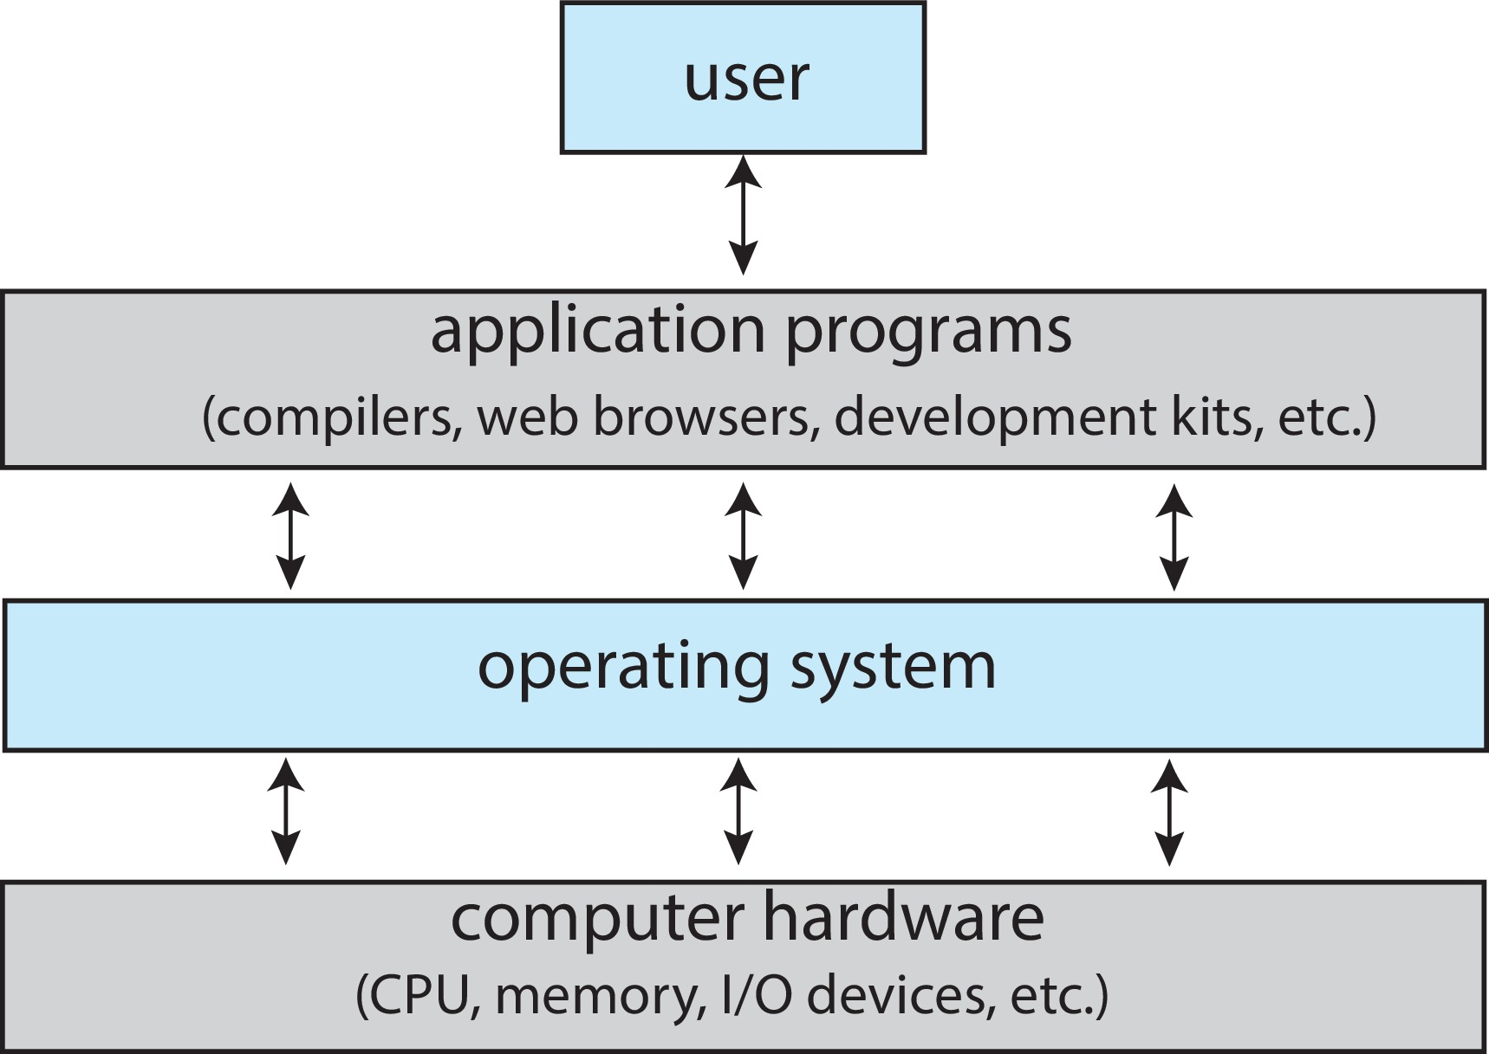
Abstract View of Components of Computer

Slide 8
What Operating Systems Do
Depends on the point of view
Users want convenience, ease of use and good performance
Don’t care about resource utilization
But shared computer such as mainframe or minicomputer must keep all users happy
Operating system is a resource allocator and control program making efficient use of HW and managing execution of user programs
Users of dedicate systems such as workstations have dedicated resources but frequently use shared resources from servers
Mobile devices like smartphones and tables are resource poor, optimized for usability and battery life
Mobile user interfaces such as touch screens, voice recognition
Some computers have little or no user interface, such as embedded computers in devices and automobiles
Run primarily without user intervention

Slide 9
Defining Operating Systems
Term OS covers many roles
Because of myriad designs and uses of OSes
Present in toasters through ships, spacecraft, game machines, TVs and industrial control systems
Born when fixed use computers for military became more general purpose and needed resource management and program control

Slide 10
Operating System Definition
No universally accepted definition
“Everything a vendor ships when you order an operating system” is a good approximation
But varies wildly
“The one program running at all times on the computer” is the kernel, part of the operating system
Everything else is either
A system program (ships with the operating system, but not part of the kernel) , or
An application program, all programs not associated with the operating system
Today’s OSes for general purpose and mobile computing also include middleware – a set of software frameworks that provide addition services to application developers such as databases, multimedia, graphics

Slide 11
Overview of Computer System Structure

Slide 12
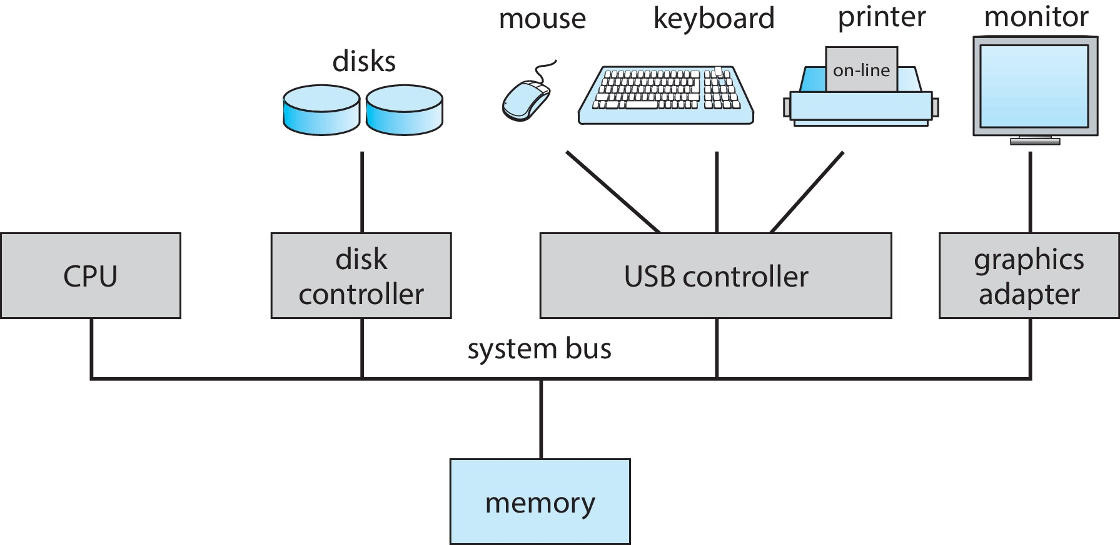
Computer System Organization
Computer-system operation
One or more CPUs, device controllers connect through common bus providing access to shared memory
Concurrent execution of CPUs and devices competing for memory cycles

Slide 13
Computer-System Operation
I/O devices and the CPU can execute concurrently
Each device controller is in charge of a particular device type
Each device controller has a local buffer
Each device controller type has an operating system device driver to manage it
CPU moves data from/to main memory to/from local buffers
I/O is from the device to local buffer of controller
Device controller informs CPU that it has finished its operation by causing an interrupt

Slide 14
Common Functions of Interrupts
Interrupt transfers control to the interrupt service routine generally, through the interrupt vector, which contains the addresses of all the service routines
Interrupt architecture must save the address of the interrupted instruction
A trap or exception is a software-generated interrupt caused either by an error or a user request
An operating system is interrupt driven

Slide 15
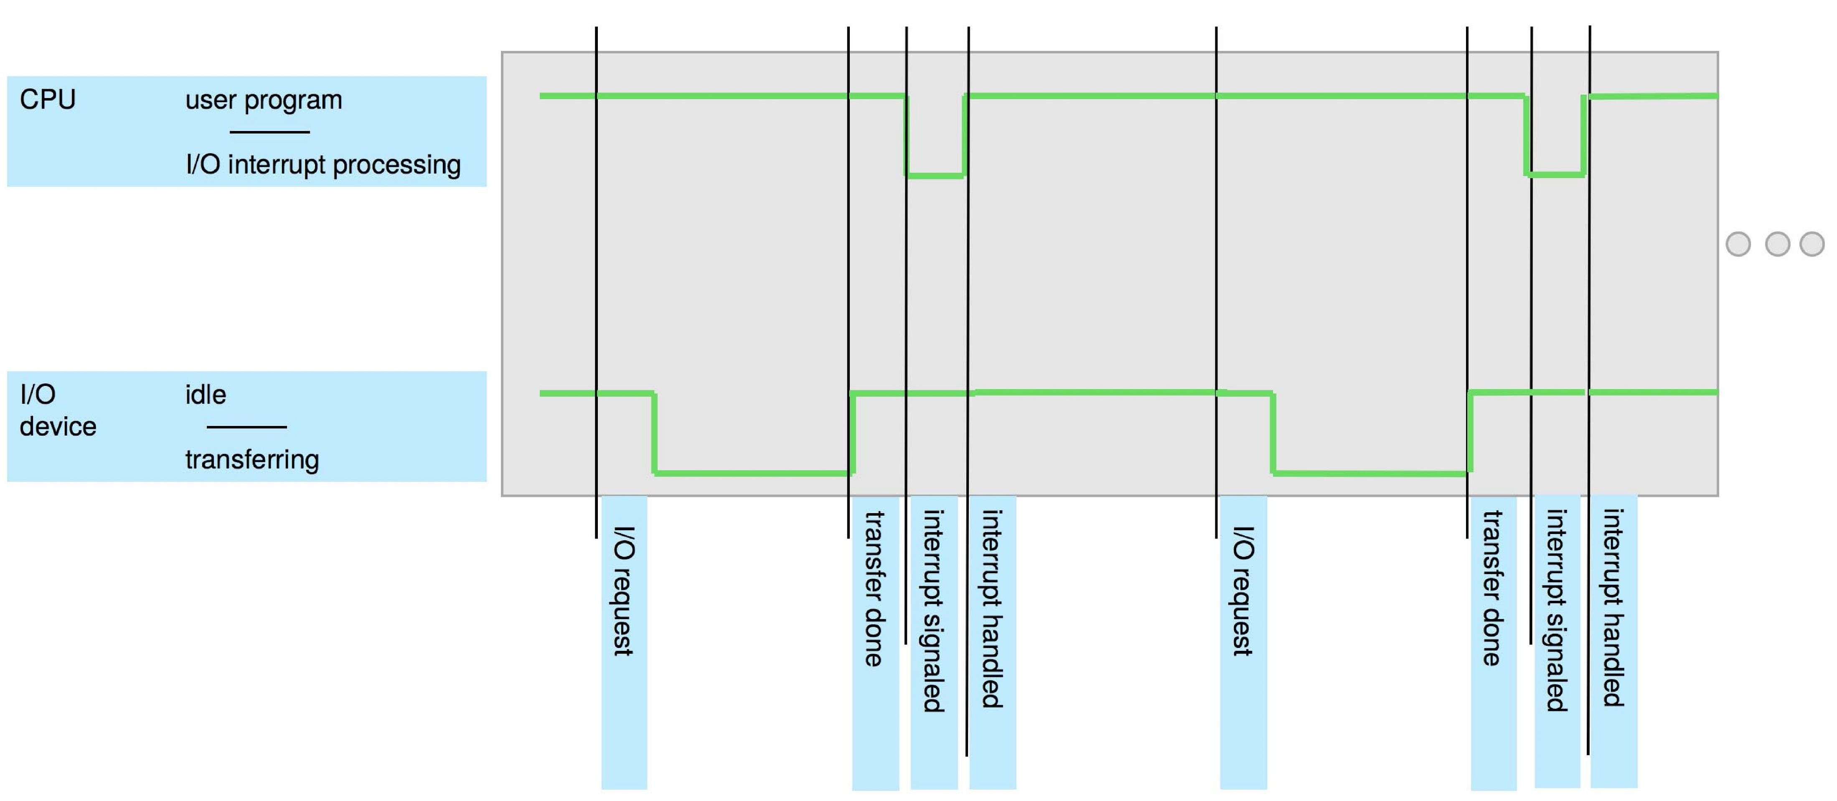
Interrupt Timeline

Slide 16
Interrupt Handling
The operating system preserves the state of the CPU by storing the registers and the program counter
Determines which type of interrupt has occurred:
Separate segments of code determine what action should be taken for each type of interrupt

Slide 17
Interrupt-drive I/O Cycle

Slide 18
I/O Structure
Two methods for handling I/O
After I/O starts, control returns to user program only upon I/O completion
After I/O starts, control returns to user program without waiting for I/O completion

Slide 19
I/O Structure (Cont.)
After I/O starts, control returns to user program only upon I/O completion
Wait instruction idles the CPU until the next interrupt
Wait loop (contention for memory access)
At most one I/O request is outstanding at a time, no simultaneous I/O processing
After I/O starts, control returns to user program without waiting for I/O completion
System call – request to the OS to allow user to wait for I/O completion
Device-status table contains entry for each I/O device indicating its type, address, and state
OS indexes into I/O device table to determine device status and to modify table entry to include interrupt

Slide 20
Computer Startup
Bootstrap program is loaded at power-up or reboot
Typically stored in ROM or EPROM, generally known as firmware
Initializes all aspects of system
Loads operating system kernel and starts execution

Slide 21
Storage Structure

Slide 22
Storage Structure
Main memory – only large storage media that the CPU can access directly
Random access
Typically volatile
Typically random-access memory in the form of Dynamic Random-access Memory (DRAM)
Secondary storage – extension of main memory that provides large nonvolatile storage capacity

Slide 23
Storage Structure (Cont.)
Hard Disk Drives (HDD) – rigid metal or glass platters covered with magnetic recording material
Disk surface is logically divided into tracks, which are subdivided into sectors
The disk controller determines the logical interaction between the device and the computer
Non-volatile memory (NVM) devices– faster than hard disks, nonvolatile
Various technologies
Becoming more popular as capacity and performance increases, price drops

Slide 24
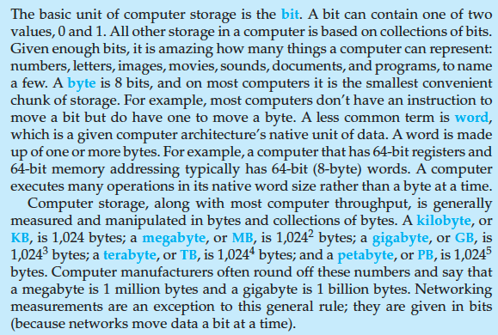
Storage Definitions and Notation Review
The basic unit of computer storage is the bit. A bit can contain one of two
values, 0 and 1. All other storage in a computer is based on collections of bits.
Given enough bits, it is amazing how many things a computer can represent:
numbers, letters, images, movies, sounds, documents, and programs, to name
a few. A byte is 8 bits, and on most computers it is the smallest convenient
chunk of storage. For example, most computers don’t have an instruction to
move a bit but do have one to move a byte. A less common term is word,
which is a given computer architecture’s native unit of data. A word is made
up of one or more bytes. For example, a computer that has 64-bit registers and
64-bit memory addressing typically has 64-bit (8-byte) words. A computer
executes many operations in its native word size rather than a byte at a time.
Computer storage, along with most computer throughput, is generally
measured and manipulated in bytes and collections of bytes. A kilobyte, or
KB , is 1,024 bytes; a megabyte, or MB, is 1,024² bytes; a gigabyte, or GB, is
1,024³ bytes; a terabyte, or TB, is 1,024⁴ bytes; and a petabyte, or PB, is 1,024⁵
bytes. Computer manufacturers often round off these numbers and say that
a megabyte is 1 million bytes and a gigabyte is 1 billion bytes. Networking
measurements are an exception to this general rule; they are given in bits
(because networks move data a bit at a time).

Slide 25
Storage Hierarchy
Storage systems organized in hierarchy
Speed
Cost
Volatility
Caching – copying information into faster storage system; main memory can be viewed as a cache for secondary storage
Device Driver for each device controller to manage I/O
Provides uniform interface between controller and kernel

Slide 26
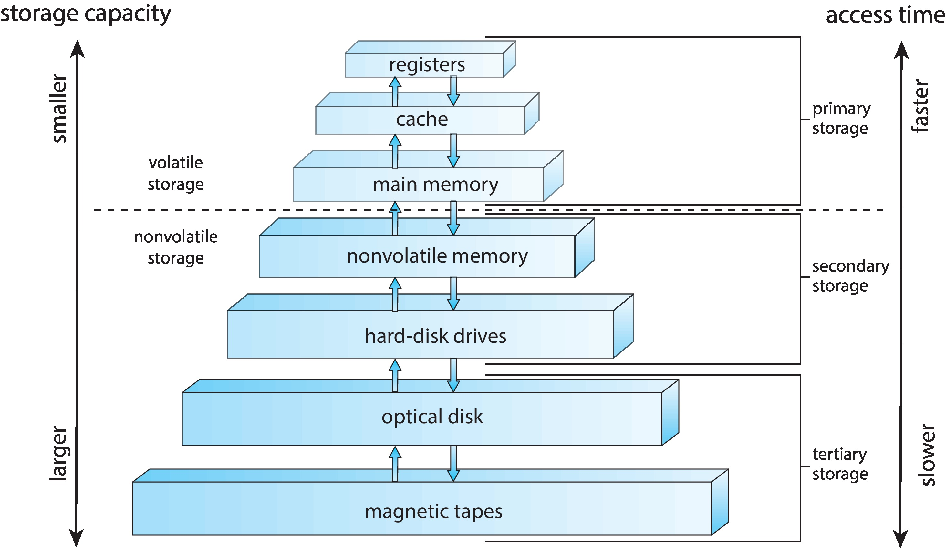
Storage-Device Hierarchy

Slide 27
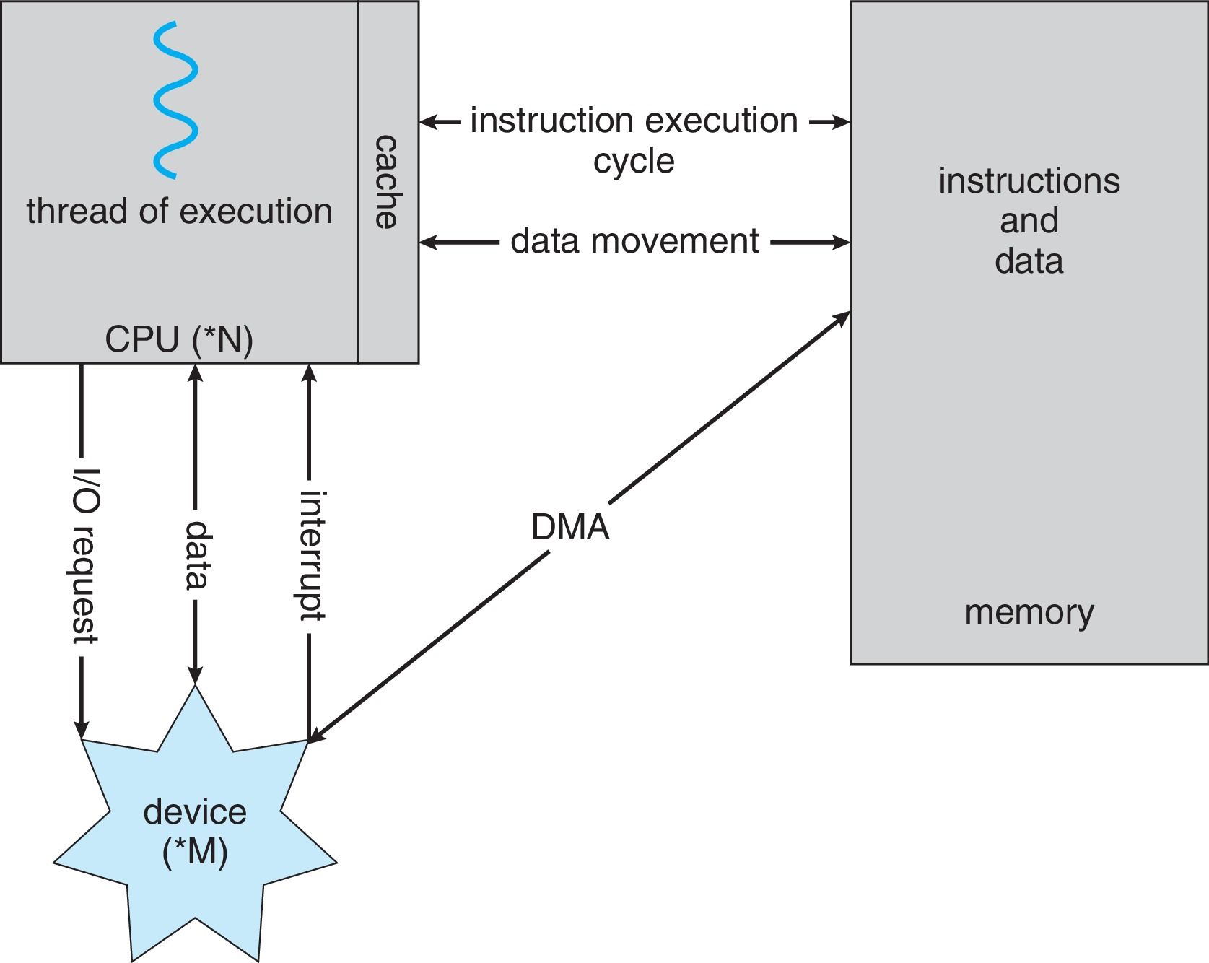
How a Modern Computer Works
A von Neumann architecture

Slide 28
Direct Memory Access Structure
Used for high-speed I/O devices able to transmit information at close to memory speeds
Device controller transfers blocks of data from buffer storage directly to main memory without CPU intervention
Only one interrupt is generated per block, rather than the one interrupt per byte

Slide 29
Operating-System Operations
Bootstrap program – simple code to initialize the system, load the kernel
Kernel loads
Starts system daemons (services provided outside of the kernel)
Kernel interrupt driven (hardware and software)
Hardware interrupt by one of the devices
Software interrupt (exception or trap):
Software error (e.g., division by zero)
Request for operating system service – system call
Other process problems include infinite loop, processes modifying each other or the operating system

Slide 30
Multiprogramming (Batch system)
Single user cannot always keep CPU and I/O devices busy
Multiprogramming organizes jobs (code and data) so CPU always has one to execute
A subset of total jobs in system is kept in memory
One job selected and run via job scheduling
When job has to wait (for I/O for example), OS switches to another job

Slide 31
Multitasking (Timesharing)
A logical extension of Batch systems– the CPU switches jobs so frequently that users can interact with each job while it is running, creating interactive computing
Response time should be < 1 second
Each user has at least one program executing in memory  process
If several jobs ready to run at the same time  CPU scheduling
If processes don’t fit in memory, swapping moves them in and out to run
Virtual memory allows execution of processes not completely in memory

Slide 32
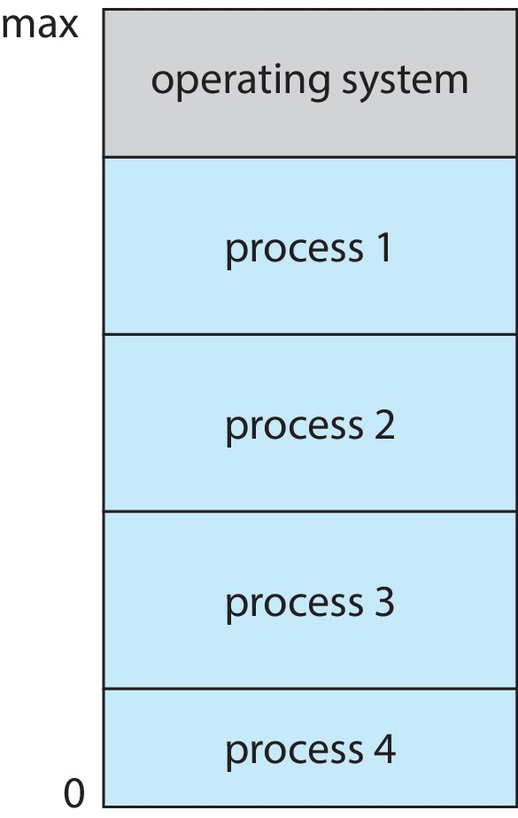
Memory Layout for Multiprogrammed System

Slide 33
Dual-mode Operation
Dual-mode operation allows OS to protect itself and other system components
User mode and kernel mode
Mode bit provided by hardware
Provides ability to distinguish when system is running user code or kernel code.
When a user is running  mode bit is “user”
When kernel code is executing  mode bit is “kernel”
How do we guarantee that user does not explicitly set the mode bit to “kernel”?
System call changes mode to kernel, return from call resets it to user
Some instructions designated as privileged, only executable in kernel mode

Slide 34
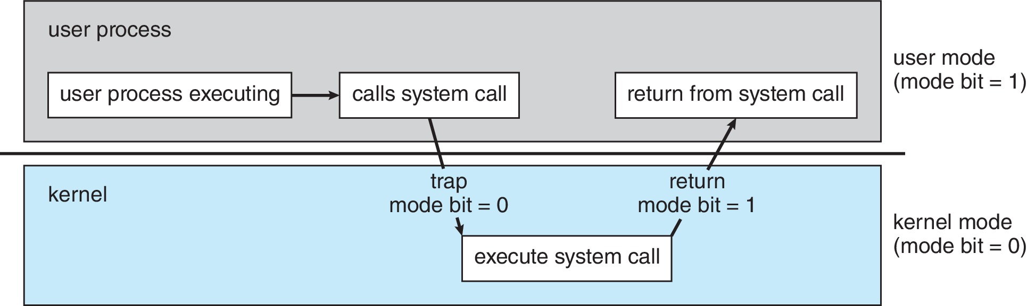
Transition from User to Kernel Mode

Slide 35
Timer
Timer to prevent infinite loop (or process hogging resources)
Timer is set to interrupt the computer after some time period
Keep a counter that is decremented by the physical clock
Operating system set the counter (privileged instruction)
When counter zero generate an interrupt
Set up before scheduling process to regain control or terminate program that exceeds allotted time

Slide 36
Process Management
A process is a program in execution. It is a unit of work within the system. Program is a passive entity; process is an active entity.
Process needs resources to accomplish its task
CPU, memory, I/O, files
Initialization data
Process termination requires reclaim of any reusable resources
Single-threaded process has one program counter specifying location of next instruction to execute
Process executes instructions sequentially, one at a time, until completion
Multi-threaded process has one program counter per thread
Typically system has many processes, some user, some operating system running concurrently on one or more CPUs
Concurrency by multiplexing the CPUs among the processes / threads

Slide 37
Process Management Activities
The operating system is responsible for the following activities in connection with process management:
Creating and deleting both user and system processes
Suspending and resuming processes
Providing mechanisms for process synchronization
Providing mechanisms for process communication
Providing mechanisms for deadlock handling

Slide 38
Memory Management
To execute a program all (or part) of the instructions must be in memory
All (or part) of the data that is needed by the program must be in memory
Memory management determines what is in memory and when
Optimizing CPU utilization and computer response to users
Memory management activities
Keeping track of which parts of memory are currently being used and by whom
Deciding which processes (or parts thereof) and data to move into and out of memory
Allocating and deallocating memory space as needed

Slide 39
File-system Management
OS provides uniform, logical view of information storage
Abstracts physical properties to logical storage unit - file
Each medium is controlled by device (i.e., disk drive, tape drive)
Varying properties include access speed, capacity, data-transfer rate, access method (sequential or random)
File-System management
Files usually organized into directories
Access control on most systems to determine who can access what
OS activities include
Creating and deleting files and directories
Primitives to manipulate files and directories
Mapping files onto secondary storage
Backup files onto stable (non-volatile) storage media

Slide 40
Mass-Storage Management
Usually disks used to store data that does not fit in main memory or data that must be kept for a “long” period of time
Proper management is of central importance
Entire speed of computer operation hinges on disk subsystem and its algorithms
OS activities
Mounting and unmounting
Free-space management
Storage allocation
Disk scheduling
Partitioning
Protection

Slide 41
Caching
Important principle, performed at many levels in a computer (in hardware, operating system, software)
Information in use copied from slower to faster storage temporarily
Faster storage (cache) checked first to determine if information is there
If it is, information used directly from the cache (fast)
If not, data copied to cache and used there
Cache smaller than storage being cached
Cache management important design problem
Cache size and replacement policy

Slide 42
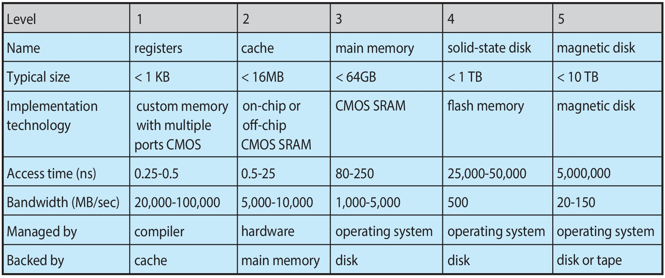
Characteristics of Various Types of Storage
Movement between levels of storage hierarchy can be explicit or implicit

Slide 43
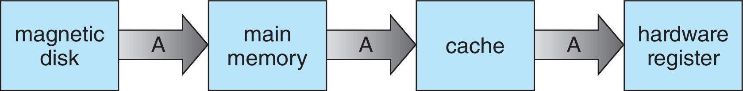
Migration of data “A” from Disk to Register
Multitasking environments must be careful to use most recent value, no matter where it is stored in the storage hierarchy
Multiprocessor environment must provide cache coherency in hardware such that all CPUs have the most recent value in their cache
Distributed environment situation even more complex
Several copies of a datum can exist
Various solutions covered in Chapter 19

Slide 44
I/O Subsystem
One purpose of OS is to hide peculiarities of hardware devices from the user
I/O subsystem responsible for
Memory management of I/O including buffering (storing data temporarily while it is being transferred), caching (storing parts of data in faster storage for performance), spooling (the overlapping of output of one job with input of other jobs)
General device-driver interface
Drivers for specific hardware devices

Slide 45
Protection and Security
Protection – any mechanism for controlling access of processes or users to resources defined by the OS
Security – defense of the system against internal and external attacks
Huge range, including denial-of-service, worms, viruses, identity theft, theft of service
Systems generally first distinguish among users, to determine who can do what
User identities (user IDs, security IDs) include name and associated number, one per user
User ID then associated with all files, processes of that user to determine access control
Group identifier (group ID) allows set of users to be defined and controls managed, then also associated with each process, file
Privilege escalation allows user to change to effective ID with more rights

Slide 46
Virtualization
Allows operating systems to run applications within other OSes
Vast and growing industry
Emulation used when source CPU type different from target type (i.e. PowerPC to Intel x86)
Generally slowest method
When computer language not compiled to native code – Interpretation
Virtualization – OS natively compiled for CPU, running guest OSes also natively compiled
Consider VMware running WinXP guests, each running applications, all on native WinXP host OS
VMM (virtual machine Manager) provides virtualization services

Slide 47
Virtualization (cont.)
Use cases involve laptops and desktops running multiple OSes for exploration or compatibility
Apple laptop running Mac OS X host, Windows as a guest
Developing apps for multiple OSes without having multiple systems
Quality assurance testing applications without having multiple systems
Executing and managing compute environments within data centers
VMM can run natively, in which case they are also the host
There is no general-purpose host then (VMware ESX and Citrix XenServer)

Slide 48
Computing Environments - Virtualization

Slide 49
Distributed Systems
Collection of separate, possibly heterogeneous, systems networked together
Network is a communications path, TCP/IP most common
Local Area Network (LAN)
Wide Area Network (WAN)
Metropolitan Area Network (MAN)
Personal Area Network (PAN)
Network Operating System provides features between systems across network
Communication scheme allows systems to exchange messages
Illusion of a single system

Slide 50
Computer System Architecture

Slide 51
Computer-System Architecture
Most systems use a single general-purpose processor
Most systems have special-purpose processors as well
Multiprocessors systems growing in use and importance
Also known as parallel systems, tightly-coupled systems
Advantages include:
Increased throughput
Economy of scale
Increased reliability – graceful degradation or fault tolerance
Two types:
Asymmetric Multiprocessing – each processor is assigned a specie task.
Symmetric Multiprocessing – each processor performs all tasks

Slide 52
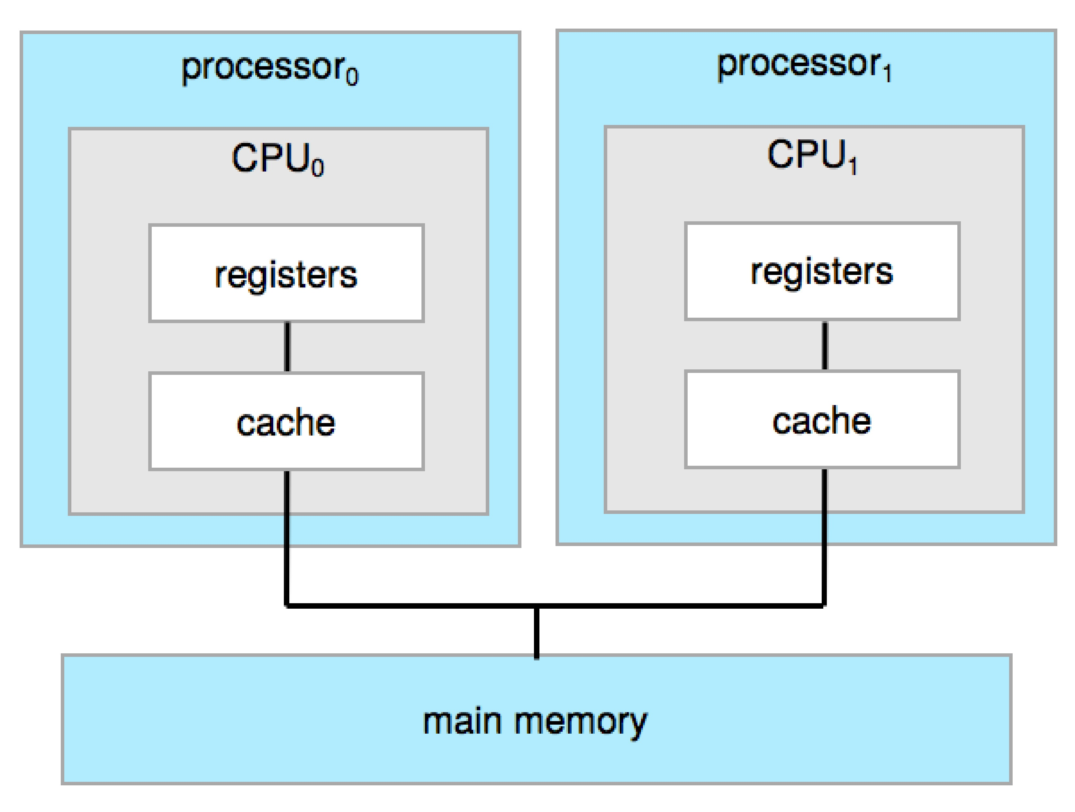
Symmetric Multiprocessing Architecture

Slide 53
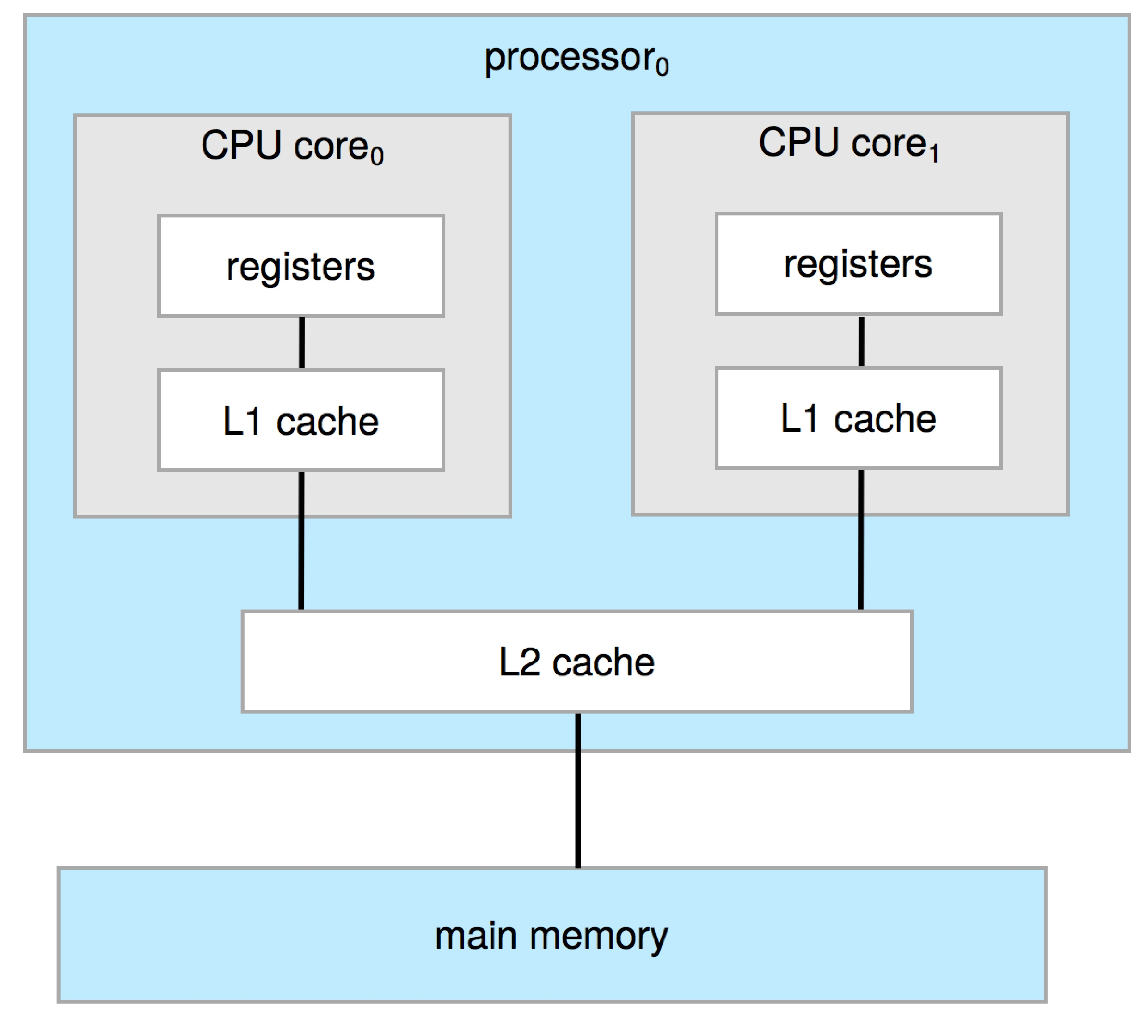
Dual-Core Design
Multi-chip and multicore
Systems containing all chips
Chassis containing multiple separate systems

Slide 54
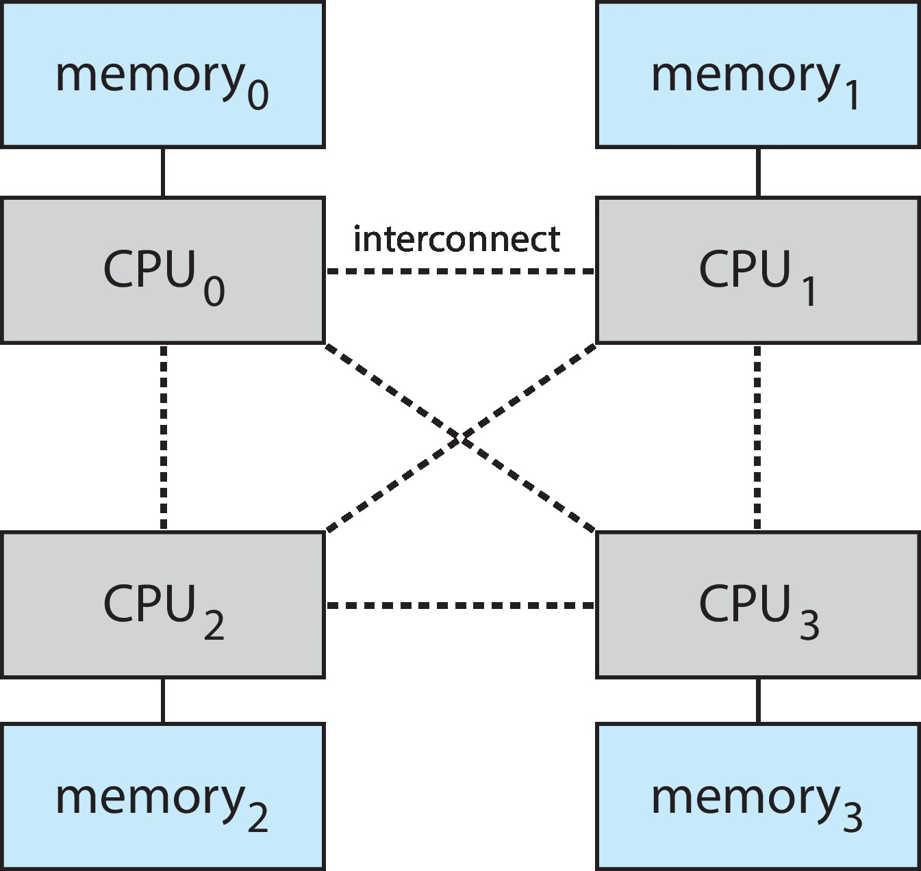
Non-Uniform Memory Access System

Slide 55
Clustered Systems
Like multiprocessor systems, but multiple systems working together
Usually sharing storage via a storage-area network (SAN)
Provides a high-availability service which survives failures
Asymmetric clustering has one machine in hot-standby mode
Symmetric clustering has multiple nodes running applications, monitoring each other
Some clusters are for high-performance computing (HPC)
Applications must be written to use parallelization
Some have distributed lock manager (DLM) to avoid conflicting operations

Slide 56
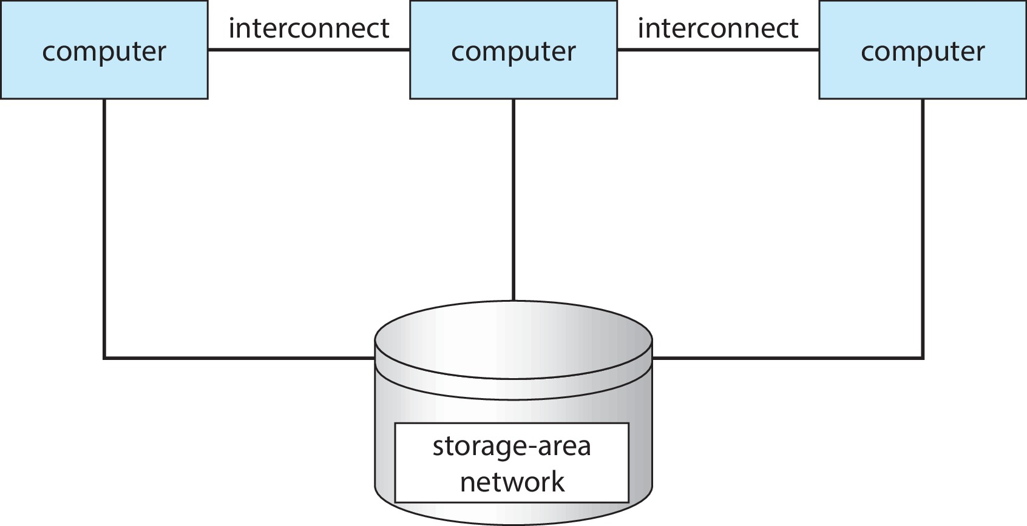
Clustered Systems

Slide 57
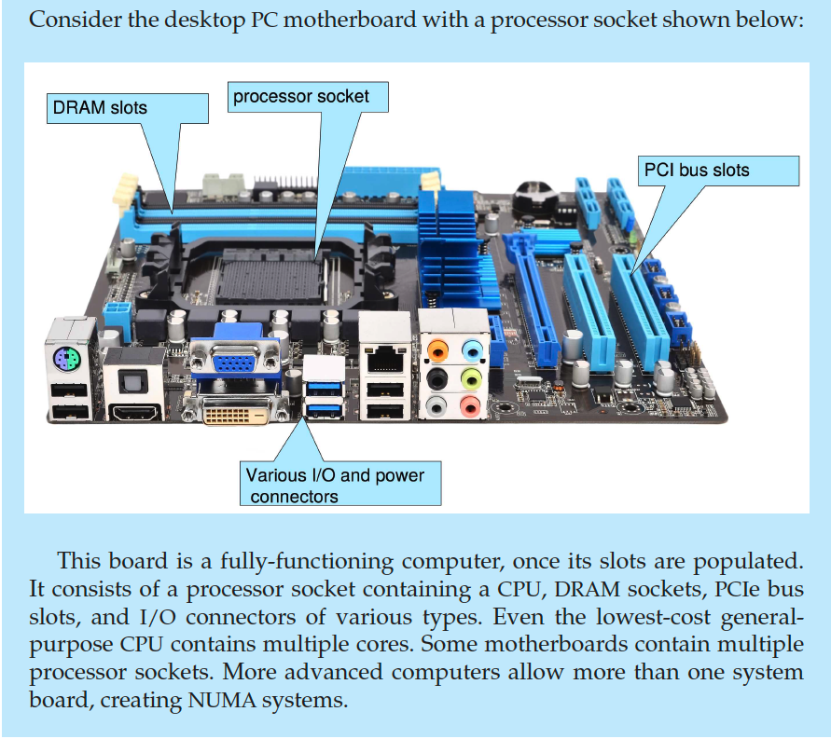
PC Motherboard

Slide 58
Computer System Environments

Slide 59
Computing Environments
Traditional
Mobile
Client Server
Pear-to-Pear
Cloud computing
Real-time Embedded

Slide 60
Traditional
Stand-alone general-purpose machines
But blurred as most systems interconnect with others (i.e., the Internet)
Portals provide web access to internal systems
Network computers (thin clients) are like Web terminals
Mobile computers interconnect via wireless networks
Networking becoming ubiquitous – even home systems use firewalls to protect home computers from Internet attacks

Slide 61
Mobile
Handheld smartphones, tablets, etc.
What is the functional difference between them and a “traditional” laptop?
Extra feature – more OS features (GPS, gyroscope)
Allows new types of apps like augmented reality
Use IEEE 802.11 wireless, or cellular data networks for connectivity
Leaders are Apple iOS and Google Android

Slide 62
Client Server
Client-Server Computing
Dumb terminals supplanted by smart PCs
Many systems now servers, responding to requests generated by clients
Compute-server system provides an interface to client to request services (i.e., database)
File-server system provides interface for clients to store and retrieve files

Slide 63
Peer-to-Peer
Another model of distributed system
P2P does not distinguish clients and servers
Instead all nodes are considered peers
May each act as client, server or both
Node must join P2P network
Registers its service with central lookup service on network, or
Broadcast request for service and respond to requests for service via discovery protocol
Examples include Napster and Gnutella, Voice over IP (VoIP) such as Skype

Slide 64
Cloud Computing
Delivers computing, storage, even apps as a service across a network
Logical extension of virtualization because it uses virtualization as the base for it functionality.
Amazon EC2 has thousands of servers, millions of virtual machines, petabytes of storage available across the Internet, pay based on usage

Slide 65
Cloud Computing (Cont.)
Many types
Public cloud – available via Internet to anyone willing to pay
Private cloud – run by a company for the company’s own use
Hybrid cloud – includes both public and private cloud components
Software as a Service (SaaS) – one or more applications available via the Internet (i.e., word processor)
Platform as a Service (PaaS) – software stack ready for application use via the Internet (i.e., a database server)
Infrastructure as a Service (IaaS) – servers or storage available over Internet (i.e., storage available for backup use)

Slide 66
Cloud Computing (cont.)
Cloud computing environments composed of traditional OSes, plus VMMs, plus cloud management tools
Internet connectivity requires security like firewalls
Load balancers spread traffic across multiple applications

Slide 67
Real-Time Embedded Systems
Real-time embedded systems most prevalent form of computers
Vary considerable, special purpose, limited purpose OS, real-time OS
Use expanding
Many other special computing environments as well
Some have OSes, some perform tasks without an OS
Real-time OS has well-defined fixed time constraints
Processing must be done within constraint
Correct operation only if constraints met

Slide 68
Free and Open-Source Operating Systems
Operating systems made available in source-code format rather than just binary closed-source and proprietary
Counter to the copy protection and Digital Rights Management (DRM) movement
Started by Free Software Foundation (FSF), which has “copyleft” GNU Public License (GPL)
Free software and open-source software are two different ideas championed by different groups of people
http://gnu.org/philosophy/open-source-misses-the-point.html/
Examples include GNU/Linux and BSD UNIX (including core of Mac OS X), and many more
Can use VMM like VMware Player (Free on Windows), Virtualbox (open source and free on many platforms - http://www.virtualbox.com)
Use to run guest operating systems for exploration

Slide 69
The Study of Operating Systems
There has never been a more interesting time to study operating systems, and it has never been
easier. The open-source movement has overtaken operating systems, causing many of them to be
made available in both source and binary (executable) format. The list of operating
systems available in both formats includes Linux, BUSD UNIX, Solaris, and part of macOS.
The availability of source code allows us to study operating systems from the inside out.
Questions that we could once answer only by looking at documentation or the behavior of an
operating system we can now answer by examining the code itself.
Operating systems that are no longer commercially viable have been open-sourced as well, enabling
us to study how systems operated in a time of fewer CPU, memory, and storage resources.
An extensive but incomplete list of open-source operating-system projects is available
from https://curlie.org/Computers/Software/Operating_Systems/Open_Source/
In addition, the rise of virtualization as a mainstream (and frequently free) computer function
makes it possible to run many operating systems on top of one core system. For example, VMware
(http://www.vmware.com) providesa free “player” for Windows on which hundreds of free
“virtual appliances” can run. Virtualbox (http://www.virtualbox.com) provides a free, open-source
virtual machine manager on many operating systems. Using such tools, students can try out
hundreds of operating systems without dedicated hardware.
The advent of open-source operating systems has also made it easier to make the move from
student to operating-system developer. With some knowledge, some effort, and an Internet
connection, a student can even create a new operating-system distribution. Just a few years ago,
it was difficult or impossible to get access to source code. Now, such access is limited only by
how much interest, time, and disk space a student has.

Slide 70
End of Chapter 1

Slide 71
Kernel Data Structures
Many similar to standard programming data structures
Singly linked list
Doubly linked list
Circular linked list

Slide 72
Kernel Data Structures
Binary search tree left <= right
Search performance is O(n)
Balanced binary search tree is O(lg n)

Slide 73
Kernel Data Structures
Hash function can create a hash map
Bitmap – string of n binary digits representing the status of n items
Linux data structures defined in include files <linux/list.h>, <linux/kfifo.h>, <linux/rbtree.h>

Slide 74
Computer Startup
Bootstrap program is loaded at power-up or reboot
Typically stored in ROM or EPROM, generally known as firmware
Initializes all aspects of system
Loads operating system kernel and starts execution

Slide 75
Characteristics of Various Types of Storage
Movement between levels of storage hierarchy can be explicit or implicit

Slide 76
Chapter 2: Operating-System Services

Slide 77
Outline
Operating System Services
User and Operating System-Interface
System Calls
System Services
Linkers and Loaders
Why Applications are Operating System Specific
Design and Implementation
Operating System Structure
Building and Booting an Operating System
Operating System Debugging

Slide 78
Objectives
Identify services provided by an operating system
Illustrate how system calls are used to provide operating system services
Compare and contrast monolithic, layered, microkernel, modular, and hybrid strategies for designing operating systems
Illustrate the process for booting an operating system
Apply tools for monitoring operating system performance
Design and implement kernel modules for interacting with a Linux kernel

Slide 79
Operating System Services
Operating systems provide an environment for execution of programs and services to programs and users
One set of operating-system services provides functions that are helpful to the user:
User interface - Almost all operating systems have a user interface (UI).
Varies between Command-Line (CLI), Graphics User Interface (GUI), touch-screen, Batch
Program execution - The system must be able to load a program into memory and to run that program, end execution, either normally or abnormally (indicating error)
I/O operations - A running program may require I/O, which may involve a file or an I/O device
File-system manipulation - The file system is of particular interest. Programs need to read and write files and directories, create and delete them, search them, list file Information, permission management.

Slide 80
Operating System Services (Cont.)
One set of operating-system services provides functions that are helpful to the user (Cont.):
Communications – Processes may exchange information, on the same computer or between computers over a network
Communications may be via shared memory or through message passing (packets moved by the OS)
Error detection – OS needs to be constantly aware of possible errors
May occur in the CPU and memory hardware, in I/O devices, in user program
For each type of error, OS should take the appropriate action to ensure correct and consistent computing
Debugging facilities can greatly enhance the user’s and programmer’s abilities to efficiently use the system

Slide 81
Operating System Services (Cont.)
Another set of OS functions exists for ensuring the efficient operation of the system itself via resource sharing
Resource allocation - When multiple users or multiple jobs running concurrently, resources must be allocated to each of them
Many types of resources - CPU cycles, main memory, file storage, I/O devices.
Logging - To keep track of which users use how much and what kinds of computer resources
Protection and security - The owners of information stored in a multiuser or networked computer system may want to control use of that information, concurrent processes should not interfere with each other
Protection involves ensuring that all access to system resources is controlled
Security of the system from outsiders requires user authentication, extends to defending external I/O devices from invalid access attempts

Slide 82
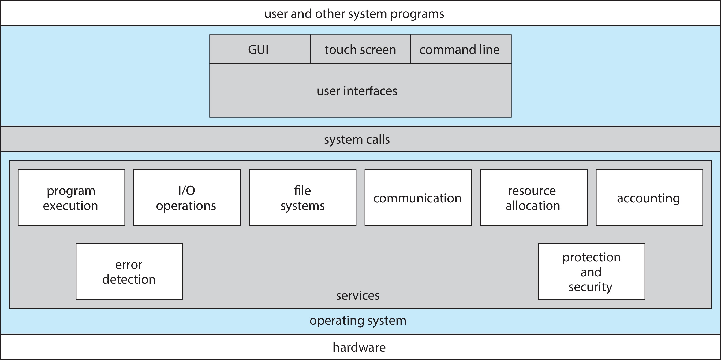
A View of Operating System Services

Slide 83
Command Line interpreter
CLI allows direct command entry
Sometimes implemented in kernel, sometimes by systems program
Sometimes multiple flavors implemented – shells
Primarily fetches a command from user and executes it
Sometimes commands built-in, sometimes just names of programs
If the latter, adding new features doesn’t require shell modification

Slide 84
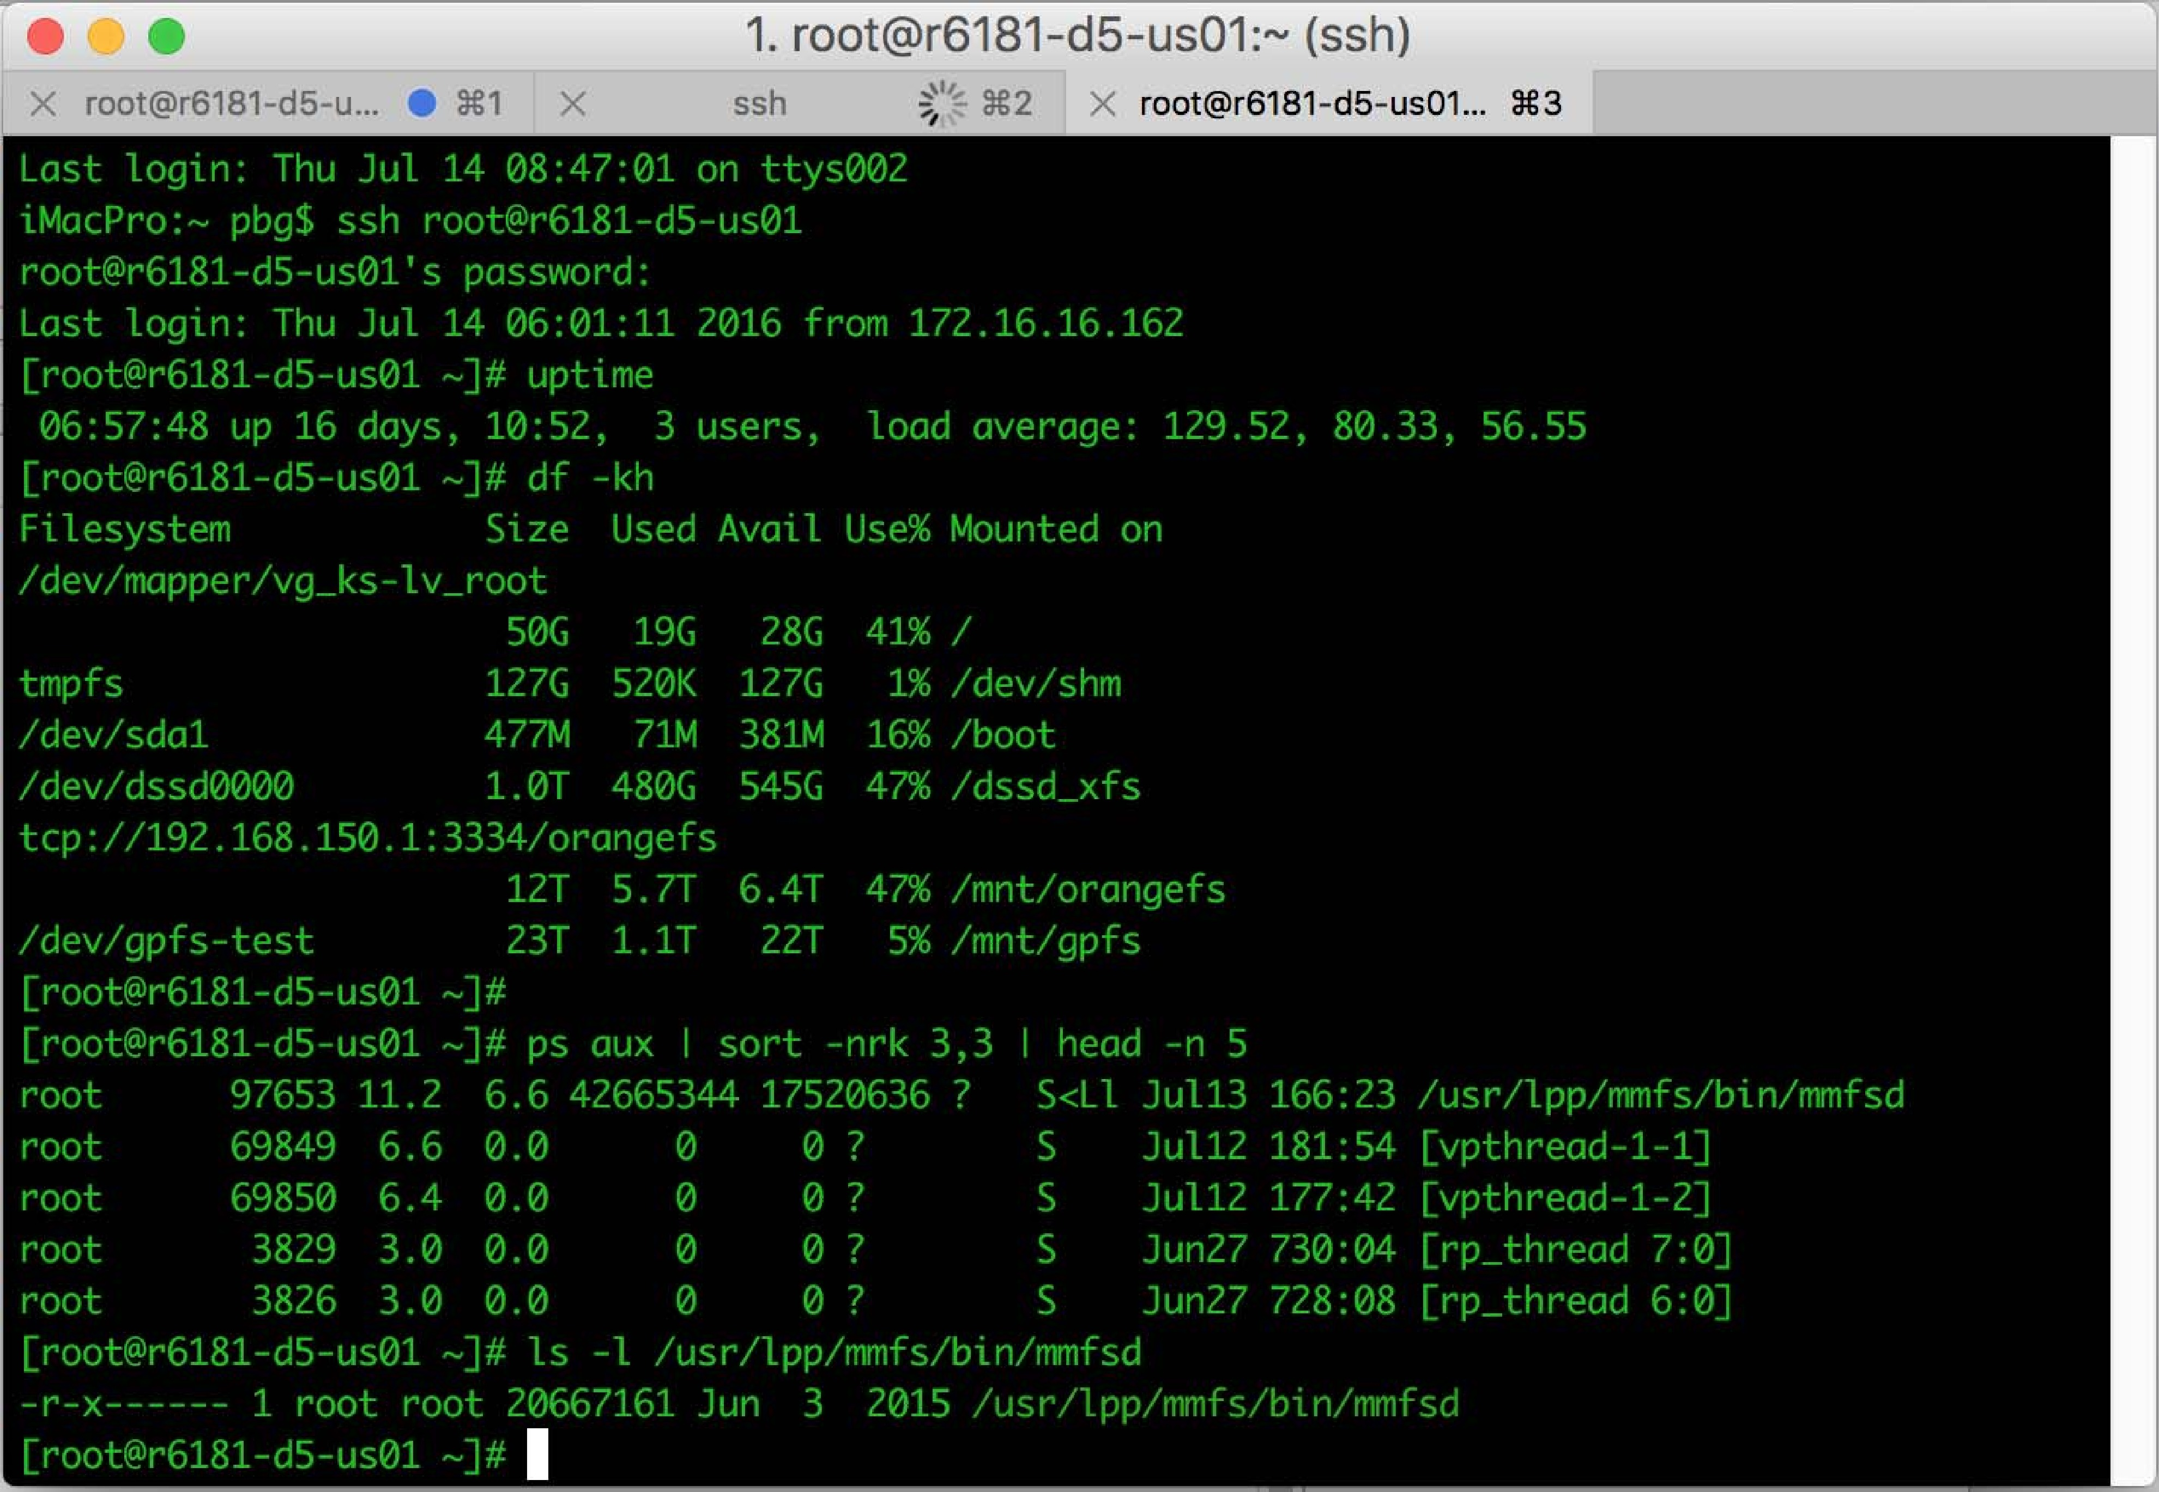
Bourne Shell Command Interpreter

Slide 85
User Operating System Interface - GUI
User-friendly desktop metaphor interface
Usually mouse, keyboard, and monitor
Icons represent files, programs, actions, etc
Various mouse buttons over objects in the interface cause various actions (provide information, options, execute function, open directory (known as a folder)
Invented at Xerox PARC
Many systems now include both CLI and GUI interfaces
Microsoft Windows is GUI with CLI “command” shell
Apple Mac OS X is “Aqua” GUI interface with UNIX kernel underneath and shells available
Unix and Linux have CLI with optional GUI interfaces (CDE, KDE, GNOME)

Slide 86

Touchscreen Interfaces
Touchscreen devices require new interfaces
Mouse not possible or not desired
Actions and selection based on gestures
Virtual keyboard for text entry
Voice commands

Slide 87
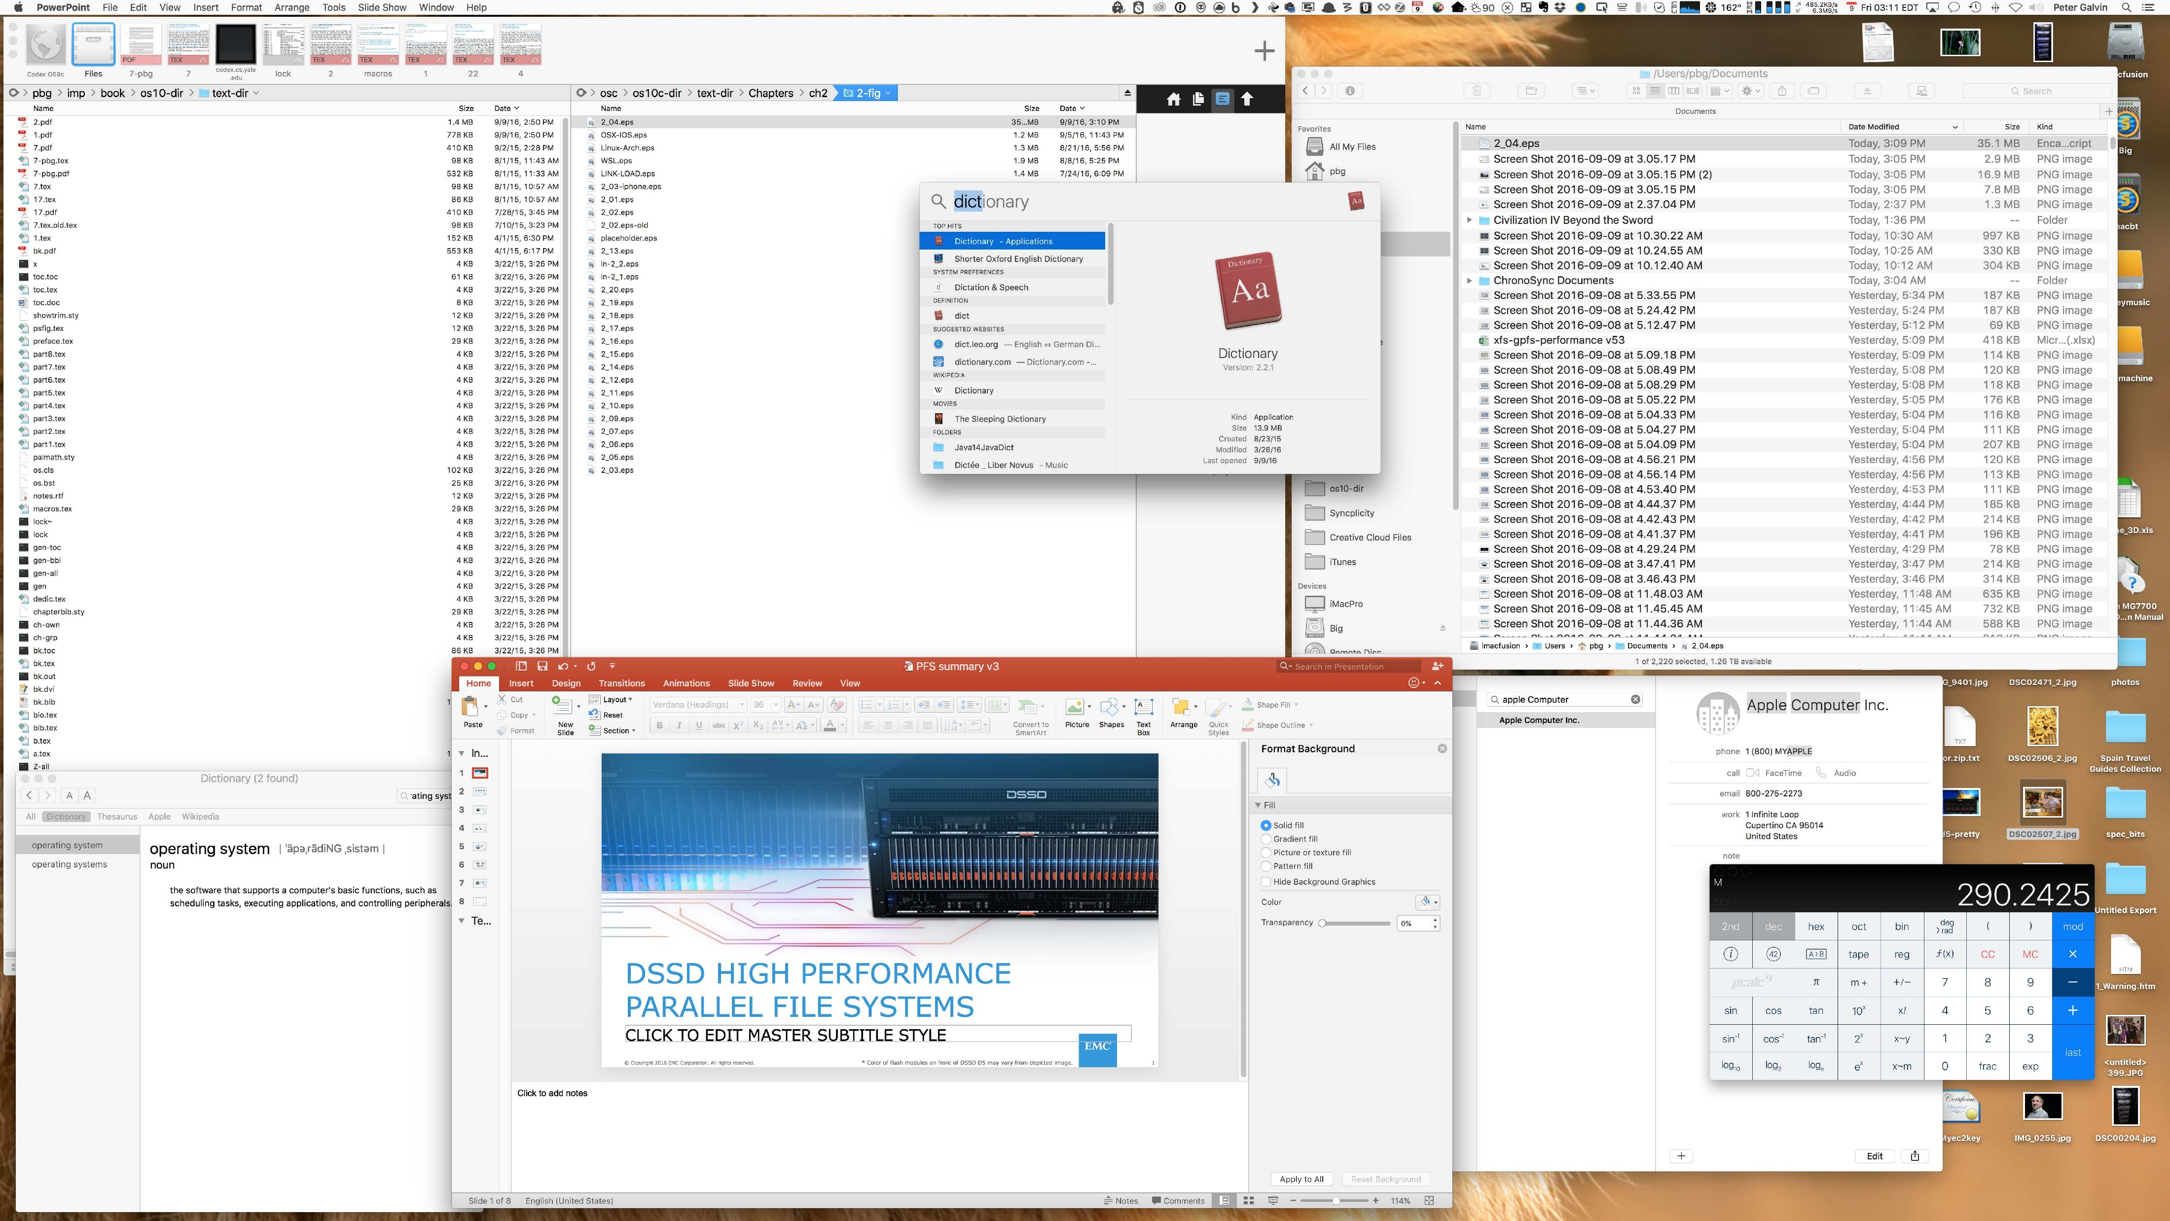
The Mac OS X GUI

Slide 88
System Calls
Programming interface to the services provided by the OS
Typically written in a high-level language (C or C++)
Mostly accessed by programs via a high-level Application Programming Interface (API) rather than direct system call use
Three most common APIs are Win32 API for Windows, POSIX API for POSIX-based systems (including virtually all versions of UNIX, Linux, and Mac OS X), and Java API for the Java virtual machine (JVM)
Note that the system-call names used throughout this text are generic

Slide 89
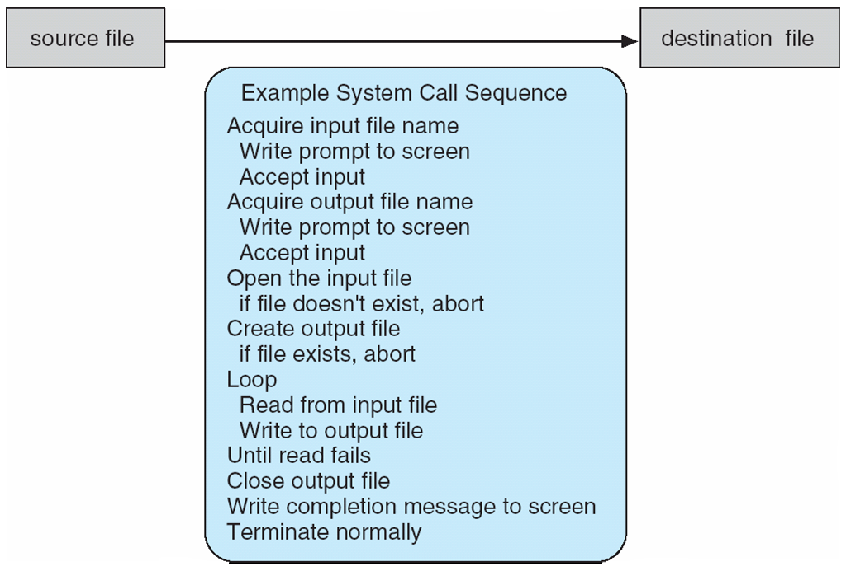
Example of System Calls
System call sequence to copy the contents of one file to another file

Slide 90
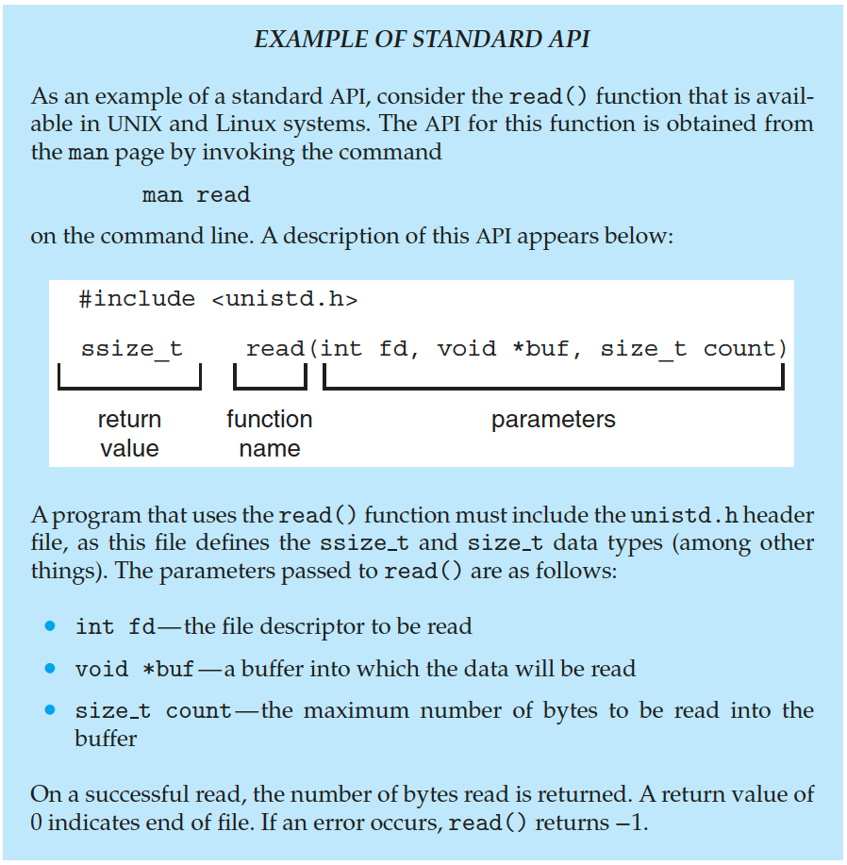
Example of Standard API

Slide 91
System Call Implementation
Typically, a number is associated with each system call
System-call interface maintains a table indexed according to these numbers
The system call interface invokes the intended system call in OS kernel and returns status of the system call and any return values
The caller need know nothing about how the system call is implemented
Just needs to obey API and understand what OS will do as a result call
Most details of OS interface hidden from programmer by API
Managed by run-time support library (set of functions built into libraries included with compiler)

Slide 92
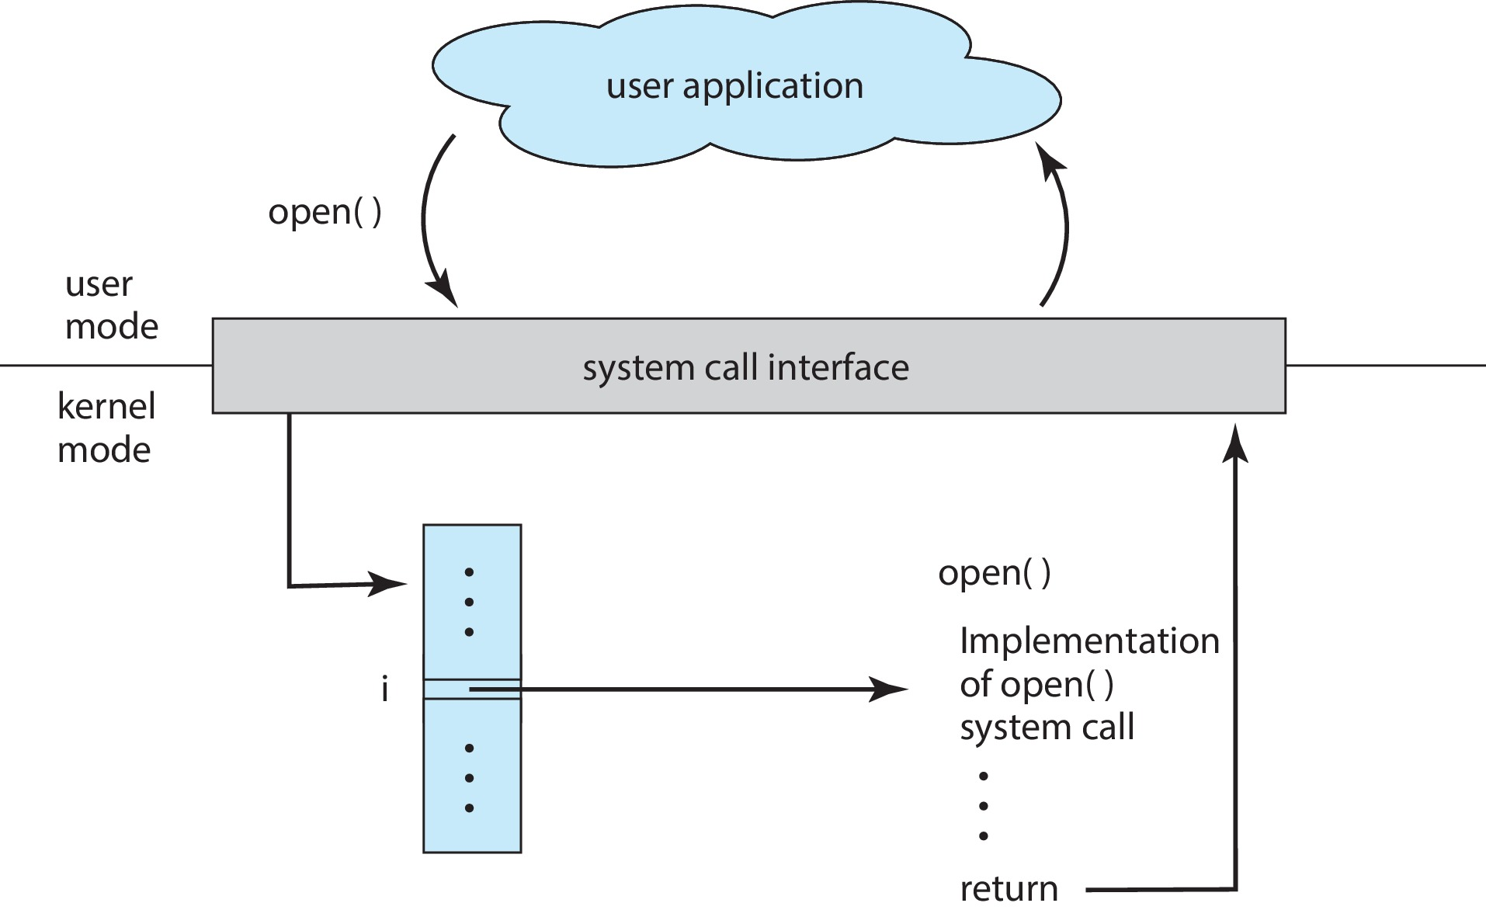
API – System Call – OS Relationship

Slide 93
System Call Parameter Passing
Often, more information is required than simply identity of desired system call
Exact type and amount of information vary according to OS and call
Three general methods used to pass parameters to the OS
Simplest: pass the parameters in registers
In some cases, may be more parameters than registers
Parameters stored in a block, or table, in memory, and address of block passed as a parameter in a register
This approach taken by Linux and Solaris
Parameters placed, or pushed, onto the stack by the program and popped off the stack by the operating system
Block and stack methods do not limit the number or length of parameters being passed

Slide 94
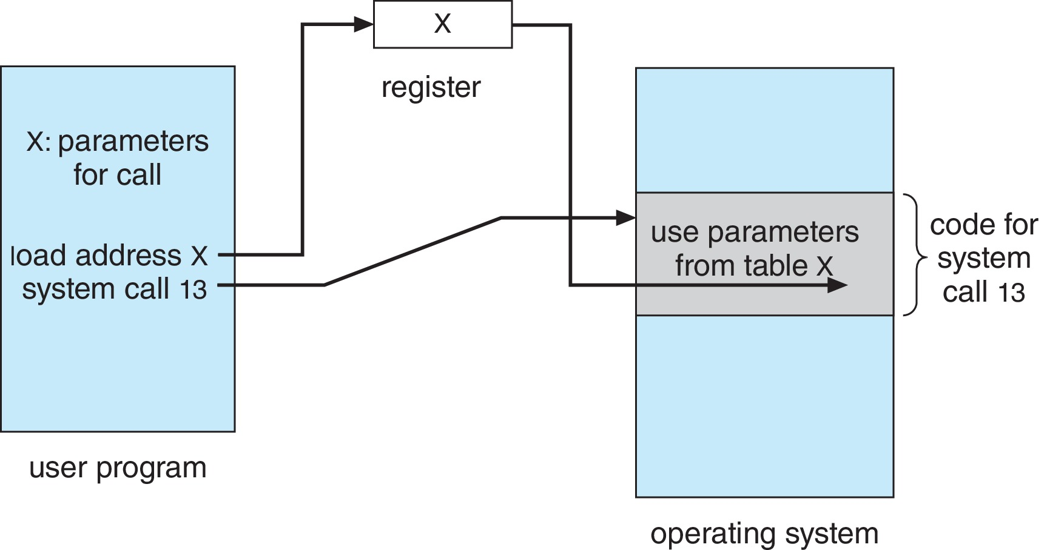
Parameter Passing via Table

Slide 95
Types of System Calls
Process control
create process, terminate process
end, abort
load, execute
get process attributes, set process attributes
wait for time
wait event, signal event
allocate and free memory
Dump memory if error
Debugger for determining bugs, single step execution
Locks for managing access to shared data between processes

Slide 96
Types of System Calls (Cont.)
File management
create file, delete file
open, close file
read, write, reposition
get and set file attributes
Device management
request device, release device
read, write, reposition
get device attributes, set device attributes
logically attach or detach devices

Slide 97
Types of System Calls (Cont.)
Information maintenance
get time or date, set time or date
get system data, set system data
get and set process, file, or device attributes
Communications
create, delete communication connection
send, receive messages if message passing model to host name or process name
From client to server
Shared-memory model create and gain access to memory regions
transfer status information
attach and detach remote devices

Slide 98
Types of System Calls (Cont.)
Protection
Control access to resources
Get and set permissions
Allow and deny user access

Slide 99
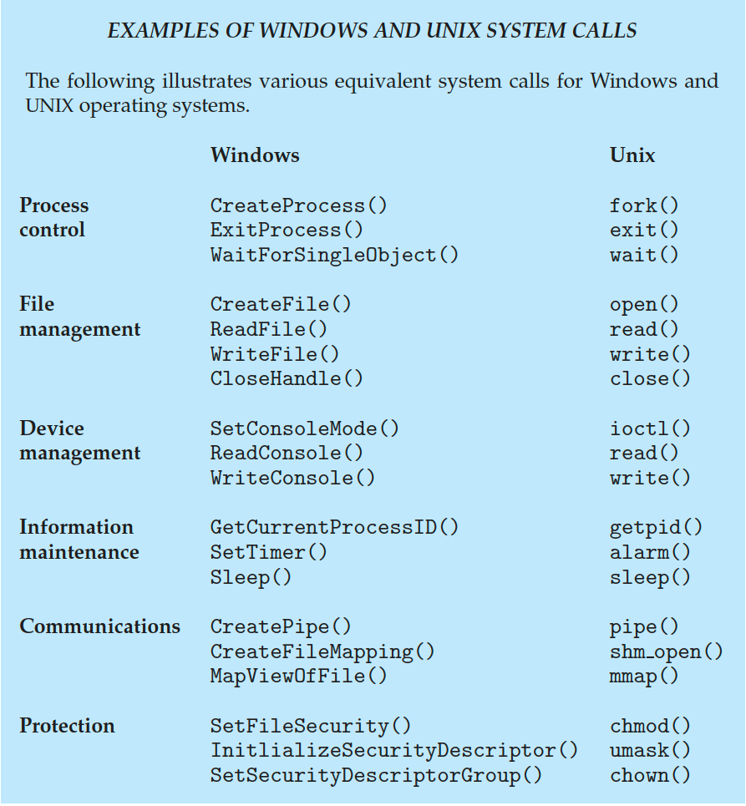
Examples of Windows and Unix System Calls

Slide 100
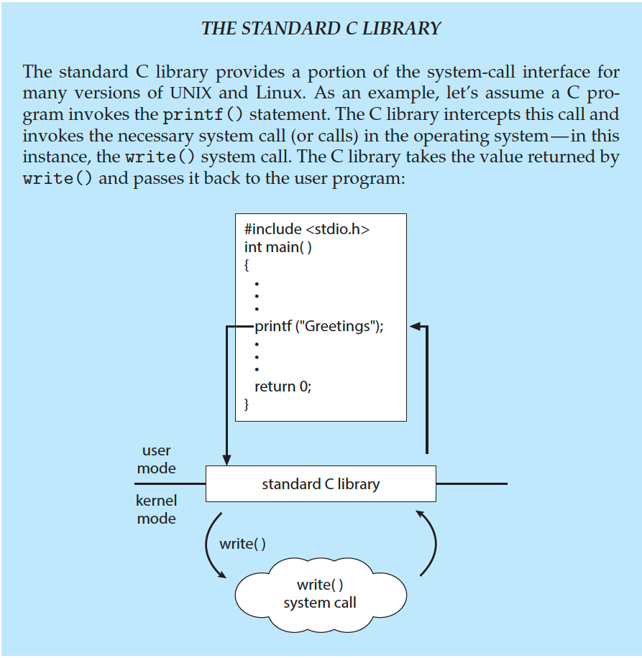
Standard C Library Example
C program invoking printf() library call, which calls write() system call

Slide 101
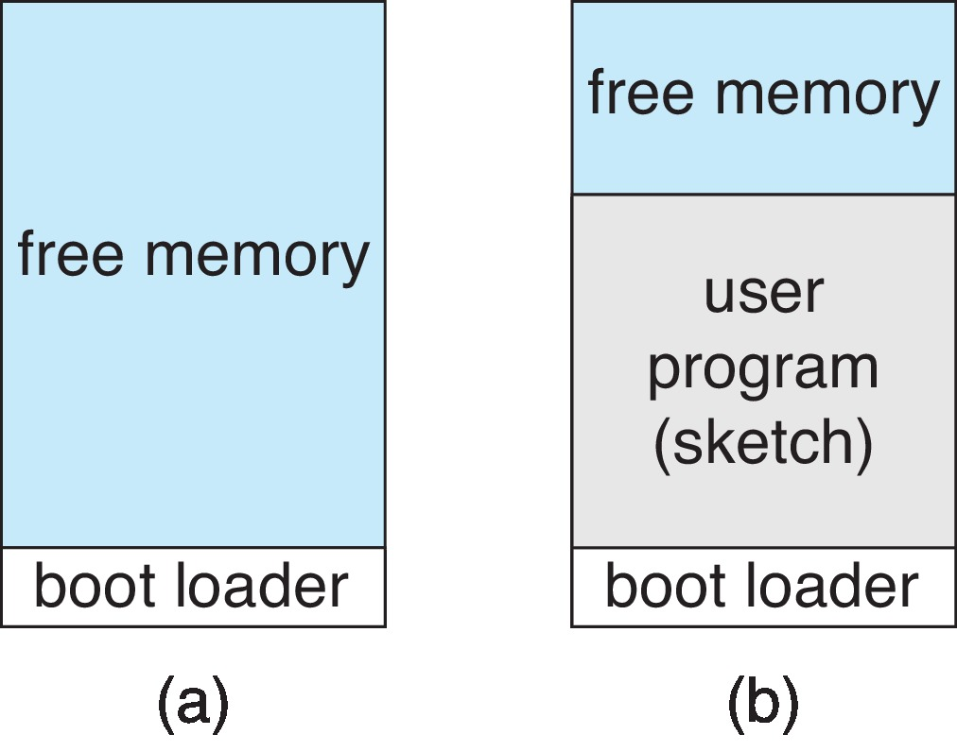
Example: Arduino
Single-tasking
No operating system
Programs (sketch) loaded via USB into flash memory
Single memory space
Boot loader loads program
Program exit -> shell reloaded
At system startup running a program

Slide 102
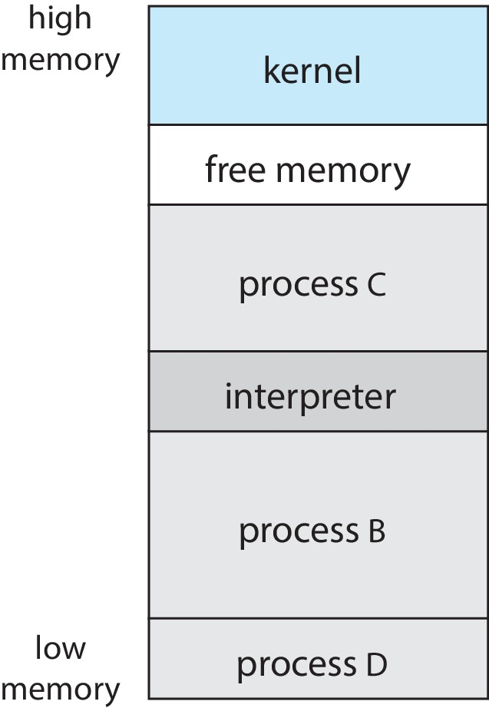
Example: FreeBSD
Unix variant
Multitasking
User login -> invoke user’s choice of shell
Shell executes fork() system call to create process
Executes exec() to load program into process
Shell waits for process to terminate or continues with user commands
Process exits with:
code = 0 – no error
code > 0 – error code

Slide 103
System Services
System programs provide a convenient environment for program development and execution. They can be divided into:
File manipulation
Status information sometimes stored in a file
Programming language support
Program loading and execution
Communications
Background services
Application programs
Most users’ view of the operation system is defined by system programs, not the actual system calls

Slide 104
System Services (Cont.)
Provide a convenient environment for program development and execution
Some of them are simply user interfaces to system calls; others are considerably more complex
File management - Create, delete, copy, rename, print, dump, list, and generally manipulate files and directories
Status information
Some ask the system for info - date, time, amount of available memory, disk space, number of users
Others provide detailed performance, logging, and debugging information
Typically, these programs format and print the output to the terminal or other output devices
Some systems implement a registry - used to store and retrieve configuration information

Slide 105
System Services (Cont.)
File modification
Text editors to create and modify files
Special commands to search contents of files or perform transformations of the text
Programming-language support - Compilers, assemblers, debuggers and interpreters sometimes provided
Program loading and execution- Absolute loaders, relocatable loaders, linkage editors, and overlay-loaders, debugging systems for higher-level and machine language
Communications - Provide the mechanism for creating virtual connections among processes, users, and computer systems
Allow users to send messages to one another’s screens, browse web pages, send electronic-mail messages, log in remotely, transfer files from one machine to another

Slide 106
System Services (Cont.)
Background Services
Launch at boot time
Some for system startup, then terminate
Some from system boot to shutdown
Provide facilities like disk checking, process scheduling, error logging, printing
Run in user context not kernel context
Known as services, subsystems, daemons
Application programs
Don’t pertain to system
Run by users
Not typically considered part of OS
Launched by command line, mouse click, finger poke

Slide 107
Linkers and Loaders
Source code compiled into object files designed to be loaded into any physical memory location – relocatable object file
Linker combines these into single binary executable file
Also brings in libraries
Program resides on secondary storage as binary executable
Must be brought into memory by loader to be executed
Relocation assigns final addresses to program parts and adjusts code and data in program to match those addresses
Modern general purpose systems don’t link libraries into executables
Rather, dynamically linked libraries (in Windows, DLLs) are loaded as needed, shared by all that use the same version of that same library (loaded once)
Object, executable files have standard formats, so operating system knows how to load and start them

Slide 108
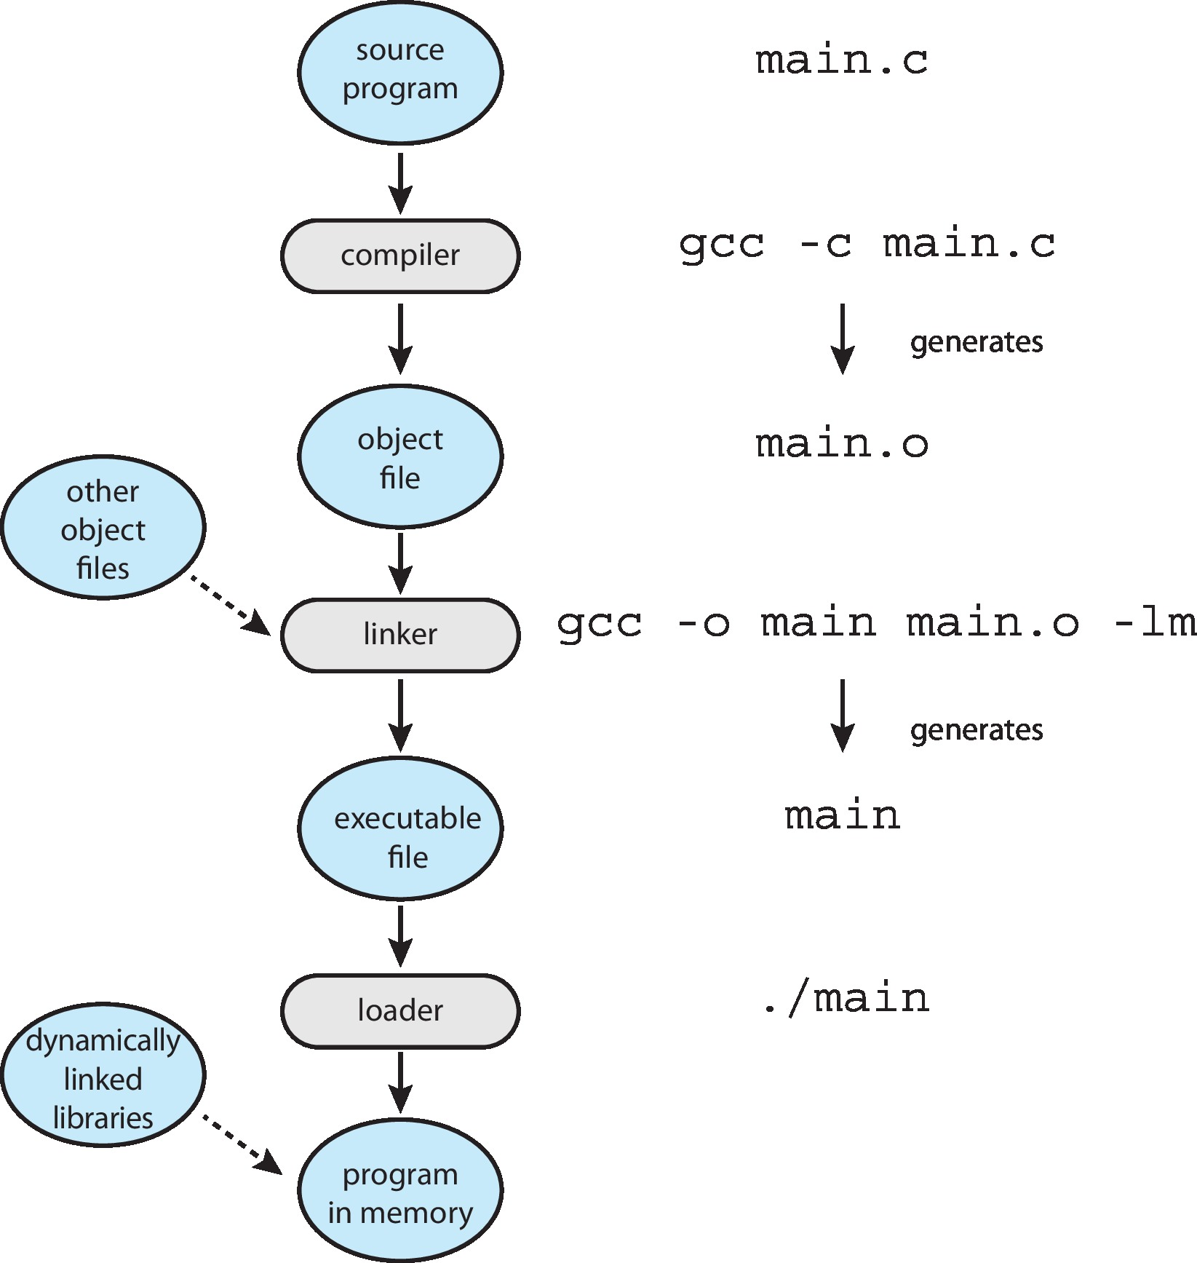
The Role of the Linker and Loader

Slide 109
Why Applications are Operating System Specific
Apps compiled on one system usually not executable on other operating systems
Each operating system provides its own unique system calls
Own file formats, etc.
Apps can be multi-operating system
Written in interpreted language like Python, Ruby, and interpreter available on multiple operating systems
App written in language that includes a VM containing the running app (like Java)
Use standard language (like C), compile separately on each operating system to run on each
Application Binary Interface (ABI) is architecture equivalent of API, defines how different components of binary code can interface for a given operating system on a given architecture, CPU, etc.

Slide 110
Design and Implementation
Design and Implementation of OS is not “solvable”, but some approaches have proven successful
Internal structure of different Operating Systems can vary widely
Start the design by defining goals and specifications
Affected by choice of hardware, type of system
User goals and System goals
User goals – operating system should be convenient to use, easy to learn, reliable, safe, and fast
System goals – operating system should be easy to design, implement, and maintain, as well as flexible, reliable, error-free, and efficient
Specifying and designing an OS is highly creative task of software engineering

Slide 111
Policy and Mechanism
Policy: What needs to be done?
Example: Interrupt after every 100 seconds
Mechanism: How to do something?
Example: timer
Important principle: separate policy from mechanism
The separation of policy from mechanism is a very important principle, it allows maximum flexibility if policy decisions are to be changed later.
Example: change 100 to 200

Slide 112
Implementation
Much variation
Early OSes in assembly language
Then system programming languages like Algol, PL/1
Now C, C++
Actually usually a mix of languages
Lowest levels in assembly
Main body in C
Systems programs in C, C++, scripting languages like PERL, Python, shell scripts
More high-level language easier to port to other hardware
But slower
Emulation can allow an OS to run on non-native hardware

Slide 113
Operating System Structure
General-purpose OS is very large program
Various ways to structure ones
Simple structure – MS-DOS
More complex – UNIX
Layered – an abstraction
Microkernel – Mach

Slide 114
Monolithic Structure – Original UNIX
UNIX – limited by hardware functionality, the original UNIX operating system had limited structuring.
The UNIX OS consists of two separable parts
Systems programs
The kernel
Consists of everything below the system-call interface and above the physical hardware
Provides the file system, CPU scheduling, memory management, and other operating-system functions; a large number of functions for one level

Slide 115
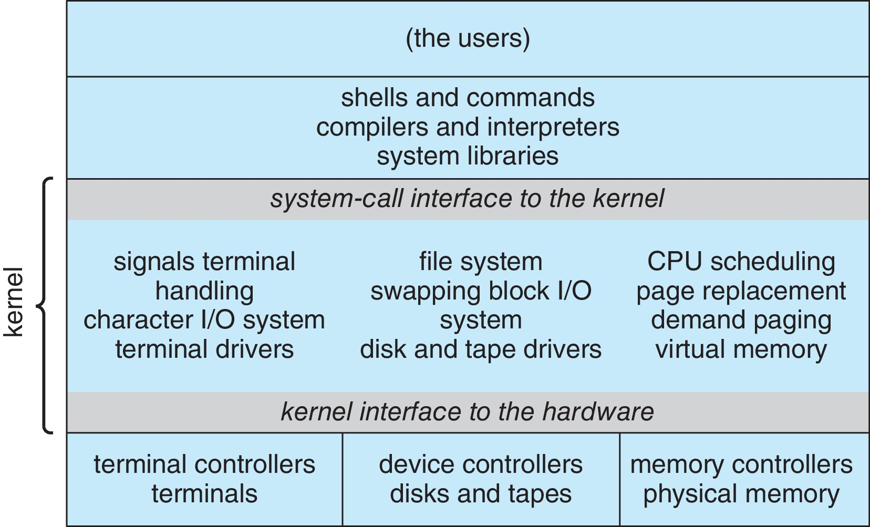
Traditional UNIX System Structure
Beyond simple but not fully layered

Slide 116
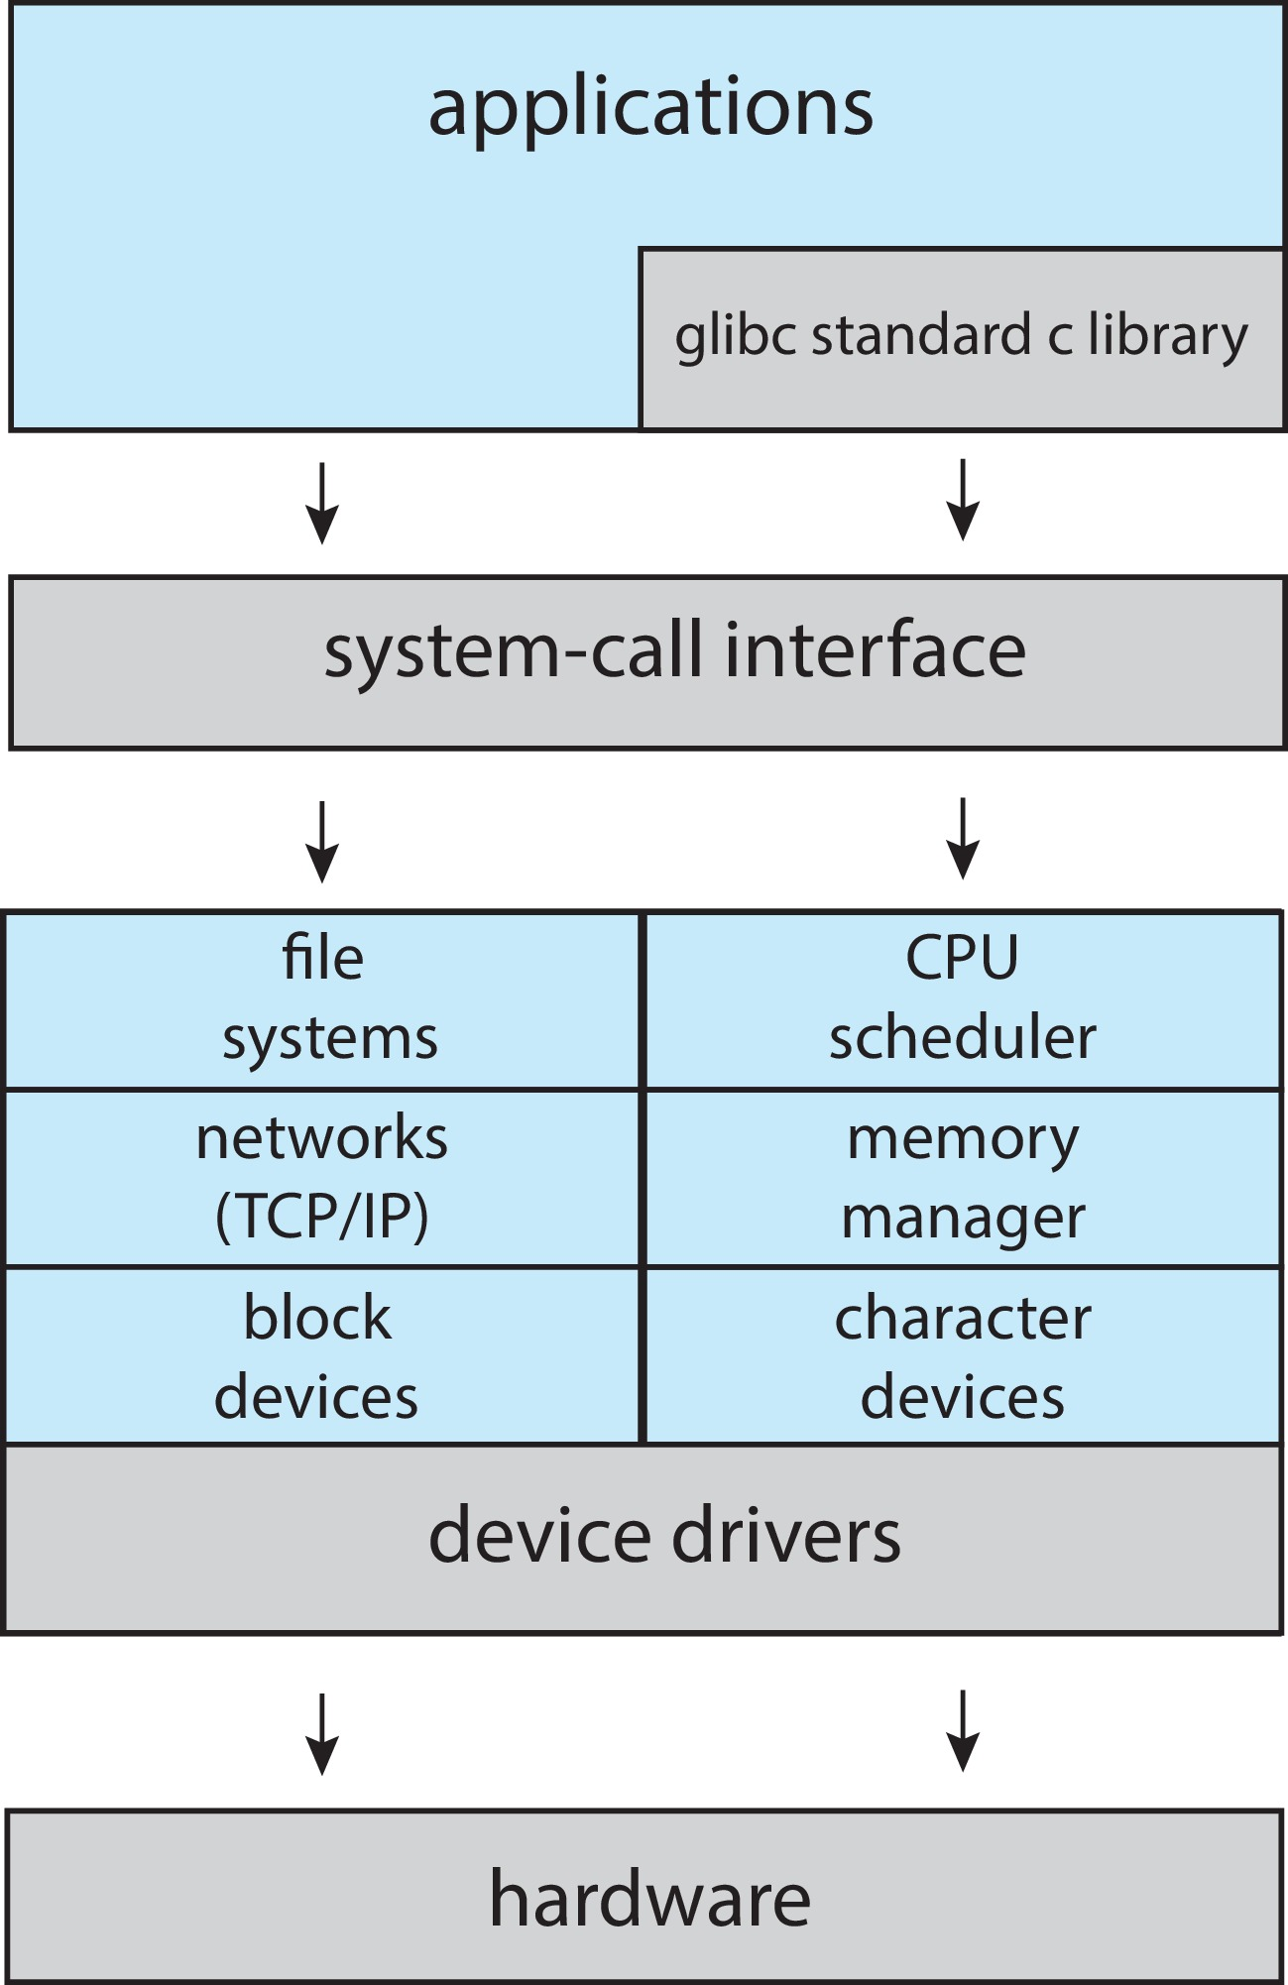
Linux System Structure
Monolithic plus modular design

Slide 117
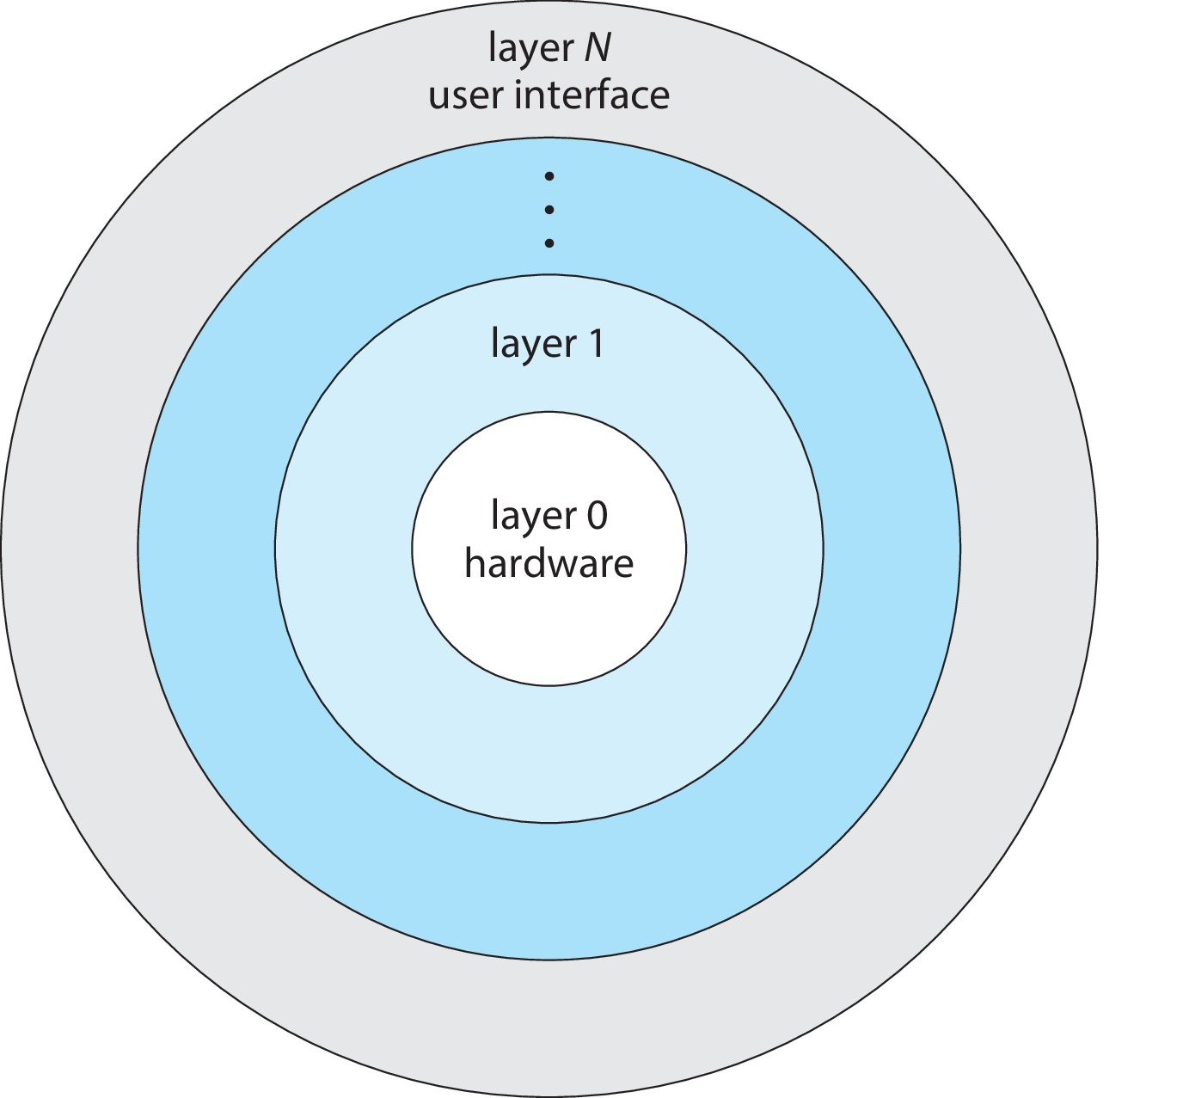
Layered Approach
The operating system is divided into a number of layers (levels), each built on top of lower layers. The bottom layer (layer 0), is the hardware; the highest (layer N) is the user interface.
With modularity, layers are selected such that each uses functions (operations) and services of only lower-level layers

Slide 118
Microkernels
Moves as much from the kernel into user space
Mach is an example of microkernel
Mac OS X kernel (Darwin) partly based on Mach
Communication takes place between user modules using message passing
Benefits:
Easier to extend a microkernel
Easier to port the operating system to new architectures
More reliable (less code is running in kernel mode)
More secure
Detriments:
Performance overhead of user space to kernel space communication

Slide 119
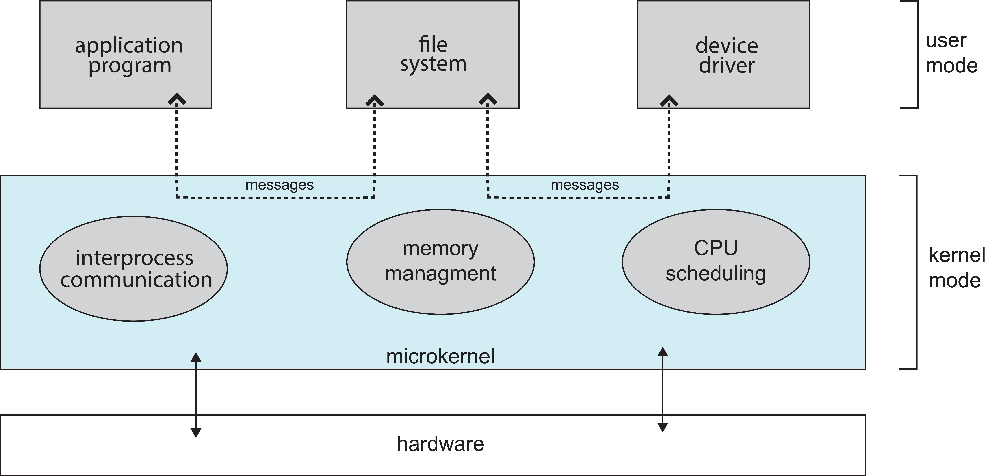
Microkernel System Structure

Slide 120
Modules
Many modern operating systems implement loadable kernel modules (LKMs)
Uses object-oriented approach
Each core component is separate
Each talks to the others over known interfaces
Each is loadable as needed within the kernel
Overall, similar to layers but with more flexible
Linux, Solaris, etc.

Slide 121
Hybrid Systems
Most modern operating systems are not one pure model
Hybrid combines multiple approaches to address performance, security, usability needs
Linux and Solaris kernels in kernel address space, so monolithic, plus modular for dynamic loading of functionality
Windows mostly monolithic, plus microkernel for different subsystem personalities
Apple Mac OS X hybrid, layered, Aqua UI plus Cocoa programming environment
Below is kernel consisting of Mach microkernel and BSD Unix parts, plus I/O kit and dynamically loadable modules (called kernel extensions)

Slide 122
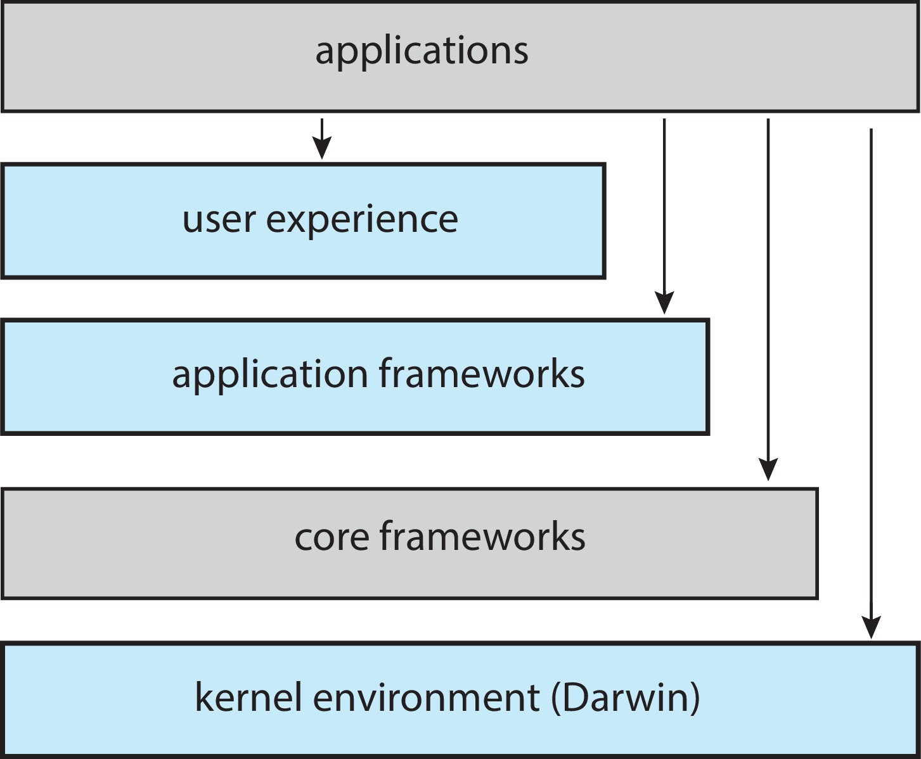
macOS and iOS Structure

Slide 123
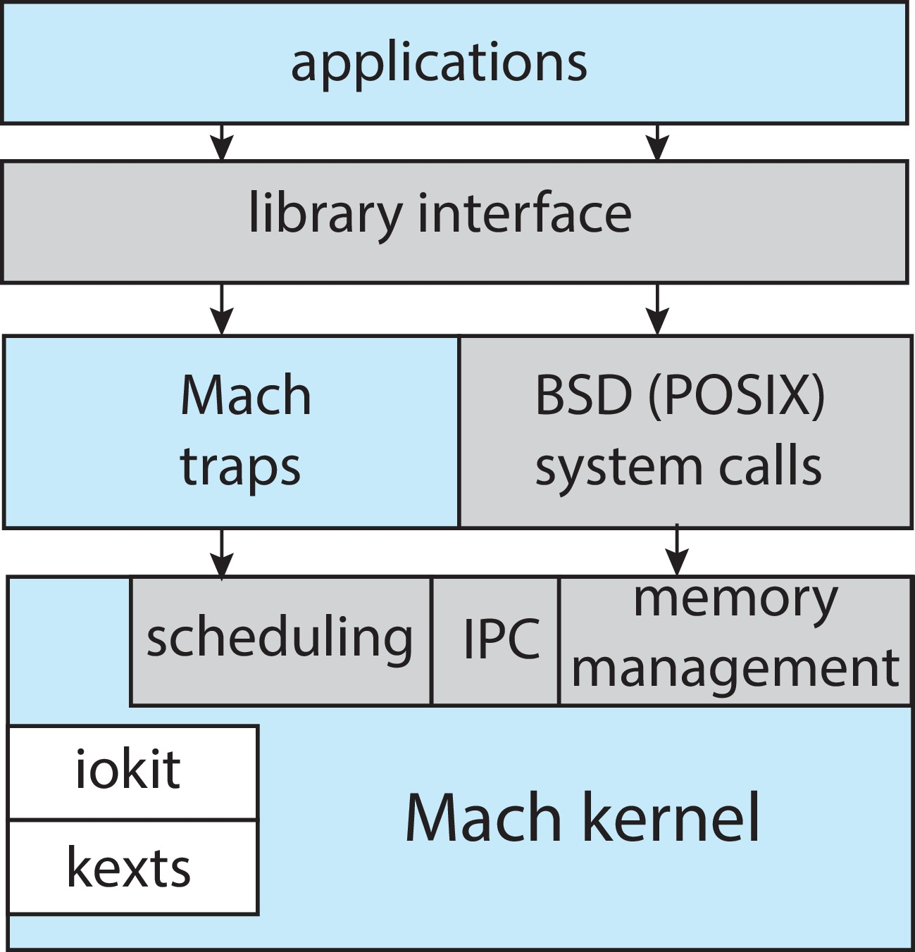
Darwin

Slide 124
iOS
Apple mobile OS for iPhone, iPad
Structured on Mac OS X, added functionality
Does not run OS X applications natively
Also runs on different CPU architecture (ARM vs. Intel)
Cocoa Touch Objective-C API for developing apps
Media services layer for graphics, audio, video
Core services provides cloud computing, databases
Core operating system, based on Mac OS X kernel

Slide 125
Android
Developed by Open Handset Alliance (mostly Google)
Open Source
Similar stack to IOS
Based on Linux kernel but modified
Provides process, memory, device-driver management
Adds power management
Runtime environment includes core set of libraries and Dalvik virtual machine
Apps developed in Java plus Android API
Java class files compiled to Java bytecode then translated to executable than runs in Dalvik VM
Libraries include frameworks for web browser (webkit), database (SQLite), multimedia, smaller libc

Slide 126
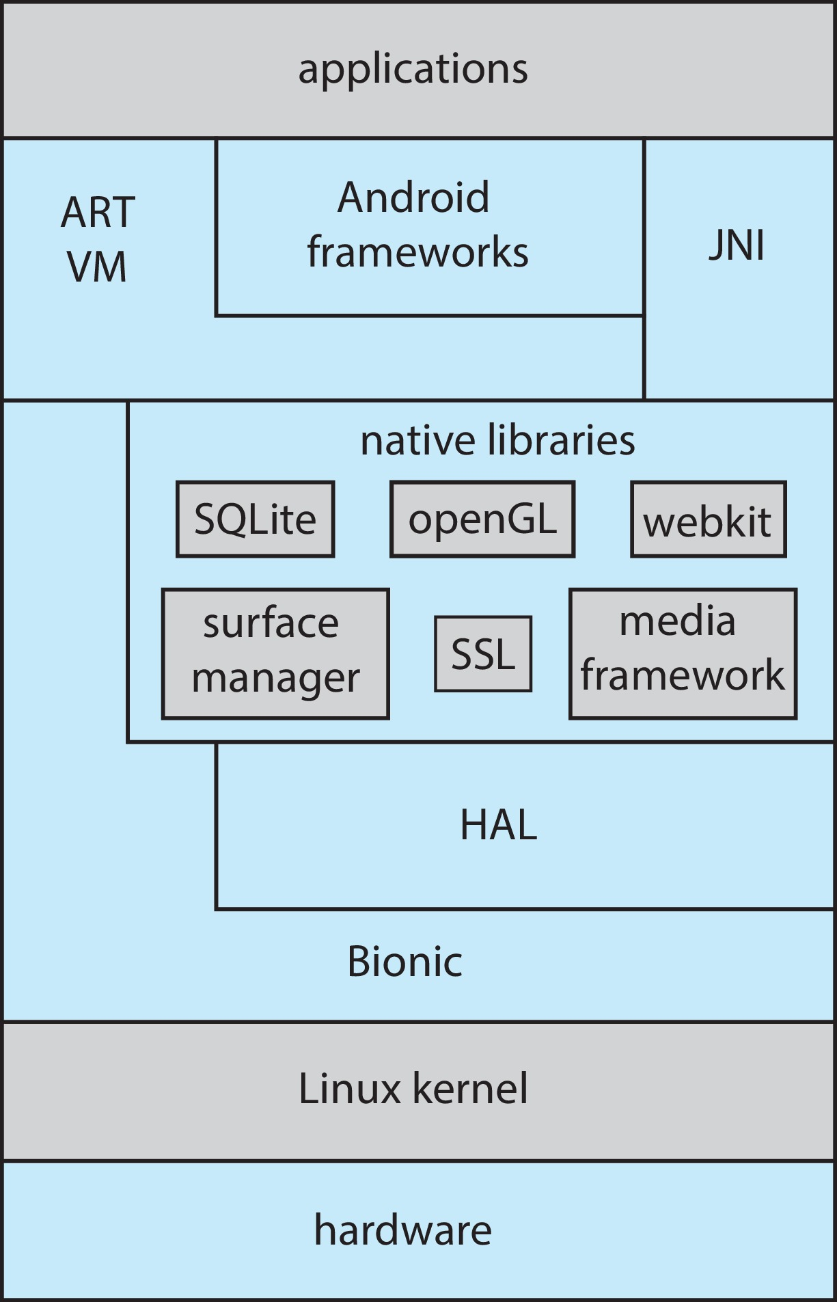
Android Architecture

Slide 127
Building and Booting an Operating System
Operating systems generally designed to run on a class of systems with variety of perpherals
Commonly, operating system already installed on purchased computer
But can build and install some other operating systems
If generating an operating system from scratch
Write the operating system source code
Configure the operating system for the system on which it will run
Compile the operating system
Install the operating system
Boot the computer and its new operating system

Slide 128
Building and Booting Linux
Download Linux source code (http://www.kernel.org)
Configure kernel via “make menuconfig”
Compile the kernel using “make”
Produces vmlinuz, the kernel image
Compile kernel modules via “make modules”
Install kernel modules into vmlinuz via “make modules_install”
Install new kernel on the system via “make install”

Slide 129
System Boot
When power initialized on system, execution starts at a fixed memory location
Operating system must be made available to hardware so hardware can start it
Small piece of code – bootstrap loader, BIOS, stored in ROM or EEPROM locates the kernel, loads it into memory, and starts it
Sometimes two-step process where boot block at fixed location loaded by ROM code, which loads bootstrap loader from disk
Modern systems replace BIOS with Unified Extensible Firmware Interface (UEFI)
Common bootstrap loader, GRUB, allows selection of kernel from multiple disks, versions, kernel options
Kernel loads and system is then running
Boot loaders frequently allow various boot states, such as single user mode

Slide 130
Operating-System Debugging
Debugging is finding and fixing errors, or bugs
Also performance tuning
OS generate log files containing error information
Failure of an application can generate core dump file capturing memory of the process
Operating system failure can generate crash dump file containing kernel memory
Beyond crashes, performance tuning can optimize system performance
Sometimes using trace listings of activities, recorded for analysis
Profiling is periodic sampling of instruction pointer to look for statistical trends
Kernighan’s Law: “Debugging is twice as hard as writing the code in the first place. Therefore, if you write the code as cleverly as possible, you are, by definition, not smart enough to debug it.”

Slide 131
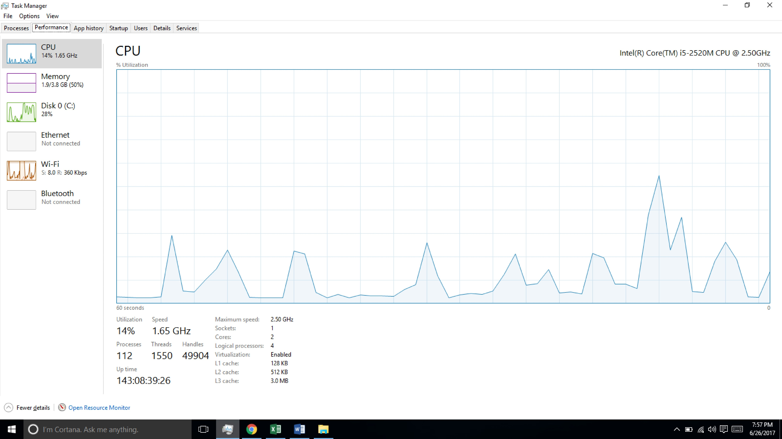
Performance Tuning
Improve performance by removing bottlenecks
OS must provide means of computing and displaying measures of system behavior
For example, “top” program or Windows Task Manager

Slide 132
Tracing
Collects data for a specific event, such as steps involved in a system call invocation
Tools include
strace – trace system calls invoked by a process
gdb – source-level debugger
perf – collection of Linux performance tools
tcpdump – collects network packets

Slide 133
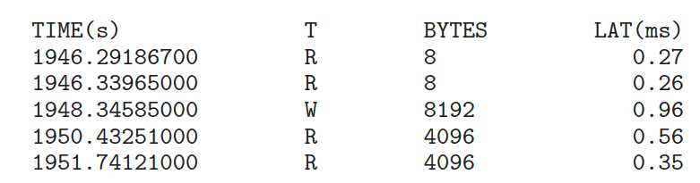
BCC
Debugging interactions between user-level and kernel code nearly impossible without toolset that understands both and an instrument their actions
BCC (BPF Compiler Collection) is a rich toolkit providing tracing features for Linux
See also the original DTrace
For example, disksnoop.py traces disk I/O activity
Many other tools (next slide)

Slide 134
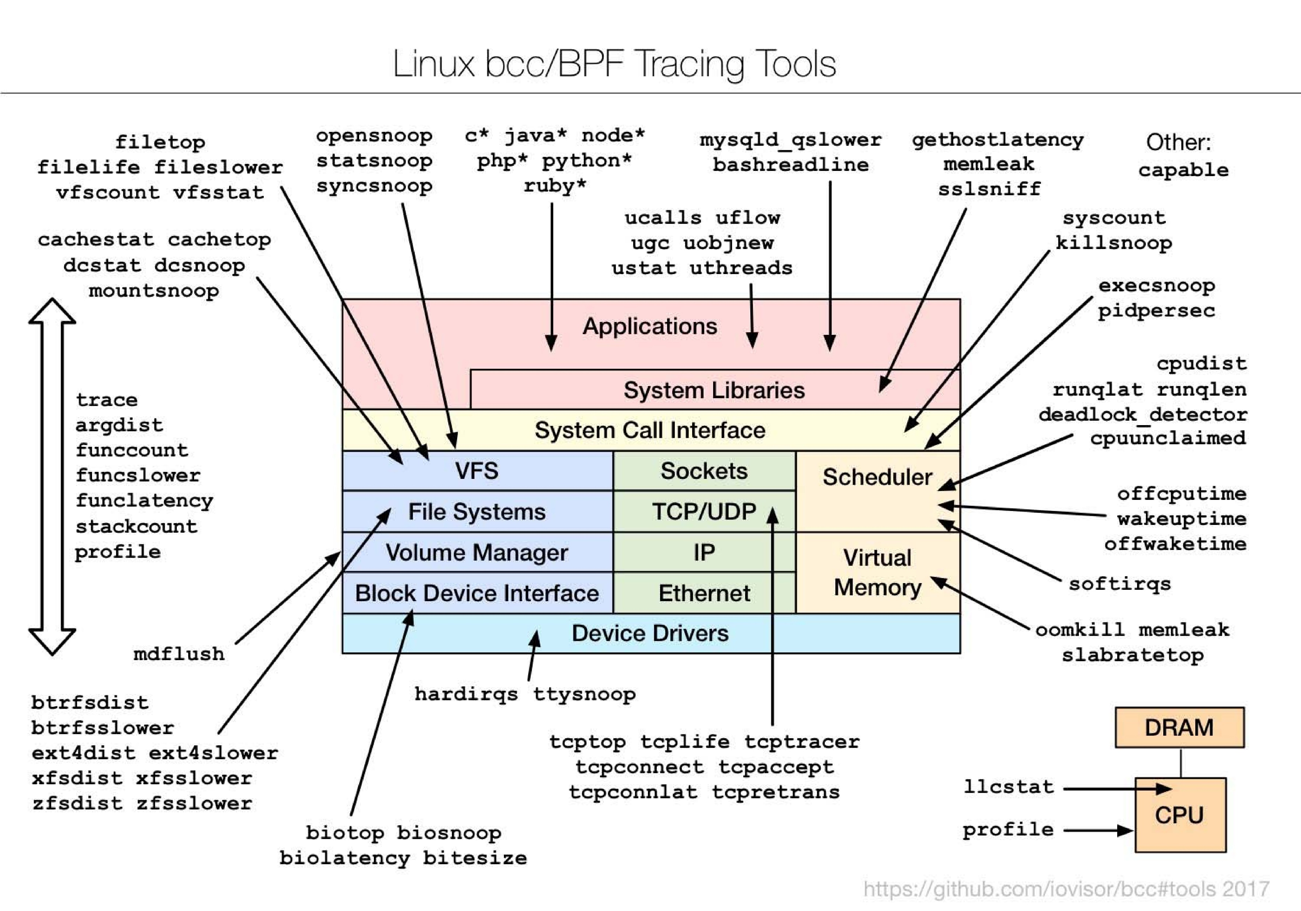
Linux bcc/BPF Tracing Tools

Slide 135
End of Chapter 2

Slide 136
Chapter 3: Processes

Slide 137
Outline
Process Concept
Process Scheduling
Operations on Processes
Interprocess Communication
IPC in Shared-Memory Systems
IPC in Message-Passing Systems
Examples of IPC Systems
Communication in Client-Server Systems

Slide 138
Objectives
Identify the separate components of a process and illustrate how they are represented and scheduled in an operating system.
Describe how processes are created and terminated in an operating system, including developing programs using the appropriate system calls that perform these operations.
Describe and contrast interprocess communication using shared memory and message passing.
Design programs that uses pipes and POSIX shared memory to perform interprocess communication.
Describe client-server communication using sockets and remote procedure calls.
Design kernel modules that interact with the Linux operating system.

Slide 139
Process Concept
An operating system executes a variety of programs that run as a process.
Process – a program in execution; process execution must progress in sequential fashion. No parallel execution of instructions of a single process
Multiple parts
The program code, also called text section
Current activity including program counter, processor registers
Stack containing temporary data
Function parameters, return addresses, local variables
Data section containing global variables
Heap containing memory dynamically allocated during run time

Slide 140
Process Concept (Cont.)
Program is passive entity stored on disk (executable file); process is active
Program becomes process when an executable file is loaded into memory
Execution of program started via GUI mouse clicks, command line entry of its name, etc.
One program can be several processes
Consider multiple users executing the same program

Slide 141
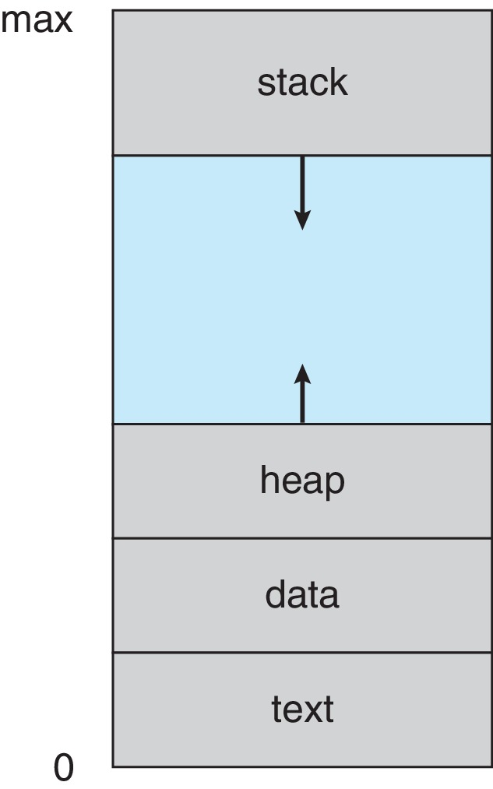
Process in Memory

Slide 142
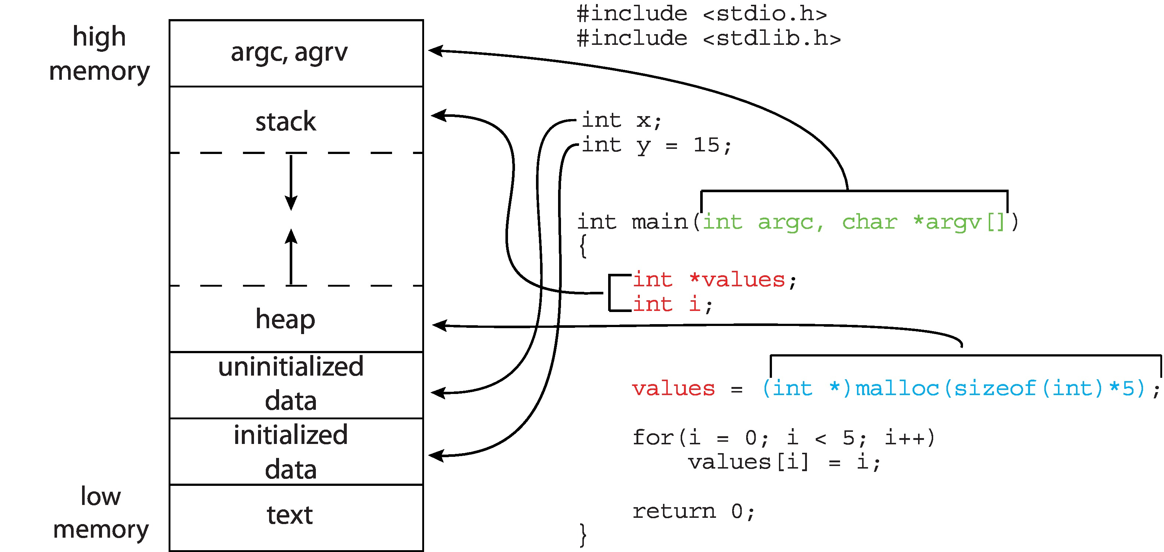
Memory Layout of a C Program

Slide 143
Process State
As a process executes, it changes state
New: The process is being created
Running: Instructions are being executed
Waiting: The process is waiting for some event to occur
Ready: The process is waiting to be assigned to a processor
Terminated: The process has finished execution

Slide 144
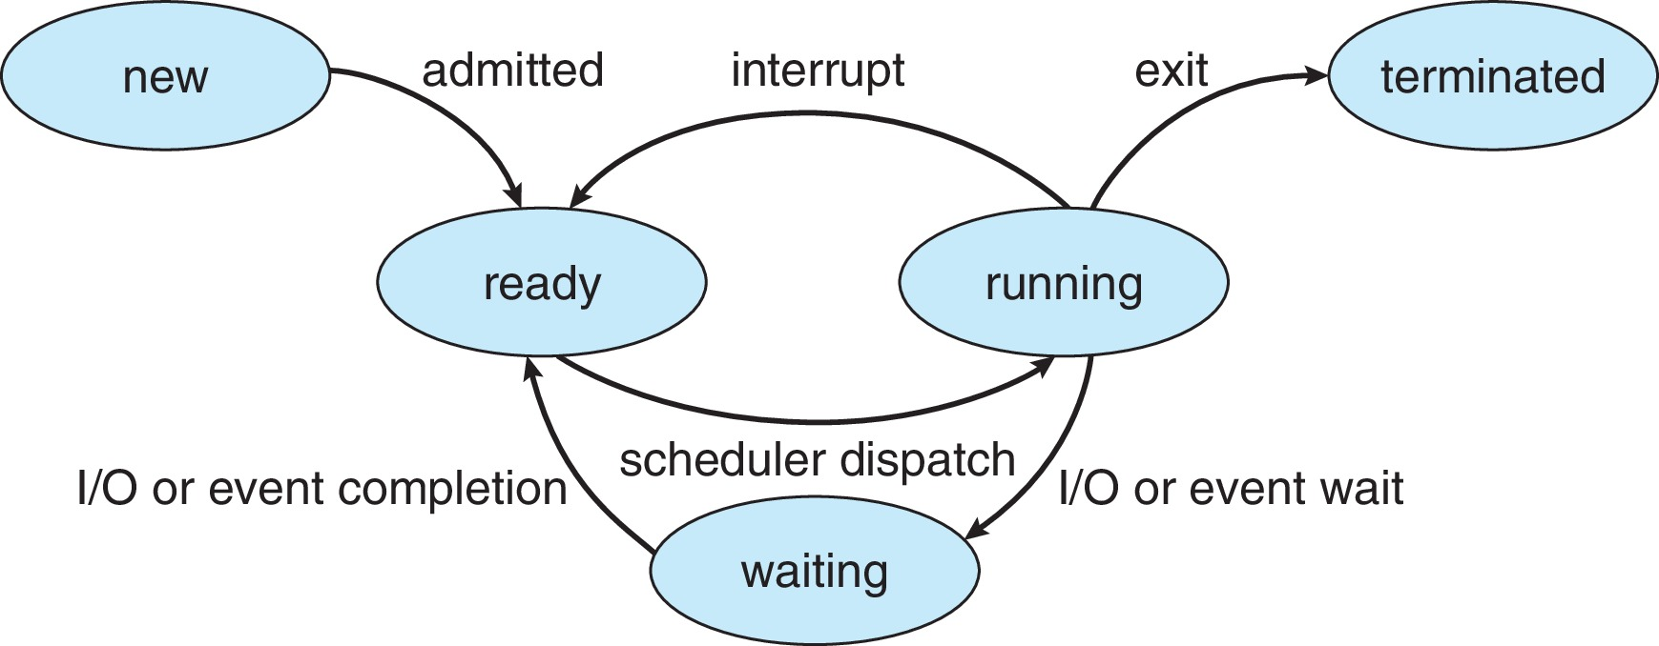
Diagram of Process State

Slide 145
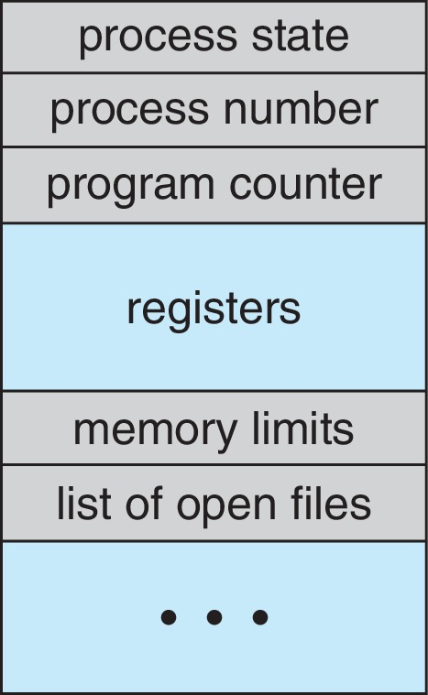
Process Control Block (PCB)
Information associated with each process(also called task control block)
Process state – running, waiting, etc.
Program counter – location of instruction to next execute
CPU registers – contents of all process-centric registers
CPU scheduling information- priorities, scheduling queue pointers
Memory-management information – memory allocated to the process
Accounting information – CPU used, clock time elapsed since start, time limits
I/O status information – I/O devices allocated to process, list of open files

Slide 146
Threads
So far, process has a single thread of execution
Consider having multiple program counters per process
Multiple locations can execute at once
Multiple threads of control -> threads
Must then have storage for thread details, multiple program counters in PCB
Explore in detail in Chapter 4

Slide 147
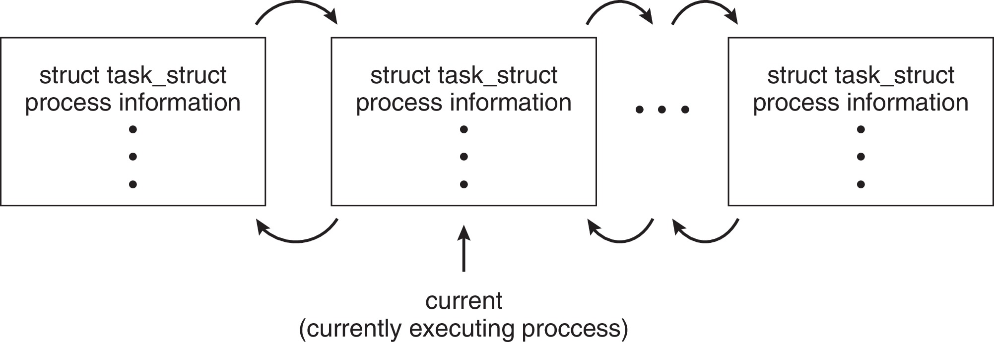
Process Representation in Linux
Represented by the C structure task_struct
pid t_pid; /* process identifier */ long state; /* state of the process */ unsigned int time_slice /* scheduling information */ struct task_struct *parent;/* this process’s parent */ struct list_head children; /* this process’s children */ struct files_struct *files;/* list of open files */ struct mm_struct *mm; /* address space of this process */

Slide 148
Process Scheduling
Process scheduler selects among available processes for next execution on CPU core
Goal -- Maximize CPU use, quickly switch processes onto CPU core
Maintains scheduling queues of processes
Ready queue – set of all processes residing in main memory, ready and waiting to execute
Wait queues – set of processes waiting for an event (i.e., I/O)
Processes migrate among the various queues

Slide 149
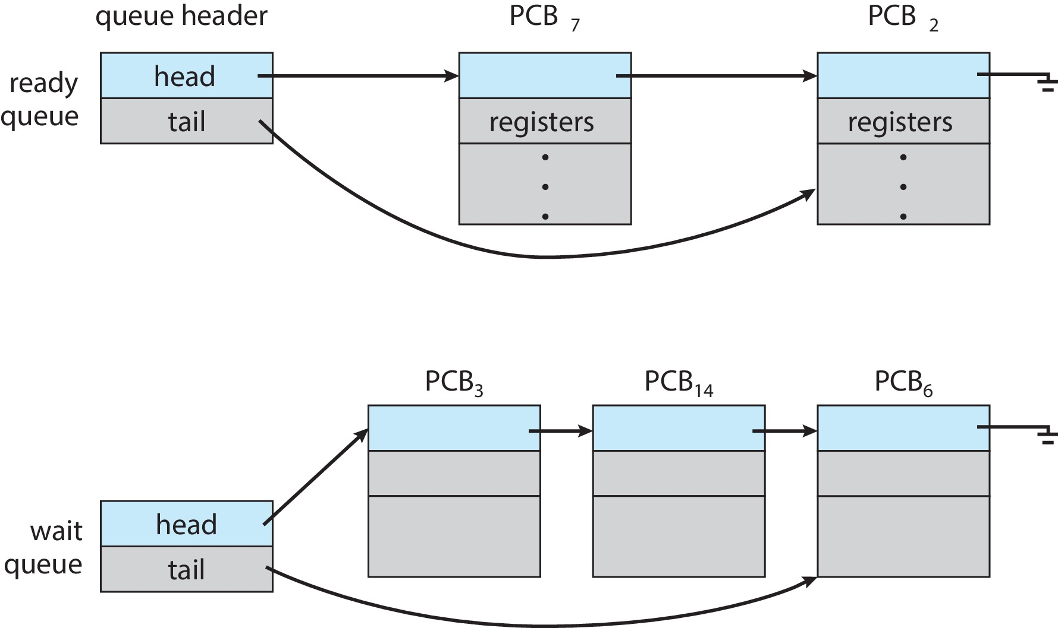
Ready and Wait Queues

Slide 150
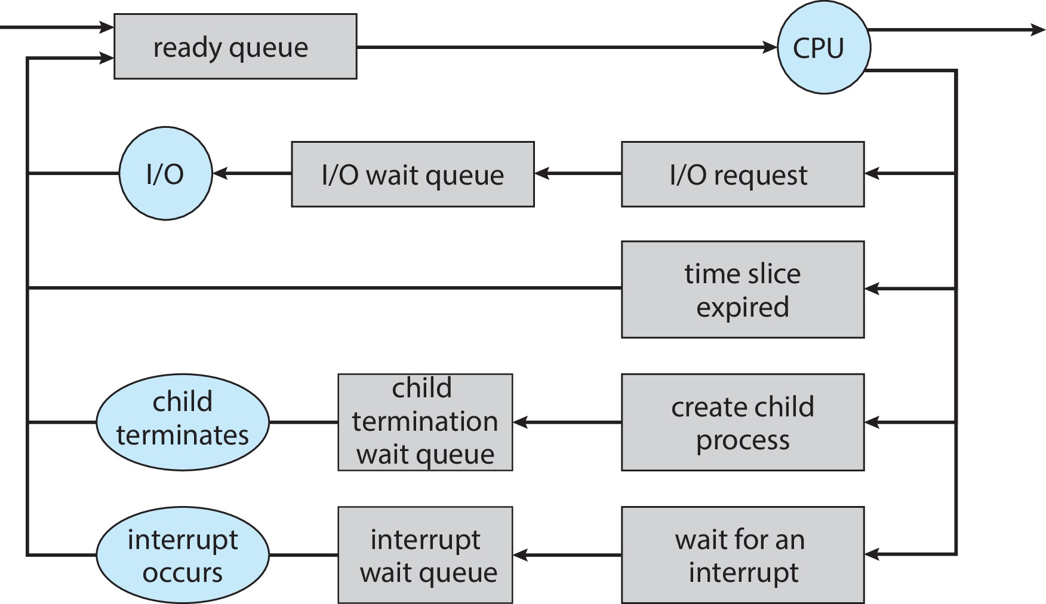
Representation of Process Scheduling

Slide 151
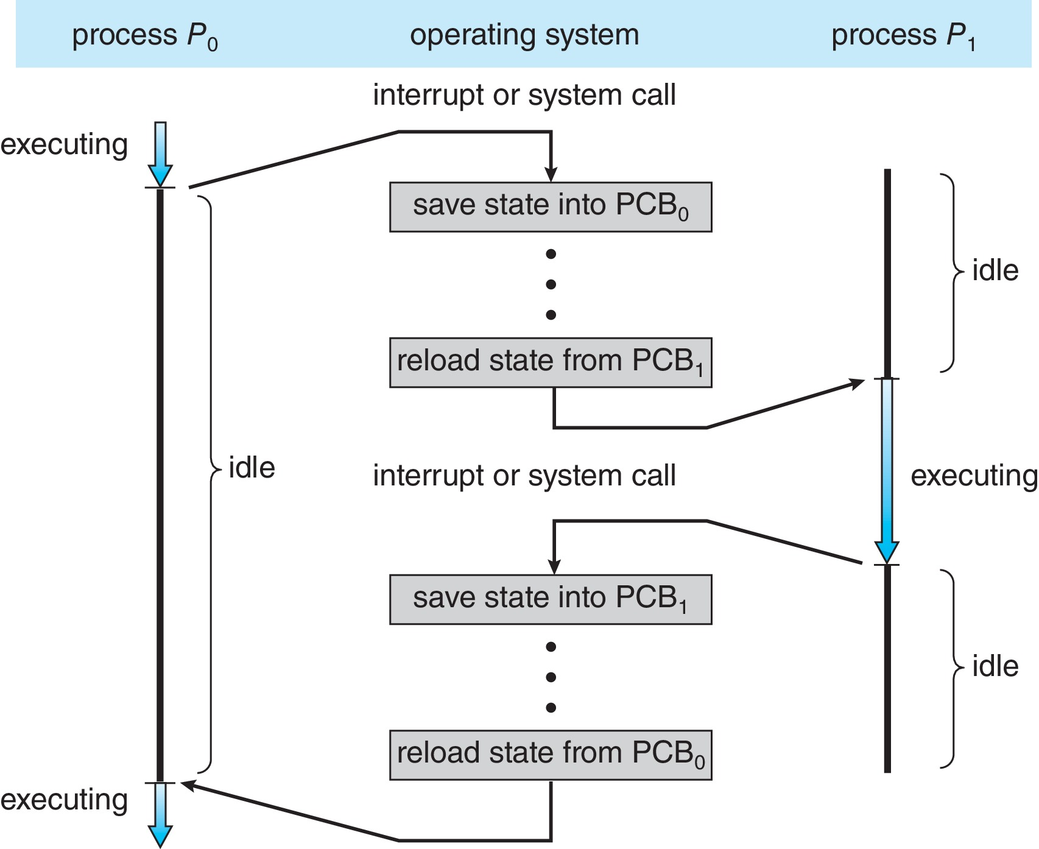
CPU Switch From Process to Process
A context switch occurs when the CPU switches from one process to another.

Slide 152
Context Switch
When CPU switches to another process, the system must save the state of the old process and load the saved state for the new process via a context switch
Context of a process represented in the PCB
Context-switch time is pure overhead; the system does no useful work while switching
The more complex the OS and the PCB ➔ the longer the context switch
Time dependent on hardware support
Some hardware provides multiple sets of registers per CPU ➔ multiple contexts loaded at once

Slide 153
Multitasking in Mobile Systems
Some mobile systems (e.g., early version of iOS) allow only one process to run, others suspended
Due to screen real estate, user interface limits iOS provides for a
Single foreground process- controlled via user interface
Multiple background processes– in memory, running, but not on the display, and with limits
Limits include single, short task, receiving notification of events, specific long-running tasks like audio playback
Android runs foreground and background, with fewer limits
Background process uses a service to perform tasks
Service can keep running even if background process is suspended
Service has no user interface, small memory use

Slide 154
Operations on Processes
System must provide mechanisms for:
Process creation
Process termination

Slide 155
Process Creation
Parent process create children processes, which, in turn create other processes, forming a tree of processes
Generally, process identified and managed via a process identifier (pid)
Resource sharing options
Parent and children share all resources
Children share subset of parent’s resources
Parent and child share no resources
Execution options
Parent and children execute concurrently
Parent waits until children terminate

Slide 156
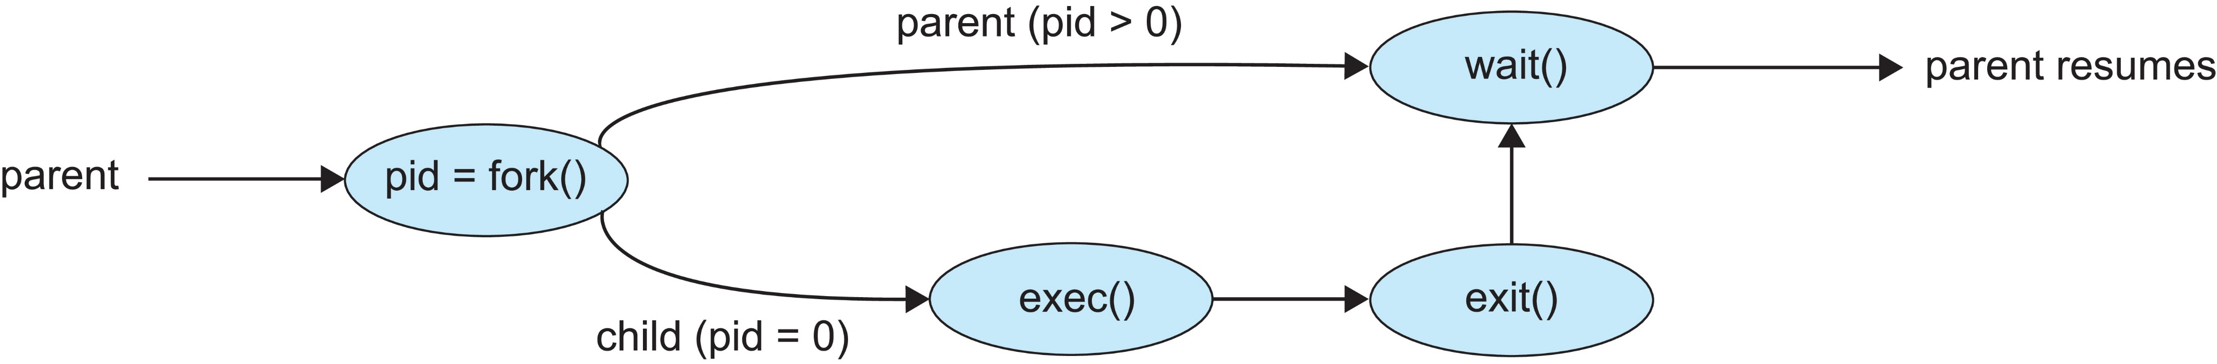
Process Creation (Cont.)
Address space
Child duplicate of parent
Child has a program loaded into it
UNIX examples
fork() system call creates new process
exec() system call used after a fork() to replace the process’ memory space with a new program
Parent process calls wait()waiting for the child to terminate

Slide 157
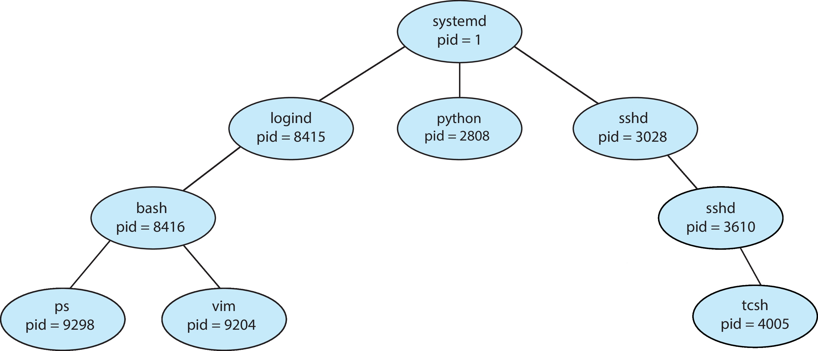
A Tree of Processes in Linux

Slide 158
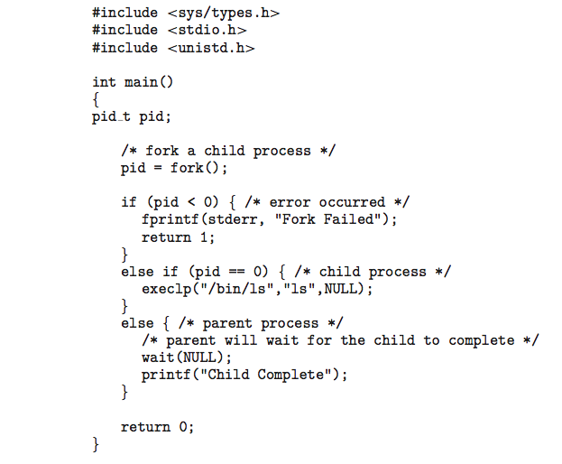
C Program Forking Separate Process

Slide 159
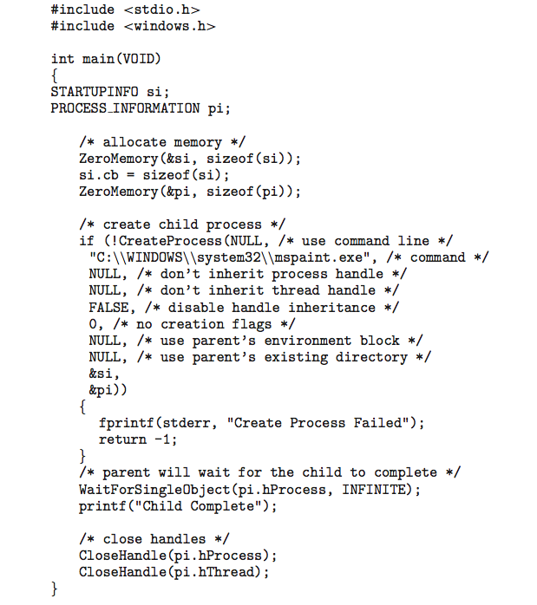
Creating a Separate Process via Windows API

Slide 160
Process Termination
Process executes last statement and then asks the operating system to delete it using the exit() system call.
Returns status data from child to parent (via wait())
Process’ resources are deallocated by operating system
Parent may terminate the execution of children processes using the abort() system call. Some reasons for doing so:
Child has exceeded allocated resources
Task assigned to child is no longer required
The parent is exiting, and the operating systems does not allow a child to continue if its parent terminates

Slide 161
Process Termination
Some operating systems do not allow child to exists if its parent has terminated. If a process terminates, then all its children must also be terminated.
cascading termination. All children, grandchildren, etc., are terminated.
The termination is initiated by the operating system.
The parent process may wait for termination of a child process by using the wait()system call. The call returns status information and the pid of the terminated process
pid = wait(&status);
If no parent waiting (did not invoke wait()) process is a zombie
If parent terminated without invoking wait(), process is an orphan

Slide 162
Android Process Importance Hierarchy
Mobile operating systems often have to terminate processes to reclaim system resources such as memory. From most to least important:
Foreground process
Visible process
Service process
Background process
Empty process
Android will begin terminating processes that are least important.

Slide 163

Multiprocess Architecture – Chrome Browser
Many web browsers ran as single process (some still do)
If one web site causes trouble, entire browser can hang or crash
Google Chrome Browser is multiprocess with 3 different types of processes:
Browser process manages user interface, disk and network I/O
Renderer process renders web pages, deals with HTML, Javascript. A new renderer created for each website opened
Runs in sandbox restricting disk and network I/O, minimizing effect of security exploits
Plug-in process for each type of plug-in

Slide 164
Interprocess Communication
Processes within a system may be independent or cooperating
Cooperating process can affect or be affected by other processes, including sharing data
Reasons for cooperating processes:
Information sharing
Computation speedup
Modularity
Convenience
Cooperating processes need interprocess communication (IPC)
Two models of IPC
Shared memory
Message passing

Slide 165
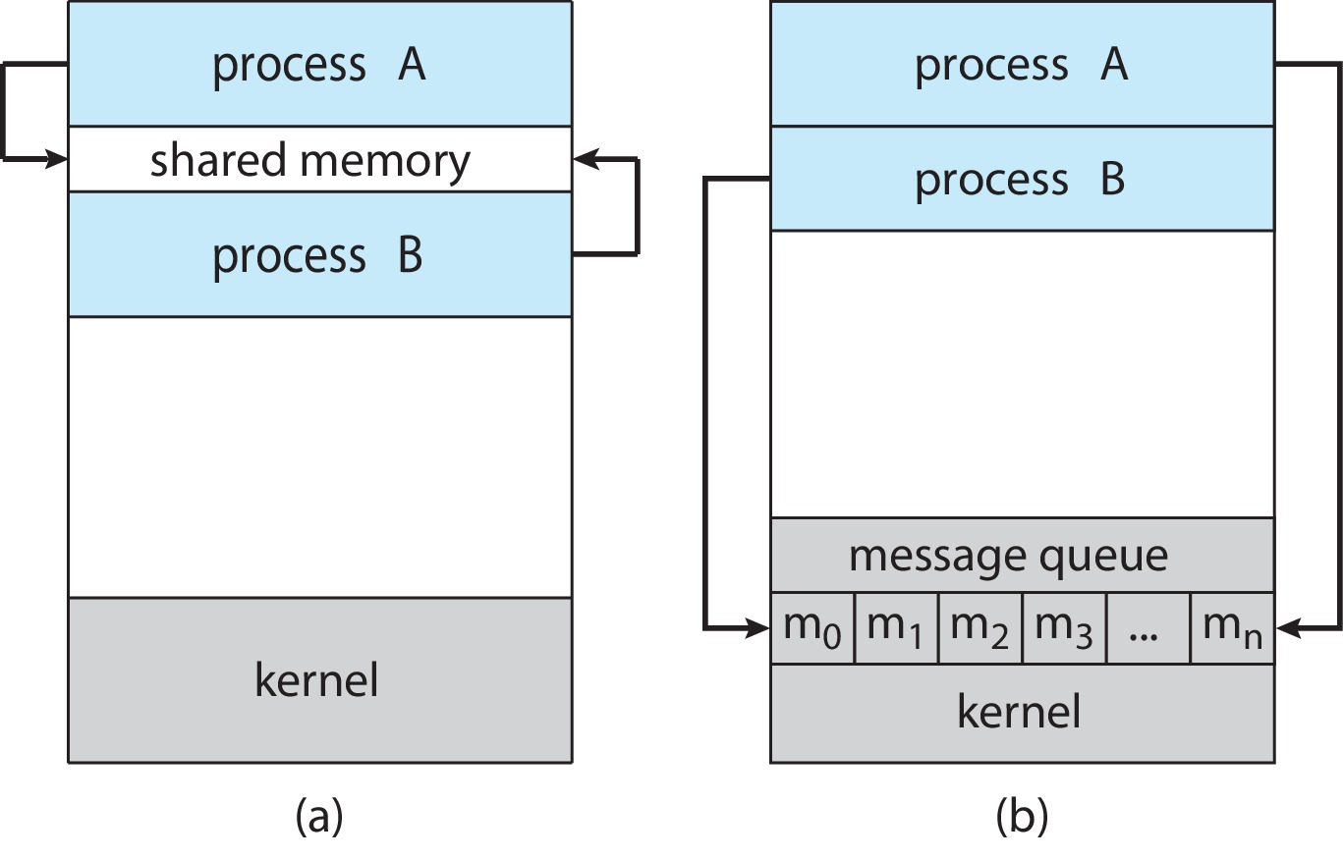
Communications Models
(a) Shared memory. (b) Message passing.

Slide 166
Producer-Consumer Problem
Paradigm for cooperating processes:
producer process produces information that is consumed by a consumer process
Two variations:
unbounded-buffer places no practical limit on the size of the buffer:
Producer never waits
Consumer waits if there is no buffer to consume
bounded-buffer assumes that there is a fixed buffer size
Producer must wait if all buffers are full
Consumer waits if there is no buffer to consume

Slide 167
IPC – Shared Memory
An area of memory shared among the processes that wish to communicate
The communication is under the control of the users processes not the operating system.
Major issues is to provide mechanism that will allow the user processes to synchronize their actions when they access shared memory.
Synchronization is discussed in great details in Chapters 6 & 7.

Slide 168
Bounded-Buffer – Shared-Memory Solution
Shared data
#define BUFFER_SIZE 10
typedef struct {
. . .
} item;
item buffer[BUFFER_SIZE];
int in = 0;
int out = 0;
Solution is correct, but can only use BUFFER_SIZE-1 elements

Slide 169
Producer Process – Shared Memory
item next_produced;
while (true) {
/* produce an item in next produced */
while (((in + 1) % BUFFER_SIZE) == out)
; /* do nothing */
buffer[in] = next_produced;
in = (in + 1) % BUFFER_SIZE;
}

Slide 170
Consumer Process – Shared Memory
item next_consumed;
while (true) { while (in == out)
; /* do nothing */ next_consumed = buffer[out];
out = (out + 1) % BUFFER_SIZE;
/* consume the item in next consumed */
}

Slide 171
What about Filling all the Buffers?
Suppose that we wanted to provide a solution to the consumer-producer problem that fills all the buffers.
We can do so by having an integer counter that keeps track of the number of full buffers.
Initially, counter is set to 0.
The integer counter is incremented by the producer after it produces a new buffer.
The integer counter is and is decremented by the consumer after it consumes a buffer.

Slide 172
Producer
while (true) { /* produce an item in next produced */
while (counter == BUFFER_SIZE)
; /* do nothing */
buffer[in] = next_produced;
in = (in + 1) % BUFFER_SIZE;
counter++;
}

Slide 173
Consumer
while (true) {
while (counter == 0)
; /* do nothing */
next_consumed = buffer[out];
out = (out + 1) % BUFFER_SIZE;
counter--;
/* consume the item in next consumed */
}

Slide 174
Race Condition
counter++ could be implemented as register1 = counter register1 = register1 + 1 counter = register1
counter-- could be implemented as register2 = counter register2 = register2 - 1 counter = register2
Consider this execution interleaving with “count = 5” initially:
S0: producer execute register1 = counter {register1 = 5} S1: producer execute register1 = register1 + 1 {register1 = 6} S2: consumer execute register2 = counter {register2 = 5} S3: consumer execute register2 = register2 – 1 {register2 = 4} S4: producer execute counter = register1 {counter = 6 } S5: consumer execute counter = register2 {counter = 4}

Slide 175
Race Condition (Cont.)
Question – why was there no race condition in the first solution (where at most N – 1) buffers can be filled?
More in Chapter 6.

Slide 176
IPC – Message Passing
Processes communicate with each other without resorting to shared variables
IPC facility provides two operations:
send(message)
receive(message)
The message size is either fixed or variable

Slide 177
Message Passing (Cont.)
If processes P and Q wish to communicate, they need to:
Establish a communication link between them
Exchange messages via send/receive
Implementation issues:
How are links established?
Can a link be associated with more than two processes?
How many links can there be between every pair of communicating processes?
What is the capacity of a link?
Is the size of a message that the link can accommodate fixed or variable?
Is a link unidirectional or bi-directional?

Slide 178
Implementation of Communication Link
Physical:
Shared memory
Hardware bus
Network
Logical:
Direct or indirect
Synchronous or asynchronous
Automatic or explicit buffering

Slide 179
Direct Communication
Processes must name each other explicitly:
send (P, message) – send a message to process P
receive(Q, message) – receive a message from process Q
Properties of communication link
Links are established automatically
A link is associated with exactly one pair of communicating processes
Between each pair there exists exactly one link
The link may be unidirectional, but is usually bi-directional

Slide 180
Indirect Communication
Messages are directed and received from mailboxes (also referred to as ports)
Each mailbox has a unique id
Processes can communicate only if they share a mailbox
Properties of communication link
Link established only if processes share a common mailbox
A link may be associated with many processes
Each pair of processes may share several communication links
Link may be unidirectional or bi-directional

Slide 181
Indirect Communication (Cont.)
Operations
Create a new mailbox (port)
Send and receive messages through mailbox
Delete a mailbox
Primitives are defined as:
send(A, message) – send a message to mailbox A
receive(A, message) – receive a message from mailbox A

Slide 182
Indirect Communication (Cont.)
Mailbox sharing
P₁, P₂, and P₃ share mailbox A
P₁, sends; P₂ and P₃ receive
Who gets the message?
Solutions
Allow a link to be associated with at most two processes
Allow only one process at a time to execute a receive operation
Allow the system to select arbitrarily the receiver. Sender is notified who the receiver was.

Slide 183
Synchronization
Message passing may be either blocking or non-blocking
Blocking is considered synchronous
Blocking send -- the sender is blocked until the message is received
Blocking receive -- the receiver is blocked until a message is available
Non-blocking is considered asynchronous
Non-blocking send -- the sender sends the message and continue
Non-blocking receive -- the receiver receives:
A valid message, or
Null message
Different combinations possible
If both send and receive are blocking, we have a rendezvous

Slide 184
Producer-Consumer: Message Passing
Producer
message next_produced; while (true) { /* produce an item in next_produced */
send(next_produced);
}
Consumer
message next_consumed; while (true) { receive(next_consumed) /* consume the item in next_consumed */ }

Slide 185
Buffering
Queue of messages attached to the link.
Implemented in one of three ways
1. Zero capacity – no messages are queued on a link. Sender must wait for receiver (rendezvous)
2. Bounded capacity – finite length of n messages Sender must wait if link full
3. Unbounded capacity – infinite length Sender never waits

Slide 186
Examples of IPC Systems - POSIX
POSIX Shared Memory
Process first creates shared memory segment shm_fd = shm_open(name, O CREAT | O RDWR, 0666);
Also used to open an existing segment
Set the size of the object
ftruncate(shm_fd, 4096);
Use mmap() to memory-map a file pointer to the shared memory object
Reading and writing to shared memory is done by using the pointer returned by mmap().

Slide 187

IPC POSIX Producer

Slide 188

IPC POSIX Consumer

Slide 189
Examples of IPC Systems - Mach
Mach communication is message based
Even system calls are messages
Each task gets two ports at creation - Kernel and Notify
Messages are sent and received using the mach_msg() function
Ports needed for communication, created via
mach_port_allocate()
Send and receive are flexible; for example four options if mailbox full:
Wait indefinitely
Wait at most n milliseconds
Return immediately
Temporarily cache a message

Slide 190
Mach Messages
#include<mach/mach.h>
struct message { mach_msg_header_t header;
int data;
}; mach port t client;
mach port t server;

Slide 191

Mach Message Passing - Client

Slide 192

Mach Message Passing - Server

Slide 193
Examples of IPC Systems – Windows
Message-passing centric via advanced local procedure call (LPC) facility
Only works between processes on the same system
Uses ports (like mailboxes) to establish and maintain communication channels
Communication works as follows:
The client opens a handle to the subsystem’s connection port object.
The client sends a connection request.
The server creates two private communication ports and returns the handle to one of them to the client.
The client and server use the corresponding port handle to send messages or callbacks and to listen for replies.

Slide 194

Local Procedure Calls in Windows

Slide 195
Pipes
Acts as a conduit allowing two processes to communicate
Issues:
Is communication unidirectional or bidirectional?
In the case of two-way communication, is it half or full-duplex?
Must there exist a relationship (i.e., parent-child) between the communicating processes?
Can the pipes be used over a network?
Ordinary pipes – cannot be accessed from outside the process that created it. Typically, a parent process creates a pipe and uses it to communicate with a child process that it created.
Named pipes – can be accessed without a parent-child relationship.

Slide 196

Ordinary Pipes
Ordinary Pipes allow communication in standard producer-consumer style
Producer writes to one end (the write-end of the pipe)
Consumer reads from the other end (the read-end of the pipe)
Ordinary pipes are therefore unidirectional
Require parent-child relationship between communicating processes
Windows calls these anonymous pipes

Slide 197
Named Pipes
Named Pipes are more powerful than ordinary pipes
Communication is bidirectional
No parent-child relationship is necessary between the communicating processes
Several processes can use the named pipe for communication
Provided on both UNIX and Windows systems

Slide 198
Communications in Client-Server Systems
Sockets
Remote Procedure Calls

Slide 199
Sockets
A socket is defined as an endpoint for communication
Concatenation of IP address and port – a number included at start of message packet to differentiate network services on a host
The socket 161.25.19.8:1625 refers to port 1625 on host 161.25.19.8
Communication consists between a pair of sockets
All ports below 1024 are well known, used for standard services
Special IP address 127.0.0.1 (loopback) to refer to system on which process is running

Slide 200

Socket Communication

Slide 201

Sockets in Java
Three types of sockets
Connection-oriented (TCP)
Connectionless (UDP)
MulticastSocket class– data can be sent to multiple recipients
Consider this “Date” server in Java:

Slide 202

Sockets in Java
The equivalent Date client

Slide 203
Remote Procedure Calls
Remote procedure call (RPC) abstracts procedure calls between processes on networked systems
Again uses ports for service differentiation
Stubs – client-side proxy for the actual procedure on the server
The client-side stub locates the server and marshalls the parameters
The server-side stub receives this message, unpacks the marshalled parameters, and performs the procedure on the server
On Windows, stub code compile from specification written in Microsoft Interface Definition Language (MIDL)

Slide 204
Remote Procedure Calls (Cont.)
Data representation handled via External Data Representation (XDL) format to account for different architectures
Big-endian and little-endian
Remote communication has more failure scenarios than local
Messages can be delivered exactly once rather than at most once
OS typically provides a rendezvous (or matchmaker) service to connect client and server

Slide 205

Execution of RPC

Slide 206
End of Chapter 3

Slide 207
Producer-Consumer Problem
Paradigm for cooperating processes:
producer process produces information that is consumed by a consumer process
Two variations:
unbounded-buffer places no practical limit on the size of the buffer:
Producer never waits
Consumer waits if there is no buffer to consume
bounded-buffer assumes that there is a fixed buffer size
Producer must wait if all buffers are full
Consumer waits if there is no buffer to consume

Slide 208
Cooperating Processes
Independent process cannot affect or be affected by the execution of another process
Cooperating process can affect or be affected by the execution of another process
Advantages of process cooperation
Information sharing
Computation speed-up
Modularity
Convenience

Slide 209
Synchronization
Message passing may be either blocking or non-blocking
Blocking is considered synchronous
Blocking send -- the sender is blocked until the message is received
Blocking receive -- the receiver is blocked until a message is available
Non-blocking is considered asynchronous
Non-blocking send -- the sender sends the message and continue
Non-blocking receive -- the receiver receives:
A valid message, or
Null message
Different combinations possible
If both send and receive are blocking, we have a rendezvous

Slide 210
Chapter 4: Threads & Concurrency

Slide 211
Outline
Overview
Multicore Programming
Multithreading Models
Thread Libraries
Implicit Threading
Threading Issues
Operating System Examples

Slide 212
Objectives
Identify the basic components of a thread, and contrast threads and processes
Describe the benefits and challenges of designng multithreaded applications
Illustrate different approaches to implicit threading including thread pools, fork-join, and Grand Central Dispatch
Describe how the Windows and Linux operating systems represent threads
Design multithreaded applications using the Pthreads, Java, and Windows threading APIs

Slide 213
Motivation
Most modern applications are multithreaded
Threads run within application
Multiple tasks with the application can be implemented by separate threads
Update display
Fetch data
Spell checking
Answer a network request
Process creation is heavy-weight while thread creation is light-weight
Can simplify code, increase efficiency
Kernels are generally multithreaded

Slide 214

Single and Multithreaded Processes

Slide 215

Multithreaded Server Architecture

Slide 216
Benefits
Responsiveness – may allow continued execution if part of process is blocked, especially important for user interfaces
Resource Sharing – threads share resources of process, easier than shared memory or message passing
Economy – cheaper than process creation, thread switching lower overhead than context switching
Scalability – process can take advantage of multicore architectures

Slide 217
Multicore Programming
Multicore or multiprocessor systems putting pressure on programmers, challenges include:
Dividing activities
Balance
Data splitting
Data dependency
Testing and debugging
Parallelism implies a system can perform more than one task simultaneously
Concurrency supports more than one task making progress
Single processor / core, scheduler providing concurrency

Slide 218


Concurrency vs. Parallelism
Concurrent execution on single-core system:
Parallelism on a multi-core system:

Slide 219
Multicore Programming
Types of parallelism
Data parallelism – distributes subsets of the same data across multiple cores, same operation on each
Task parallelism – distributing threads across cores, each thread performing unique operation

Slide 220

Data and Task Parallelism

Slide 221

Amdahl’s Law
Identifies performance gains from adding additional cores to an application that has both serial and parallel components
S is serial portion
N processing cores
That is, if application is 75% parallel / 25% serial, moving from 1 to 2 cores results in speedup of 1.6 times
As N approaches infinity, speedup approaches 1 / S
Serial portion of an application has disproportionate effect on performance gained by adding additional cores
But does the law take into account contemporary multicore systems?

Slide 222

Amdahl’s Law

Slide 223
User Threads and Kernel Threads
User threads - management done by user-level threads library
Three primary thread libraries:
POSIX Pthreads
Windows threads
Java threads
Kernel threads - Supported by the Kernel
Examples – virtually all general -purpose operating systems, including:
Windows
Linux
Mac OS X
iOS
Android

Slide 224

User and Kernel Threads

Slide 225
Multithreading Models
Many-to-One
One-to-One
Many-to-Many

Slide 226

Many-to-One
Many user-level threads mapped to single kernel thread
One thread blocking causes all to block
Multiple threads may not run in parallel on muticore system because only one may be in kernel at a time
Few systems currently use this model
Examples:
Solaris Green Threads
GNU Portable Threads

Slide 227

One-to-One
Each user-level thread maps to kernel thread
Creating a user-level thread creates a kernel thread
More concurrency than many-to-one
Number of threads per process sometimes restricted due to overhead
Examples
Windows
Linux

Slide 228

Many-to-Many Model
Allows many user level threads to be mapped to many kernel threads
Allows the operating system to create a sufficient number of kernel threads
Windows with the ThreadFiber package
Otherwise not very common

Slide 229

Two-level Model
Similar to M:M, except that it allows a user thread to be bound to kernel thread

Slide 230
Thread Libraries
Thread library provides programmer with API for creating and managing threads
Two primary ways of implementing
Library entirely in user space
Kernel-level library supported by the OS

Slide 231
Pthreads
May be provided either as user-level or kernel-level
A POSIX standard (IEEE 1003.1c) API for thread creation and synchronization
Specification, not implementation
API specifies behavior of the thread library, implementation is up to development of the library
Common in UNIX operating systems (Linux & Mac OS X)

Slide 232

Pthreads Example

Slide 233

Pthreads Example (Cont.)

Slide 234
Pthreads Code for Joining 10 Threads

Slide 235

Windows Multithreaded C Program

Slide 236

Windows Multithreaded C Program (Cont.)

Slide 237

Java Threads
Java threads are managed by the JVM
Typically implemented using the threads model provided by underlying OS
Java threads may be created by:
Extending Thread class
Implementing the Runnable interface
Standard practice is to implement Runnable interface

Slide 238



Java Threads
Implementing Runnable interface:
Creating a thread:
Waiting on a thread:

Slide 239


Java Executor Framework
Rather than explicitly creating threads, Java also allows thread creation around the Executor interface:
The Executor is used as follows:

Slide 240

Java Executor Framework

Slide 241

Java Executor Framework (Cont.)

Slide 242
Implicit Threading
Growing in popularity as numbers of threads increase, program correctness more difficult with explicit threads
Creation and management of threads done by compilers and run-time libraries rather than programmers
Five methods explored
Thread Pools
Fork-Join
OpenMP
Grand Central Dispatch
Intel Threading Building Blocks

Slide 243

Thread Pools
Create a number of threads in a pool where they await work
Advantages:
Usually slightly faster to service a request with an existing thread than create a new thread
Allows the number of threads in the application(s) to be bound to the size of the pool
Separating task to be performed from mechanics of creating task allows different strategies for running task
i.e.,Tasks could be scheduled to run periodically
Windows API supports thread pools:

Slide 244

Java Thread Pools
Three factory methods for creating thread pools in Executors class:

Slide 245

Java Thread Pools (Cont.)

Slide 246

Fork-Join Parallelism
Multiple threads (tasks) are forked, and then joined.

Slide 247

Fork-Join Parallelism
General algorithm for fork-join strategy:

Slide 248

Fork-Join Parallelism

Slide 249

Fork-Join Parallelism in Java

Slide 250

Fork-Join Parallelism in Java

Slide 251

Fork-Join Parallelism in Java
The ForkJoinTask is an abstract base class
RecursiveTask and RecursiveAction classes extend ForkJoinTask
RecursiveTask returns a result (via the return value from the compute() method)
RecursiveAction does not return a result

Slide 252

OpenMP
Set of compiler directives and an API for C, C++, FORTRAN
Provides support for parallel programming in shared-memory environments
Identifies parallel regions – blocks of code that can run in parallel
#pragma omp parallel
Create as many threads as there are cores

Slide 253

Run the for loop in parallel

Slide 254
Grand Central Dispatch
Apple technology for macOS and iOS operating systems
Extensions to C, C++ and Objective-C languages, API, and run-time library
Allows identification of parallel sections
Manages most of the details of threading
Block is in “^{ }” : ˆ{ printf("I am a block"); }
Blocks placed in dispatch queue
Assigned to available thread in thread pool when removed from queue

Slide 255
Grand Central Dispatch
Two types of dispatch queues:
serial – blocks removed in FIFO order, queue is per process, called main queue
Programmers can create additional serial queues within program
concurrent – removed in FIFO order but several may be removed at a time
Four system wide queues divided by quality of service:
QOS_CLASS_USER_INTERACTIVE
QOS_CLASS_USER_INITIATED
QOS_CLASS_USER_UTILITY
QOS_CLASS_USER_BACKGROUND

Slide 256

Grand Central Dispatch
For the Swift language a task is defined as a closure – similar to a block, minus the caret
Closures are submitted to the queue using the dispatch_async() function:

Slide 257

Intel Threading Building Blocks (TBB)
Template library for designing parallel C++ programs
A serial version of a simple for loop
The same for loop written using TBB with parallel_for statement:

Slide 258
Threading Issues
Semantics of fork() and exec() system calls
Signal handling
Synchronous and asynchronous
Thread cancellation of target thread
Asynchronous or deferred
Thread-local storage
Scheduler Activations

Slide 259
Semantics of fork() and exec()
Does fork()duplicate only the calling thread or all threads?
Some UNIXes have two versions of fork
exec() usually works as normal – replace the running process including all threads

Slide 260
Signal Handling
Signals are used in UNIX systems to notify a process that a particular event has occurred.
A signal handler is used to process signals
Signal is generated by particular event
Signal is delivered to a process
Signal is handled by one of two signal handlers:
default
user-defined
Every signal has default handler that kernel runs when handling signal
User-defined signal handler can override default
For single-threaded, signal delivered to process

Slide 261
Signal Handling (Cont.)
Where should a signal be delivered for multi-threaded?
Deliver the signal to the thread to which the signal applies
Deliver the signal to every thread in the process
Deliver the signal to certain threads in the process
Assign a specific thread to receive all signals for the process

Slide 262

Thread Cancellation
Terminating a thread before it has finished
Thread to be canceled is target thread
Two general approaches:
Asynchronous cancellation terminates the target thread immediately
Deferred cancellation allows the target thread to periodically check if it should be cancelled
Pthread code to create and cancel a thread:

Slide 263

Thread Cancellation (Cont.)
Invoking thread cancellation requests cancellation, but actual cancellation depends on thread state
If thread has cancellation disabled, cancellation remains pending until thread enables it
Default type is deferred
Cancellation only occurs when thread reaches cancellation point
i.e., pthread_testcancel()
Then cleanup handler is invoked
On Linux systems, thread cancellation is handled through signals

Slide 264


Thread Cancellation in Java
Deferred cancellation uses the interrupt() method, which sets the interrupted status of a thread.
A thread can then check to see if it has been interrupted:

Slide 265
Thread-Local Storage
Thread-local storage (TLS) allows each thread to have its own copy of data
Useful when you do not have control over the thread creation process (i.e., when using a thread pool)
Different from local variables
Local variables visible only during single function invocation
TLS visible across function invocations
Similar to static data
TLS is unique to each thread

Slide 266

Scheduler Activations
Both M:M and Two-level models require communication to maintain the appropriate number of kernel threads allocated to the application
Typically use an intermediate data structure between user and kernel threads – lightweight process (LWP)
Appears to be a virtual processor on which process can schedule user thread to run
Each LWP attached to kernel thread
How many LWPs to create?
Scheduler activations provide upcalls - a communication mechanism from the kernel to the upcall handler in the thread library
This communication allows an application to maintain the correct number kernel threads

Slide 267
Operating System Examples
Windows Threads
Linux Threads
Notes:
267

Slide 268
Windows Threads
Windows API – primary API for Windows applications
Implements the one-to-one mapping, kernel-level
Each thread contains
A thread id
Register set representing state of processor
Separate user and kernel stacks for when thread runs in user mode or kernel mode
Private data storage area used by run-time libraries and dynamic link libraries (DLLs)
The register set, stacks, and private storage area are known as the context of the thread

Slide 269
Windows Threads (Cont.)
The primary data structures of a thread include:
ETHREAD (executive thread block) – includes pointer to process to which thread belongs and to KTHREAD, in kernel space
KTHREAD (kernel thread block) – scheduling and synchronization info, kernel-mode stack, pointer to TEB, in kernel space
TEB (thread environment block) – thread id, user-mode stack, thread-local storage, in user space

Slide 270

Windows Threads Data Structures

Slide 271

Linux Threads
Linux refers to them as tasks rather than threads
Thread creation is done through clone() system call
clone() allows a child task to share the address space of the parent task (process)
Flags control behavior
struct task_struct points to process data structures (shared or unique)

Slide 272
End of Chapter 4

Slide 273
Chapter 5: CPU Scheduling

Slide 274
Outline
Basic Concepts
Scheduling Criteria
Scheduling Algorithms
Thread Scheduling
Multi-Processor Scheduling
Real-Time CPU Scheduling
Operating Systems Examples
Algorithm Evaluation

Slide 275
Objectives
Describe various CPU scheduling algorithms
Assess CPU scheduling algorithms based on scheduling criteria
Explain the issues related to multiprocessor and multicore scheduling
Describe various real-time scheduling algorithms
Describe the scheduling algorithms used in the Windows, Linux, and Solaris operating systems
Apply modeling and simulations to evaluate CPU scheduling algorithms

Slide 276

Basic Concepts
Maximum CPU utilization obtained with multiprogramming
CPU–I/O Burst Cycle – Process execution consists of a cycle of CPU execution and I/O wait
CPU burst followed by I/O burst
CPU burst distribution is of main concern

Slide 277

Histogram of CPU-burst Times
Large number of short bursts
Small number of longer bursts

Slide 278
CPU Scheduler
The CPU scheduler selects from among the processes in ready queue, and allocates a CPU core to one of them
Queue may be ordered in various ways
CPU scheduling decisions may take place when a process:
1. Switches from running to waiting state
2. Switches from running to ready state
3. Switches from waiting to ready
Terminates
For situations 1 and 4, there is no choice in terms of scheduling. A new process (if one exists in the ready queue) must be selected for execution.
For situations 2 and 3, however, there is a choice.

Slide 279
Preemptive and Nonpreemptive Scheduling
When scheduling takes place only under circumstances 1 and 4, the scheduling scheme is nonpreemptive.
Otherwise, it is preemptive.
Under Nonpreemptive scheduling, once the CPU has been allocated to a process, the process keeps the CPU until it releases it either by terminating or by switching to the waiting state.
Virtually all modern operating systems including Windows, MacOS, Linux, and UNIX use preemptive scheduling algorithms.

Slide 280
Preemptive Scheduling and Race Conditions
Preemptive scheduling can result in race conditions when data are shared among several processes.
Consider the case of two processes that share data. While one process is updating the data, it is preempted so that the second process can run. The second process then tries to read the data, which are in an inconsistent state.
This issue will be explored in detail in Chapter 6.

Slide 281

Dispatcher
Dispatcher module gives control of the CPU to the process selected by the CPU scheduler; this involves:
Switching context
Switching to user mode
Jumping to the proper location in the user program to restart that program
Dispatch latency – time it takes for the dispatcher to stop one process and start another running

Slide 282
Scheduling Criteria
CPU utilization – keep the CPU as busy as possible
Throughput – # of processes that complete their execution per time unit
Turnaround time – amount of time to execute a particular process
Waiting time – amount of time a process has been waiting in the ready queue
Response time – amount of time it takes from when a request was submitted until the first response is produced.

Slide 283
Scheduling Algorithm Optimization Criteria
Max CPU utilization
Max throughput
Min turnaround time
Min waiting time
Min response time

Slide 284
First- Come, First-Served (FCFS) Scheduling
Process Burst Time
P₁ 24
P₂ 3
P₃ 3
Suppose that the processes arrive in the order: P₁ , P₂ , P₃ The Gantt Chart for the schedule is:
Waiting time for P₁ = 0; P₂ = 24; P₃ = 27
Average waiting time: (0 + 24 + 27)/3 = 17

Slide 285
FCFS Scheduling (Cont.)
Suppose that the processes arrive in the order:
P₂ , P₃ , P₁
The Gantt chart for the schedule is:
Waiting time for P₁ = 6; P₂ = 0; P₃ = 3
Average waiting time: (6 + 0 + 3)/3 = 3
Much better than previous case
Convoy effect - short process behind long process
Consider one CPU-bound and many I/O-bound processes

Slide 286
Shortest-Job-First (SJF) Scheduling
Associate with each process the length of its next CPU burst
Use these lengths to schedule the process with the shortest time
SJF is optimal – gives minimum average waiting time for a given set of processes
The difficulty is knowing the length of the next CPU request
Could ask the user

Slide 287
Shortest-Job-First (SJF) Scheduling
Associate with each process the length of its next CPU burst
Use these lengths to schedule the process with the shortest time
SJF is optimal – gives minimum average waiting time for a given set of processes
Preemptive version called shortest-remaining-time-first
How do we determine the length of the next CPU burst?
Could ask the user
Estimate

Slide 288
Example of SJF
ProcessArriva l Time Burst Time
P₁ 0.0 6
P₂ 2.0 8
P₃ 4.0 7
P₄ 5.0 3
SJF scheduling chart
Average waiting time = (3 + 16 + 9 + 0) / 4 = 7

Slide 289

Determining Length of Next CPU Burst
Can only estimate the length – should be similar to the previous one
Then pick process with shortest predicted next CPU burst
Can be done by using the length of previous CPU bursts, using exponential averaging
Commonly, α set to ½

Slide 290

Prediction of the Length of the Next CPU Burst

Slide 291
Examples of Exponential Averaging
α =0
τ_{n+1} = τ_{n}
Recent history does not count
α =1
τ_{n+1} = α t_{n}
Only the actual last CPU burst counts
If we expand the formula, we get:
τ_{n+1} = α t_{n}+(1 - α)α t_{n} ₋₁ + …
+(1 - α )^{j} α t_{n} _{-j} + …
+(1 - α )^{n +1} τ₀
Since both α and (1 - α) are less than or equal to 1, each successive term has less weight than its predecessor

Slide 292
Example of Shortest-remaining-time-first
Now we add the concepts of varying arrival times and preemption to the analysis
ProcessA arri Arrival TimeT Burst Time
P₁ 0 8
P₂ 1 4
P₃ 2 9
P₄ 3 5
Preemptive SJF Gantt Chart
Average waiting time = [(10-1)+(1-1)+(17-2)+(5-3)]/4 = 26/4 = 6.5

Slide 293
Round Robin (RR)
Each process gets a small unit of CPU time (time quantum q), usually 10-100 milliseconds. After this time has elapsed, the process is preempted and added to the end of the ready queue.
If there are n processes in the ready queue and the time quantum is q, then each process gets 1/n of the CPU time in chunks of at most q time units at once. No process waits more than (n-1)q time units.
Timer interrupts every quantum to schedule next process
Performance
q large ⇒ FIFO
q small ⇒ q must be large with respect to context switch, otherwise overhead is too high

Slide 294
Example of RR with Time Quantum = 4
Process Burst Time
P₁ 24
P₂ 3
P₃ 3
The Gantt chart is:
Typically, higher average turnaround than SJF, but better response
q should be large compared to context switch time
q usually 10 milliseconds to 100 milliseconds,
Context switch < 10 microseconds

Slide 295

Time Quantum and Context Switch Time

Slide 296

Turnaround Time Varies With The Time Quantum
80% of CPU bursts should be shorter than q

Slide 297
Priority Scheduling
A priority number (integer) is associated with each process
The CPU is allocated to the process with the highest priority (smallest integer ≡ highest priority)
Preemptive
Nonpreemptive
SJF is priority scheduling where priority is the inverse of predicted next CPU burst time
Problem ≡ Starvation – low priority processes may never execute
Solution ≡ Aging – as time progresses increase the priority of the process

Slide 298

Example of Priority Scheduling
ProcessA arri Burst TimeT Priority
P₁ 10 3
P₂ 1 1
P₃ 2 4
P₄ 1 5
P₅ 5 2
Priority scheduling Gantt Chart
Average waiting time = 8.2

Slide 299

Priority Scheduling w/ Round-Robin
ProcessA arri Burst TimeT Priority
P₁ 4 3
P₂ 5 2
P₃ 8 2
P₄ 7 1
P₅ 3 3
Run the process with the highest priority. Processes with the same priority run round-robin
Gantt Chart with time quantum = 2

Slide 300

Multilevel Queue
With priority scheduling, have separate queues for each priority.
Schedule the process in the highest-priority queue!

Slide 301

Multilevel Queue
Prioritization based upon process type

Slide 302
Multilevel Feedback Queue
A process can move between the various queues.
Multilevel-feedback-queue scheduler defined by the following parameters:
Number of queues
Scheduling algorithms for each queue
Method used to determine when to upgrade a process
Method used to determine when to demote a process
Method used to determine which queue a process will enter when that process needs service
Aging can be implemented using multilevel feedback queue

Slide 303

Example of Multilevel Feedback Queue
Three queues:
Q₀ – RR with time quantum 8 milliseconds
Q₁ – RR time quantum 16 milliseconds
Q₂ – FCFS
Scheduling
A new process enters queue Q₀ which is served in RR
When it gains CPU, the process receives 8 milliseconds
If it does not finish in 8 milliseconds, the process is moved to queue Q₁
At Q₁ job is again served in RR and receives 16 additional milliseconds
If it still does not complete, it is preempted and moved to queue Q₂

Slide 304
Objectives
Describe various CPU scheduling algorithms
Assess CPU scheduling algorithms based on scheduling criteria
Explain the issues related to multiprocessor and multicore scheduling
Describe various real-time scheduling algorithms
Describe the scheduling algorithms used in the Windows, Linux, and Solaris operating systems
Apply modeling and simulations to evaluate CPU scheduling algorithms

Slide 305
Thread Scheduling
Distinction between user-level and kernel-level threads
When threads supported, threads scheduled, not processes
Many-to-one and many-to-many models, thread library schedules user-level threads to run on LWP
Known as process-contention scope (PCS) since scheduling competition is within the process
Typically done via priority set by programmer
Kernel thread scheduled onto available CPU is system-contention scope (SCS) – competition among all threads in system

Slide 306
Pthread Scheduling
API allows specifying either PCS or SCS during thread creation
PTHREAD_SCOPE_PROCESS schedules threads using PCS scheduling
PTHREAD_SCOPE_SYSTEM schedules threads using SCS scheduling
Can be limited by OS – Linux and macOS only allow PTHREAD_SCOPE_SYSTEM

Slide 307
Pthread Scheduling API
#include <pthread.h>
#include <stdio.h>
#define NUM_THREADS 5
int main(int argc, char *argv[]) {
int i, scope; pthread_t tid[NUM THREADS];
pthread_attr_t attr;
/* get the default attributes */
pthread_attr_init(&attr);
/* first inquire on the current scope */ if (pthread_attr_getscope(&attr, &scope) != 0)
fprintf(stderr, "Unable to get scheduling scope\n");
else {
if (scope == PTHREAD_SCOPE_PROCESS)
printf("PTHREAD_SCOPE_PROCESS");
else if (scope == PTHREAD_SCOPE_SYSTEM)
printf("PTHREAD_SCOPE_SYSTEM");
else fprintf(stderr, "Illegal scope value.\n");
}

Slide 308
Pthread Scheduling API
/* set the scheduling algorithm to PCS or SCS */
pthread_attr_setscope(&attr, PTHREAD_SCOPE_SYSTEM);
/* create the threads */ for (i = 0; i < NUM_THREADS; i++)
pthread_create(&tid[i],&attr,runner,NULL);
/* now join on each thread */ for (i = 0; i < NUM_THREADS; i++)
pthread_join(tid[i], NULL);
}
/* Each thread will begin control in this function */
void *runner(void *param) {
/* do some work ... */
pthread_exit(0);
}

Slide 309
Multiple-Processor Scheduling
CPU scheduling more complex when multiple CPUs are available
Multiprocess may be any one of the following architectures:
Multicore CPUs
Multithreaded cores
NUMA systems
Heterogeneous multiprocessing

Slide 310

Multiple-Processor Scheduling
Symmetric multiprocessing (SMP) is where each processor is self scheduling.
All threads may be in a common ready queue (a)
Each processor may have its own private queue of threads (b)

Slide 311

Multicore Processors
Recent trend to place multiple processor cores on same physical chip
Faster and consumes less power
Multiple threads per core also growing
Takes advantage of memory stall to make progress on another thread while memory retrieve happens

Slide 312

Multithreaded Multicore System
Each core has > 1 hardware threads.
If one thread has a memory stall, switch to another thread!

Slide 313

Multithreaded Multicore System
Chip-multithreading (CMT) assigns each core multiple hardware threads. (Intel refers to this as hyperthreading.)
On a quad-core system with 2 hardware threads per core, the operating system sees 8 logical processors.

Slide 314

Multithreaded Multicore System
Two levels of scheduling:
The operating system deciding which software thread to run on a logical CPU
How each core decides which hardware thread to run on the physical core.

Slide 315
Multiple-Processor Scheduling – Load Balancing
If SMP, need to keep all CPUs loaded for efficiency
Load balancing attempts to keep workload evenly distributed
Push migration – periodic task checks load on each processor, and if found pushes task from overloaded CPU to other CPUs
Pull migration – idle processors pulls waiting task from busy processor

Slide 316
Multiple-Processor Scheduling – Processor Affinity
When a thread has been running on one processor, the cache contents of that processor stores the memory accesses by that thread.
We refer to this as a thread having affinity for a processor (i.e., “processor affinity”)
Load balancing may affect processor affinity as a thread may be moved from one processor to another to balance loads, yet that thread loses the contents of what it had in the cache of the processor it was moved off of.
Soft affinity – the operating system attempts to keep a thread running on the same processor, but no guarantees.
Hard affinity – allows a process to specify a set of processors it may run on.

Slide 317
NUMA and CPU Scheduling
If the operating system is NUMA-aware, it will assign memory closes to the CPU the thread is running on.

Slide 318
Real-Time CPU Scheduling
Can present obvious challenges
Soft real-time systems – Critical real-time tasks have the highest priority, but no guarantee as to when tasks will be scheduled
Hard real-time systems – task must be serviced by its deadline

Slide 319

Real-Time CPU Scheduling
Event latency – the amount of time that elapses from when an event occurs to when it is serviced.
Two types of latencies affect performance
Interrupt latency – time from arrival of interrupt to start of routine that services interrupt
Dispatch latency – time for schedule to take current process off CPU and switch to another

Slide 320

Interrupt Latency

Slide 321

Dispatch Latency
Conflict phase of dispatch latency:
Preemption of any process running in kernel mode
Release by low-priority process of resources needed by high-priority processes

Slide 322

Priority-based Scheduling
For real-time scheduling, scheduler must support preemptive, priority-based scheduling
But only guarantees soft real-time
For hard real-time must also provide ability to meet deadlines
Processes have new characteristics: periodic ones require CPU at constant intervals
Has processing time t, deadline d, period p
0 ≤ t ≤ d ≤ p
Rate of periodic task is 1/p

Slide 323

Rate Monotonic Scheduling
A priority is assigned based on the inverse of its period
Shorter periods = higher priority;
Longer periods = lower priority
P₁ is assigned a higher priority than P₂.

Slide 324

Missed Deadlines with Rate Monotonic Scheduling
Process P2 misses finishing its deadline at time 80

Slide 325

Earliest Deadline First Scheduling (EDF)
Priorities are assigned according to deadlines: the earlier the deadline, the higher the priority;
the later the deadline, the lower the priority

Slide 326
Proportional Share Scheduling
T shares are allocated among all processes in the system
An application receives N shares where N < T
This ensures each application will receive N / T of the total processor time

Slide 327
POSIX Real-Time Scheduling
The POSIX.1b standard
API provides functions for managing real-time threads
Defines two scheduling classes for real-time threads:
SCHED_FIFO - threads are scheduled using a FCFS strategy with a FIFO queue. There is no time-slicing for threads of equal priority
SCHED_RR - similar to SCHED_FIFO except time-slicing occurs for threads of equal priority
Defines two functions for getting and setting scheduling policy:
pthread_attr_getsched_policy(pthread_attr_t *attr, int *policy)
pthread_attr_setsched_policy(pthread_attr_t *attr, int policy)

Slide 328
POSIX Real-Time Scheduling API
#include <pthread.h>
#include <stdio.h>
#define NUM_THREADS 5
int main(int argc, char *argv[])
{
int i, policy; pthread_t_tid[NUM_THREADS];
pthread_attr_t attr;
/* get the default attributes */
pthread_attr_init(&attr);
/* get the current scheduling policy */ if (pthread_attr_getschedpolicy(&attr, &policy) != 0)
fprintf(stderr, "Unable to get policy.\n");
else {
if (policy == SCHED_OTHER) printf("SCHED_OTHER\n");
else if (policy == SCHED_RR) printf("SCHED_RR\n");
else if (policy == SCHED_FIFO) printf("SCHED_FIFO\n");
}

Slide 329
POSIX Real-Time Scheduling API (Cont.)
/* set the scheduling policy - FIFO, RR, or OTHER */ if (pthread_attr_setschedpolicy(&attr, SCHED_FIFO) != 0)
fprintf(stderr, "Unable to set policy.\n");
/* create the threads */ for (i = 0; i < NUM_THREADS; i++)
pthread_create(&tid[i],&attr,runner,NULL);
/* now join on each thread */ for (i = 0; i < NUM_THREADS; i++)
pthread_join(tid[i], NULL);
}
/* Each thread will begin control in this function */
void *runner(void *param) {
/* do some work ... */
pthread_exit(0);
}

Slide 330
Operating System Examples
Linux scheduling
Windows scheduling
Solaris scheduling

Slide 331
Linux Scheduling Through Version 2.5
Prior to kernel version 2.5, ran variation of standard UNIX scheduling algorithm
Version 2.5 moved to constant order O(1) scheduling time
Preemptive, priority based
Two priority ranges: time-sharing and real-time
Real-time range from 0 to 99 and nice value from 100 to 140
Map into global priority with numerically lower values indicating higher priority
Higher priority gets larger q
Task run-able as long as time left in time slice (active)
If no time left (expired), not run-able until all other tasks use their slices
All run-able tasks tracked in per-CPU runqueue data structure
Two priority arrays (active, expired)
Tasks indexed by priority
When no more active, arrays are exchanged
Worked well, but poor response times for interactive processes

Slide 332
Linux Scheduling in Version 2.6.23 +
Completely Fair Scheduler (CFS)
Scheduling classes
Each has specific priority
Scheduler picks highest priority task in highest scheduling class
Rather than quantum based on fixed time allotments, based on proportion of CPU time
Two scheduling classes included, others can be added
default
real-time

Slide 333
Linux Scheduling in Version 2.6.23 + (Cont.)
Quantum calculated based on nice value from -20 to +19
Lower value is higher priority
Calculates target latency – interval of time during which task should run at least once
Target latency can increase if say number of active tasks increases
CFS scheduler maintains per task virtual run time in variable vruntime
Associated with decay factor based on priority of task – lower priority is higher decay rate
Normal default priority yields virtual run time = actual run time
To decide next task to run, scheduler picks task with lowest virtual run time

Slide 334

CFS Performance

Slide 335

Linux Scheduling (Cont.)
Real-time scheduling according to POSIX.1b
Real-time tasks have static priorities
Real-time plus normal map into global priority scheme
Nice value of -20 maps to global priority 100
Nice value of +19 maps to priority 139

Slide 336

Linux Scheduling (Cont.)
Linux supports load balancing, but is also NUMA-aware.
Scheduling domain is a set of CPU cores that can be balanced against one another.
Domains are organized by what they share (i.e., cache memory.) Goal is to keep threads from migrating between domains.

Slide 337
Windows Scheduling
Windows uses priority-based preemptive scheduling
Highest-priority thread runs next
Dispatcher is scheduler
Thread runs until (1) blocks, (2) uses time slice, (3) preempted by higher-priority thread
Real-time threads can preempt non-real-time
32-level priority scheme
Variable class is 1-15, real-time class is 16-31
Priority 0 is memory-management thread
Queue for each priority
If no run-able thread, runs idle thread

Slide 338
Windows Priority Classes
Win32 API identifies several priority classes to which a process can belong
REALTIME_PRIORITY_CLASS, HIGH_PRIORITY_CLASS, ABOVE_NORMAL_PRIORITY_CLASS,NORMAL_PRIORITY_CLASS, BELOW_NORMAL_PRIORITY_CLASS, IDLE_PRIORITY_CLASS
All are variable except REALTIME
A thread within a given priority class has a relative priority
TIME_CRITICAL, HIGHEST, ABOVE_NORMAL, NORMAL, BELOW_NORMAL, LOWEST, IDLE
Priority class and relative priority combine to give numeric priority
Base priority is NORMAL within the class
If quantum expires, priority lowered, but never below base

Slide 339
Windows Priority Classes (Cont.)
If wait occurs, priority boosted depending on what was waited for
Foreground window given 3x priority boost
Windows 7 added user-mode scheduling (UMS)
Applications create and manage threads independent of kernel
For large number of threads, much more efficient
UMS schedulers come from programming language libraries like C++ Concurrent Runtime (ConcRT) framework

Slide 340

Windows Priorities

Slide 341
Solaris
Priority-based scheduling
Six classes available
Time sharing (default) (TS)
Interactive (IA)
Real time (RT)
System (SYS)
Fair Share (FSS)
Fixed priority (FP)
Given thread can be in one class at a time
Each class has its own scheduling algorithm
Time sharing is multi-level feedback queue
Loadable table configurable by sysadmin

Slide 342

Solaris Dispatch Table

Slide 343

Solaris Scheduling

Slide 344
Solaris Scheduling (Cont.)
Scheduler converts class-specific priorities into a per-thread global priority
Thread with highest priority runs next
Runs until (1) blocks, (2) uses time slice, (3) preempted by higher-priority thread
Multiple threads at same priority selected via RR

Slide 345

Algorithm Evaluation
How to select CPU-scheduling algorithm for an OS?
Determine criteria, then evaluate algorithms
Deterministic modeling
Type of analytic evaluation
Takes a particular predetermined workload and defines the performance of each algorithm for that workload
Consider 5 processes arriving at time 0:

Slide 346



Deterministic Evaluation
For each algorithm, calculate minimum average waiting time
Simple and fast, but requires exact numbers for input, applies only to those inputs
FCS is 28ms:
Non-preemptive SFJ is 13ms:
RR is 23ms:

Slide 347
Queueing Models
Describes the arrival of processes, and CPU and I/O bursts probabilistically
Commonly exponential, and described by mean
Computes average throughput, utilization, waiting time, etc
Computer system described as network of servers, each with queue of waiting processes
Knowing arrival rates and service rates
Computes utilization, average queue length, average wait time, etc

Slide 348
Little’s Formula
n = average queue length
W = average waiting time in queue
λ = average arrival rate into queue
Little’s law – in steady state, processes leaving queue must equal processes arriving, thus: n = λ x W
Valid for any scheduling algorithm and arrival distribution
For example, if on average 7 processes arrive per second, and normally 14 processes in queue, then average wait time per process = 2 seconds

Slide 349
Simulations
Queueing models limited
Simulations more accurate
Programmed model of computer system
Clock is a variable
Gather statistics indicating algorithm performance
Data to drive simulation gathered via
Random number generator according to probabilities
Distributions defined mathematically or empirically
Trace tapes record sequences of real events in real systems

Slide 350

Evaluation of CPU Schedulers by Simulation

Slide 351
Implementation
Even simulations have limited accuracy
Just implement new scheduler and test in real systems
High cost, high risk
Environments vary
Most flexible schedulers can be modified per-site or per-system
Or APIs to modify priorities
But again environments vary

Slide 352
End of Chapter 5

Slide 353
Chapter 6: Synchronization Tools

Slide 354
Outline
Background
The Critical-Section Problem
Peterson’s Solution
Hardware Support for Synchronization
Mutex Locks
Semaphores
Monitors
Liveness
Evaluation

Slide 355
Objectives
Describe the critical-section problem and illustrate a race condition
Illustrate hardware solutions to the critical-section problem using memory barriers, compare-and-swap operations, and atomic variables
Demonstrate how mutex locks, semaphores, monitors, and condition variables can be used to solve the critical section problem
Evaluate tools that solve the critical-section problem in low-, Moderate-, and high-contention scenarios

Slide 356
Background
Processes can execute concurrently
May be interrupted at any time, partially completing execution
Concurrent access to shared data may result in data inconsistency
Maintaining data consistency requires mechanisms to ensure the orderly execution of cooperating processes
We illustrated in chapter 4 the problem when we considered the Bounded Buffer problem with use of a counter that is updated concurrently by the producer and consumer,. Which lead to race condition.

Slide 357

Race Condition
Processes P₀ and P₁ are creating child processes using the fork() system call
Race condition on kernel variable next_available_pid which represents the next available process identifier (pid)
Unless there is a mechanism to prevent P₀ and P₁ from accessing the variable next_available_pid the same pid could be assigned to two different processes!

Slide 358
Critical Section Problem
Consider system of n processes {p₀, p₁, … p_{n-1}}
Each process has critical section segment of code
Process may be changing common variables, updating table, writing file, etc.
When one process in critical section, no other may be in its critical section
Critical section problem is to design protocol to solve this
Each process must ask permission to enter critical section in entry section, may follow critical section with exit section, then remainder section

Slide 359

Critical Section
General structure of process P_{i}

Slide 360
Critical-Section Problem (Cont.)
Requirements for solution to critical-section problem
Mutual Exclusion - If process P_{i} is executing in its critical section, then no other processes can be executing in their critical sections
Progress - If no process is executing in its critical section and there exist some processes that wish to enter their critical section, then the selection of the process that will enter the critical section next cannot be postponed indefinitely
Bounded Waiting - A bound must exist on the number of times that other processes are allowed to enter their critical sections after a process has made a request to enter its critical section and before that request is granted
Assume that each process executes at a nonzero speed
No assumption concerning relative speed of the n processes

Slide 361
Interrupt-based Solution
Entry section: disable interrupts
Exit section: enable interrupts
Will this solve the problem?
What if the critical section is code that runs for an hour?
Can some processes starve – never enter their critical section.
What if there are two CPUs?

Slide 362
Software Solution 1
Two process solution
Assume that the load and store machine-language instructions are atomic; that is, cannot be interrupted
The two processes share one variable:
int turn;
The variable turn indicates whose turn it is to enter the critical section

Slide 363
Algorithm for Process P_{i}
while (true){
turn = i;
while (turn = = j)
;
/* critical section */
turn = j;
/* remainder section */
}

Slide 364
Correctness of the Software Solution
Mutual exclusion is preserved
P_{i} enters critical section only if:
turn = i
and turn cannot be both 0 and 1 at the same time
What about the Progress requirement?
What about the Bounded-waiting requirement?

Slide 365
Peterson’s Solution
Two process solution
Assume that the load and store machine-language instructions are atomic; that is, cannot be interrupted
The two processes share two variables:
int turn;
boolean flag[2]
The variable turn indicates whose turn it is to enter the critical section
The flag array is used to indicate if a process is ready to enter the critical section.
flag[i] = true implies that process P_{i} is ready!

Slide 366
Algorithm for Process P_{i}
while (true){
flag[i] = true;
turn = j;
while (flag[j] && turn = = j)
;
/* critical section */
flag[i] = false;
/* remainder section */
}

Slide 367
Correctness of Peterson’s Solution
Provable that the three CS requirement are met:
1. Mutual exclusion is preserved
P_{i} enters CS only if:
either flag[j] = false or turn = i
2. Progress requirement is satisfied
3. Bounded-waiting requirement is met

Slide 368
Peterson’s Solution and Modern Architecture
Although useful for demonstrating an algorithm, Peterson’s Solution is not guaranteed to work on modern architectures.
To improve performance, processors and/or compilers may reorder operations that have no dependencies
Understanding why it will not work is useful for better understanding race conditions.
For single-threaded this is ok as the result will always be the same.
For multithreaded the reordering may produce inconsistent or unexpected results!

Slide 369
Modern Architecture Example
Two threads share the data: boolean flag = false; int x = 0;
Thread 1 performs while (!flag) ; print x
Thread 2 performs x = 100; flag = true
What is the expected output?
100

Slide 370
Modern Architecture Example (Cont.)
However, since the variables flag and x are independent of each other, the instructions:
flag = true; x = 100;
for Thread 2 may be reordered
If this occurs, the output may be 0!

Slide 371

Peterson’s Solution Revisited
The effects of instruction reordering in Peterson’s Solution
This allows both processes to be in their critical section at the same time!
To ensure that Peterson’s solution will work correctly on modern computer architecture we must use Memory Barrier.

Slide 372
Memory Barrier
Memory model are the memory guarantees a computer architecture makes to application programs.
Memory models may be either:
Strongly ordered – where a memory modification of one processor is immediately visible to all other processors.
Weakly ordered – where a memory modification of one processor may not be immediately visible to all other processors.
A memory barrier is an instruction that forces any change in memory to be propagated (made visible) to all other processors.

Slide 373
Memory Barrier Instructions
When a memory barrier instruction is performed, the system ensures that all loads and stores are completed before any subsequent load or store operations are performed.
Therefore, even if instructions were reordered, the memory barrier ensures that the store operations are completed in memory and visible to other processors before future load or store operations are performed.

Slide 374
Memory Barrier Example
Returning to the example of slides 6.17 - 6.18
We could add a memory barrier to the following instructions to ensure Thread 1 outputs 100:
Thread 1 now performs while (!flag) memory_barrier(); print x
Thread 2 now performs x = 100; memory_barrier(); flag = true
For Thread 1 we are guaranteed that that the value of flag is loaded before the value of x.
For Thread 2 we ensure that the assignment to x occurs before the assignment flag.

Slide 375
Synchronization Hardware
Many systems provide hardware support for implementing the critical section code.
Uniprocessors – could disable interrupts
Currently running code would execute without preemption
Generally too inefficient on multiprocessor systems
Operating systems using this not broadly scalable
We will look at three forms of hardware support: 1. Hardware instructions 2. Atomic variables

Slide 376
Hardware Instructions
Special hardware instructions that allow us to either test-and-modify the content of a word, or two swap the contents of two words atomically (uninterruptedly.)
Test-and-Set instruction
Compare-and-Swap instruction

Slide 377
The test_and_set Instruction
Definition
boolean test_and_set (boolean *target)
{
boolean rv = *target;
*target = true;
return rv:
}
Properties
Executed atomically
Returns the original value of passed parameter
Set the new value of passed parameter to true

Slide 378
Solution Using test_and_set()
Shared boolean variable lock, initialized to false
Solution:
do { while (test_and_set(&lock))
; /* do nothing */
/* critical section */
lock = false;
/* remainder section */
} while (true);
Does it solve the critical-section problem?

Slide 379
The compare_and_swap Instruction
Definition
int compare_and_swap(int *value, int expected, int new_value)
{
int temp = *value;
if (*value == expected)
*value = new_value;
return temp;
}
Properties
Executed atomically
Returns the original value of passed parameter value
Set the variable value the value of the passed parameter new_value but only if *value == expected is true. That is, the swap takes place only under this condition.

Slide 380
Solution using compare_and_swap
Shared integer lock initialized to 0;
Solution:
while (true){ while (compare_and_swap(&lock, 0, 1) != 0)
; /* do nothing */
/* critical section */
lock = 0;
/* remainder section */
}
Does it solve the critical-section problem?

Slide 381
Bounded-waiting with compare-and-swap
while (true) { waiting[i] = true; key = 1; while (waiting[i] && key == 1)
key = compare_and_swap(&lock,0,1);
waiting[i] = false;
/* critical section */
j = (i + 1) % n;
while ((j != i) && !waiting[j])
j = (j + 1) % n;
if (j == i)
lock = 0;
else
waiting[j] = false;
/* remainder section */
}

Slide 382
Atomic Variables
Typically, instructions such as compare-and-swap are used as building blocks for other synchronization tools.
One tool is an atomic variable that provides atomic (uninterruptible) updates on basic data types such as integers and booleans.
For example:
Let sequence be an atomic variable
Let increment() be operation on the atomic variable sequence
The Command:
increment(&sequence);
ensures sequence is incremented without interruption:

Slide 383
Atomic Variables
The increment() function can be implemented as follows: void increment(atomic_int *v) { int temp; do { temp = *v; } while (temp != (compare_and_swap(v,temp,temp+1)); }

Slide 384
Mutex Locks
Previous solutions are complicated and generally inaccessible to application programmers
OS designers build software tools to solve critical section problem
Simplest is mutex lock
Boolean variable indicating if lock is available or not
Protect a critical section by
First acquire() a lock
Then release() the lock
Calls to acquire() and release() must be atomic
Usually implemented via hardware atomic instructions such as compare-and-swap.
But this solution requires busy waiting
This lock therefore called a spinlock

Slide 385
Solution to CS Problem Using Mutex Locks
while (true) {
acquire lock
critical section
release lock
remainder section
}

Slide 386
Semaphore
Synchronization tool that provides more sophisticated ways (than Mutex locks) for processes to synchronize their activities.
Semaphore S – integer variable
Can only be accessed via two indivisible (atomic) operations
wait() and signal()
Originally called P() and V()
Definition of the wait() operation
wait(S) {
while (S <= 0)
; // busy wait
S--;
}
Definition of the signal() operation
signal(S) {
S++;
}

Slide 387
Semaphore (Cont.)
Counting semaphore – integer value can range over an unrestricted domain
Binary semaphore – integer value can range only between 0 and 1
Same as a mutex lock
Can implement a counting semaphore S as a binary semaphore
With semaphores we can solve various synchronization problems

Slide 388
Semaphore Usage Example
Solution to the CS Problem
Create a semaphore “mutex” initialized to 1
wait(mutex);
CS
signal(mutex);
Consider P₁ and P₂ that with two statements S₁ and S₂ and the requirement that S₁ to happen before S₂
Create a semaphore “synch” initialized to 0
P1:
S₁;
signal(synch);
P2:
wait(synch);
S₂;

Slide 389
Semaphore Implementation
Must guarantee that no two processes can execute the wait() and signal() on the same semaphore at the same time
Thus, the implementation becomes the critical section problem where the wait and signal code are placed in the critical section
Could now have busy waiting in critical section implementation
But implementation code is short
Little busy waiting if critical section rarely occupied
Note that applications may spend lots of time in critical sections and therefore this is not a good solution

Slide 390
Semaphore Implementation with no Busy waiting
With each semaphore there is an associated waiting queue
Each entry in a waiting queue has two data items:
Value (of type integer)
Pointer to next record in the list
Two operations:
block – place the process invoking the operation on the appropriate waiting queue
wakeup – remove one of processes in the waiting queue and place it in the ready queue

Slide 391
Implementation with no Busy waiting (Cont.)
Waiting queue
typedef struct {
int value;
struct process *list;
} semaphore;

Slide 392
Implementation with no Busy waiting (Cont.)
wait(semaphore *S) {
S->value--;
if (S->value < 0) { add this process to S->list;
block();
}
}
signal(semaphore *S) {
S->value++;
if (S->value <= 0) { remove a process P from S->list;
wakeup(P);
}
}

Slide 393
Problems with Semaphores
Incorrect use of semaphore operations:
signal(mutex) …. wait(mutex)
wait(mutex) … wait(mutex)
Omitting of wait (mutex) and/or signal (mutex)
These – and others – are examples of what can occur when semaphores and other synchronization tools are used incorrectly.

Slide 394
Monitors
A high-level abstraction that provides a convenient and effective mechanism for process synchronization
Abstract data type, internal variables only accessible by code within the procedure
Only one process may be active within the monitor at a time
Pseudocode syntax of a monitor:
monitor monitor-name
{
// shared variable declarations
procedure P1 (…) { …. }
procedure P2 (…) { …. }
procedure Pn (…) {……}
initialization code (…) { … }
}

Slide 395

Schematic view of a Monitor

Slide 396
Monitor Implementation Using Semaphores
Variables
semaphore mutex
mutex = 1
Each procedure P is replaced by
wait(mutex);
…
body of P;
…
signal(mutex);
Mutual exclusion within a monitor is ensured

Slide 397
Condition Variables
condition x, y;
Two operations are allowed on a condition variable:
x.wait() – a process that invokes the operation is suspended until x.signal()
x.signal() – resumes one of processes (if any) that invoked x.wait()
If no x.wait() on the variable, then it has no effect on the variable

Slide 398

Monitor with Condition Variables

Slide 399
Usage of Condition Variable Example
Consider P₁ and P₂ that that need to execute two statements S₁ and S₂ and the requirement that S₁ to happen before S₂
Create a monitor with two procedures F₁ and F₂ that are invoked by P₁ and P₂ respectively
One condition variable “x” initialized to 0
One Boolean variable “done”
F1:
S₁;
done = true;
x.signal();
F2:
if done = false
x.wait()
S₂;

Slide 400
Monitor Implementation Using Semaphores
Variables
semaphore mutex; // (initially = 1)
semaphore next; // (initially = 0)
int next_count = 0; // number of processes waiting
inside the monitor
Each function P will be replaced by
wait(mutex);
…
body of P;
…
if (next_count > 0)
signal(next)
else
signal(mutex);
Mutual exclusion within a monitor is ensured

Slide 401
Implementation – Condition Variables
For each condition variable x, we have:
semaphore x_sem; // (initially = 0)
int x_count = 0;
The operation x.wait() can be implemented as:
x_count++;
if (next_count > 0)
signal(next);
else
signal(mutex);
wait(x_sem);
x_count--;

Slide 402
Implementation (Cont.)
The operation x.signal() can be implemented as:
if (x_count > 0) {
next_count++;
signal(x_sem);
wait(next);
next_count--;
}

Slide 403
Resuming Processes within a Monitor
If several processes queued on condition variable x, and x.signal() is executed, which process should be resumed?
FCFS frequently not adequate
Use the conditional-wait construct of the form
x.wait(c)
where:
c is an integer (called the priority number)
The process with lowest number (highest priority) is scheduled next

Slide 404
Single Resource allocation
Allocate a single resource among competing processes using priority numbers that specifies the maximum time a process plans to use the resource
R.acquire(t);
...
access the resurce;
...
R.release;
Where R is an instance of type ResourceAllocator

Slide 405
Single Resource allocation
Allocate a single resource among competing processes using priority numbers that specifies the maximum time a process plans to use the resource
The process with the shortest time is allocated the resource first
Let R is an instance of type ResourceAllocator (next slide)
Access to ResourceAllocator is done via:
R.acquire(t);
...
access the resurce;
...
R.release;
Where t is the maximum time a process plans to use the resource

Slide 406
A Monitor to Allocate Single Resource
monitor ResourceAllocator
{
boolean busy;
condition x;
void acquire(int time) {
if (busy)
x.wait(time);
busy = true;
}
void release() {
busy = false;
x.signal();
}
initialization code() {
busy = false;
}
}

Slide 407
Single Resource Monitor (Cont.)
Usage:
acquire
...
release
Incorrect use of monitor operations
release() … acquire()
acquire() … acquire())
Omitting of acquire() and/or release()

Slide 408
Liveness
Processes may have to wait indefinitely while trying to acquire a synchronization tool such as a mutex lock or semaphore.
Waiting indefinitely violates the progress and bounded-waiting criteria discussed at the beginning of this chapter.
Liveness refers to a set of properties that a system must satisfy to ensure processes make progress.
Indefinite waiting is an example of a liveness failure.

Slide 409
Liveness
Deadlock – two or more processes are waiting indefinitely for an event that can be caused by only one of the waiting processes
Let S and Q be two semaphores initialized to 1
P₀ P₁
wait(S); wait(Q);
wait(Q); wait(S);
... ...
signal(S); signal(Q);
signal(Q); signal(S);
Consider if P₀ executes wait(S) and P₁ wait(Q). When P₀ executes wait(Q), it must wait until P₁ executes signal(Q)
However, P₁ is waiting until P₀ execute signal(S).
Since these signal() operations will never be executed, P₀ and P₁ are deadlocked.

Slide 410
Liveness
Other forms of deadlock:
Starvation – indefinite blocking
A process may never be removed from the semaphore queue in which it is suspended
Priority Inversion – Scheduling problem when lower-priority process holds a lock needed by higher-priority process
Solved via priority-inheritance protocol

Slide 411
End of Chapter 6

Slide 412
Priority Inheritance Protocol
Consider the scenario with three processes P1, P2, and P3.
P1 has the highest priority, P2 the next highest, and P3 the lowest.
Assume that P3 is holding semaphore S and that P1 is waiting to S to be released
Assume that P2 is assigned the CPU and preempts P3
P3 is still holding semaphore S
P1 is waiting to S to be released
What has happened is that P2 - a process with a lower priority than P1 - has indirectly prevented P3 from gaining access to the resource.
To prevent this from occurring, a priority inheritance protocol is used. This simply allows the priority of the highest thread waiting to access a shared resource to be assigned to the thread currently using the resource. Thus, the current owner of the resource is assigned the priority of the highest priority thread wishing to acquire the resource.

Slide 413
Usage of Condition Variable Example
Consider P₁ and P₂ that that need to execute two statements S₁ and S₂ and the requirement that S₁ to happen before S₂
Create a monitor with two procedures F₁ and F₂ that are invoked by P₁ and P₂ respectively
One condition variable “x” initialized to 0
One Boolean variable “done”
F1:
S₁;
done = true;
x.signal();
F2:
if done = false
x.wait()
S₂;

Slide 414
Chapter 8: Deadlocks

Slide 415
Outline
System Model
Deadlock Characterization
Methods for Handling Deadlocks
Deadlock Prevention
Deadlock Avoidance
Deadlock Detection
Recovery from Deadlock

Slide 416
Chapter Objectives
Illustrate how deadlock can occur when mutex locks are used
Define the four necessary conditions that characterize deadlock
Identify a deadlock situation in a resource allocation graph
Evaluate the four different approaches for preventing deadlocks
Apply the banker’s algorithm for deadlock avoidance
Apply the deadlock detection algorithm
Evaluate approaches for recovering from deadlock

Slide 417
System Model
System consists of resources
Resource types R₁, R₂, . . ., R_{m}
CPU cycles, memory space, I/O devices
Each resource type R_{i} has W_{i} instances.
Each process utilizes a resource as follows:
request
use
release

Slide 418
Deadlock with Semaphores
Data:
A semaphore S1 initialized to 1
A semaphore S2 initialized to 1
Two processes P1 and P2
P1:
wait(s1)
wait(s2)
P2:
wait(s2)
wait(s1)

Slide 419
Deadlock Characterization
Deadlock can arise if four conditions hold simultaneously.
Mutual exclusion: only one process at a time can use a resource
Hold and wait: a process holding at least one resource is waiting to acquire additional resources held by other processes
No preemption: a resource can be released only voluntarily by the process holding it, after that process has completed its task
Circular wait: there exists a set {P₀, P₁, …, P_{n}} of waiting processes such that P₀ is waiting for a resource that is held by P₁, P₁ is waiting for a resource that is held by P₂, …, P_{n–1} is waiting for a resource that is held by P_{n}, and P_{n} is waiting for a resource that is held by P₀.

Slide 420
Resource-Allocation Graph
A set of vertices V and a set of edges E.
V is partitioned into two types:
P = {P₁, P₂, …, P_{n}}, the set consisting of all the processes in the system
R = {R₁, R₂, …, R_{m}}, the set consisting of all resource types in the system
request edge – directed edge P_{i} → R_{j}
assignment edge – directed edge R_{j} → P_{i}

Slide 421

Resource Allocation Graph Example
One instance of R1
Two instances of R2
One instance of R3
Three instance of R4
T1 holds one instance of R2 and is waiting for an instance of R1
T2 holds one instance of R1, one instance of R2, and is waiting for an instance of R3
T3 is holds one instance of R3

Slide 422

Resource Allocation Graph with a Deadlock

Slide 423

Graph with a Cycle But no Deadlock

Slide 424
Basic Facts
If graph contains no cycles ⇒ no deadlock
If graph contains a cycle ⇒
if only one instance per resource type, then deadlock
if several instances per resource type, possibility of deadlock

Slide 425
Methods for Handling Deadlocks
Ensure that the system will never enter a deadlock state:
Deadlock prevention
Deadlock avoidance
Allow the system to enter a deadlock state and then recover
Ignore the problem and pretend that deadlocks never occur in the system.

Slide 426
Deadlock Prevention
Invalidate one of the four necessary conditions for deadlock:
Mutual Exclusion – not required for sharable resources (e.g., read-only files); must hold for non-sharable resources
Hold and Wait – must guarantee that whenever a process requests a resource, it does not hold any other resources
Require process to request and be allocated all its resources before it begins execution, or allow process to request resources only when the process has none allocated to it.
Low resource utilization; starvation possible

Slide 427
Deadlock Prevention (Cont.)
No Preemption:
If a process that is holding some resources requests another resource that cannot be immediately allocated to it, then all resources currently being held are released
Preempted resources are added to the list of resources for which the process is waiting
Process will be restarted only when it can regain its old resources, as well as the new ones that it is requesting
Circular Wait:
Impose a total ordering of all resource types, and require that each process requests resources in an increasing order of enumeration

Slide 428

Circular Wait
Invalidating the circular wait condition is most common.
Simply assign each resource (i.e., mutex locks) a unique number.
Resources must be acquired in order.
If: first_mutex = 1 second_mutex = 5 code for thread_two could not be written as follows:

Slide 429
Deadlock Avoidance
Requires that the system has some additional a priori information available
Simplest and most useful model requires that each process declare the maximum number of resources of each type that it may need
The deadlock-avoidance algorithm dynamically examines the resource-allocation state to ensure that there can never be a circular-wait condition
Resource-allocation state is defined by the number of available and allocated resources, and the maximum demands of the processes

Slide 430
Safe State
When a process requests an available resource, system must decide if immediate allocation leaves the system in a safe state
System is in safe state if there exists a sequence <P₁, P₂, …, P_{n}> of ALL the processes in the systems such that for each P_{i}, the resources that P_{i} can still request can be satisfied by currently available resources + resources held by all the P_{j}, with j < I
That is:
If P_{i} resource needs are not immediately available, then P_{i} can wait until all P_{j} have finished
When P_{j} is finished, P_{i} can obtain needed resources, execute, return allocated resources, and terminate
When P_{i} terminates, P_{i +1} can obtain its needed resources, and so on

Slide 431
Basic Facts
If a system is in safe state ⇒ no deadlocks
If a system is in unsafe state ⇒ possibility of deadlock
Avoidance ⇒ ensure that a system will never enter an unsafe state.

Slide 432

Safe, Unsafe, Deadlock State

Slide 433
Avoidance Algorithms
Single instance of a resource type
Use a resource-allocation graph
Multiple instances of a resource type
Use the Banker’s Algorithm

Slide 434
Resource-Allocation Graph Scheme
Claim edge P_{i} → R_{j} indicated that process P_{j} may request resource R_{j}; represented by a dashed line
Claim edge converts to request edge when a process requests a resource
Request edge converted to an assignment edge when the resource is allocated to the process
When a resource is released by a process, assignment edge reconverts to a claim edge
Resources must be claimed a priori in the system

Slide 435

Resource-Allocation Graph

Slide 436

Unsafe State In Resource-Allocation Graph

Slide 437
Resource-Allocation Graph Algorithm
Suppose that process P_{i} requests a resource R_{j}
The request can be granted only if converting the request edge to an assignment edge does not result in the formation of a cycle in the resource allocation graph

Slide 438
Banker’s Algorithm
Multiple instances of resources
Each process must a priori claim maximum use
When a process requests a resource it may have to wait
When a process gets all its resources it must return them in a finite amount of time

Slide 439
Data Structures for the Banker’s Algorithm
Let n = number of processes, and m = number of resources types.
Available: Vector of length m. If available [j] = k, there are k instances of resource type R_{j} available
Max: n x m matrix. If Max [i,j] = k, then process P_{i} may request at most k instances of resource type R_{j}
Allocation: n x m matrix. If Allocation[i,j] = k then P_{i} is currently allocated k instances of R_{j}
Need: n x m matrix. If Need[i,j] = k, then P_{i} may need k more instances of R_{j} to complete its task
Need [i,j] = Max[i,j] – Allocation [i,j]

Slide 440
Safety Algorithm
Let Work and Finish be vectors of length m and n, respectively. Initialize:
Work = Available
Finish [i] = false for i = 0, 1, …, n- 1
Find an i such that both:
(a) Finish [i] = false
(b) Need_{i} ≤ Work
If no such i exists, go to step 4
Work = Work + Allocation_{i} Finish[i] = true go to step 2
If Finish [i] == true for all i, then the system is in a safe state

Slide 441
Resource-Request Algorithm for Process P_{i}
Request_{i} = request vector for process P_{i}. If Request_{i} [j] = k then process P_{i} wants k instances of resource type R_{j}
If Request_{i} ≤ Need_{i} go to step 2. Otherwise, raise error condition, since process has exceeded its maximum claim
If Request_{i} ≤ Available, go to step 3. Otherwise P_{i} must wait, since resources are not available
Pretend to allocate requested resources to P_{i} by modifying the state as follows:
Available = Available – Request_{i};
Allocation_{i} = Allocation_{i} + Request_{i};
Need_{i} = Need_{i} – Request_{i};
If safe ⇒ the resources are allocated to P_{i}
If unsafe ⇒ P_{i} must wait, and the old resource-allocation state is restored

Slide 442
Example of Banker’s Algorithm
5 processes P₀ through P₄;
3 resource types:
A (10 instances), B (5instances), and C (7 instances)
Snapshot at time T₀:
Allocation Max Available
A B C A B C A B C
P₀ 0 1 0 7 5 3 3 3 2
P₁ 2 0 0 3 2 2
P₂ 3 0 2 9 0 2
P₃ 2 1 1 2 2 2
P₄ 0 0 2 4 3 3

Slide 443
Example (Cont.)
The content of the matrix Need is defined to be Max – Allocation
Need
A B C
P₀ 7 4 3
P₁ 1 2 2
P₂ 6 0 0
P₃ 0 1 1
P₄ 4 3 1
The system is in a safe state since the sequence < P₁, P₃, P₄, P₂, P₀> satisfies safety criteria

Slide 444
Example: P₁ Request (1,0,2)
Check that Request ≤ Available (that is, (1,0,2) ≤ (3,3,2) ⇒ true
Allocation Need Available
A B C A B C A B C
P₀ 0 1 0 7 4 3 2 3 0
P₁ 3 0 2 0 2 0
P₂ 3 0 2 6 0 0
P₃ 2 1 1 0 1 1
P₄ 0 0 2 4 3 1
Executing safety algorithm shows that sequence < P₁, P₃, P₄, P₀, P₂> satisfies safety requirement
Can request for (3,3,0) by P₄ be granted?
Can request for (0,2,0) by P₀ be granted?

Slide 445
Deadlock Detection
Allow system to enter deadlock state
Detection algorithm
Recovery scheme

Slide 446
Single Instance of Each Resource Type
Maintain wait-for graph
Nodes are processes
P_{i} → P_{j} if P_{i} is waiting for P_{j}
Periodically invoke an algorithm that searches for a cycle in the graph. If there is a cycle, there exists a deadlock
An algorithm to detect a cycle in a graph requires an order of n² operations, where n is the number of vertices in the graph

Slide 447

Resource-Allocation Graph and Wait-for Graph
Resource-Allocation Graph
Corresponding wait-for graph

Slide 448
Several Instances of a Resource Type
Available: A vector of length m indicates the number of available resources of each type
Allocation: An n x m matrix defines the number of resources of each type currently allocated to each process
Request: An n x m matrix indicates the current request of each process. If Request [i][j] = k, then process P_{i} is requesting k more instances of resource type R_{j}.

Slide 449
Detection Algorithm
Let Work and Finish be vectors of length m and n, respectively Initialize:
Work = Available
For i = 1,2, …, n, if Allocation_{i} ≠ 0, then Finish[i] = false; otherwise, Finish[i] = true
Find an index i such that both:
Finish[i] == false
Request_{i} ≤ Work
If no such i exists, go to step 4

Slide 450
Detection Algorithm (Cont.)
Work = Work + Allocation_{i} Finish[i] = true go to step 2
If Finish[i] == false, for some i, 1 ≤ i ≤ n, then the system is in deadlock state. Moreover, if Finish[i] == false, then P_{i} is deadlocked
Algorithm requires an order of O(m x n²) operations to detect whether the system is in deadlocked state

Slide 451
Example of Detection Algorithm
Five processes P₀ through P₄; three resource types A (7 instances), B (2 instances), and C (6 instances)
Snapshot at time T₀:
Allocation Request Available
A B C A B C A B C
P₀ 0 1 0 0 0 0 0 0 0
P₁ 2 0 0 2 0 2
P₂ 3 0 3 0 0 0
P₃ 2 1 1 1 0 0
P₄ 0 0 2 0 0 2
Sequence <P₀, P₂, P₃, P₁, P₄> will result in Finish[i] = true for all i

Slide 452
Example (Cont.)
P₂ requests an additional instance of type C
Request
A B C
P₀ 0 0 0
P₁ 2 0 2
P₂ 0 0 1
P₃ 1 0 0
P₄ 0 0 2
State of system?
Can reclaim resources held by process P₀, but insufficient resources to fulfill other processes; requests
Deadlock exists, consisting of processes P₁, P₂, P₃, and P₄

Slide 453
Detection-Algorithm Usage
When, and how often, to invoke depends on:
How often a deadlock is likely to occur?
How many processes will need to be rolled back?
one for each disjoint cycle
If detection algorithm is invoked arbitrarily, there may be many cycles in the resource graph and so we would not be able to tell which of the many deadlocked processes “caused” the deadlock.

Slide 454
Recovery from Deadlock: Process Termination
Abort all deadlocked processes
Abort one process at a time until the deadlock cycle is eliminated
In which order should we choose to abort?
Priority of the process
How long process has computed, and how much longer to completion
Resources the process has used
Resources process needs to complete
How many processes will need to be terminated
Is process interactive or batch?

Slide 455
Recovery from Deadlock: Resource Preemption
Selecting a victim – minimize cost
Rollback – return to some safe state, restart process for that state
Starvation – same process may always be picked as victim, include number of rollback in cost factor

Slide 456
End of Chapter 8

Slide 457
Chapter 9: Main Memory

Slide 458
Chapter 9: Memory Management
Background
Contiguous Memory Allocation
Paging
Structure of the Page Table
Swapping
Example: The Intel 32 and 64-bit Architectures
Example: ARMv8 Architecture

Slide 459
Objectives
To provide a detailed description of various ways of organizing memory hardware
To discuss various memory-management techniques,
To provide a detailed description of the Intel Pentium, which supports both pure segmentation and segmentation with paging

Slide 460
Background
Program must be brought (from disk) into memory and placed within a process for it to be run
Main memory and registers are only storage CPU can access directly
Memory unit only sees a stream of:
addresses + read requests, or
address + data and write requests
Register access is done in one CPU clock (or less)
Main memory can take many cycles, causing a stall
Cache sits between main memory and CPU registers
Protection of memory required to ensure correct operation

Slide 461

Protection
Need to censure that a process can access only access those addresses in it address space.
We can provide this protection by using a pair of base and limit registers define the logical address space of a process

Slide 462

Hardware Address Protection
CPU must check every memory access generated in user mode to be sure it is between base and limit for that user
the instructions to loading the base and limit registers are privileged

Slide 463
Address Binding
Programs on disk, ready to be brought into memory to execute form an input queue
Without support, must be loaded into address 0000
Inconvenient to have first user process physical address always at 0000
How can it not be?
Addresses represented in different ways at different stages of a program’s life
Source code addresses usually symbolic
Compiled code addresses bind to relocatable addresses
i.e., “14 bytes from beginning of this module”
Linker or loader will bind relocatable addresses to absolute addresses
i.e., 74014
Each binding maps one address space to another

Slide 464
Binding of Instructions and Data to Memory
Address binding of instructions and data to memory addresses can happen at three different stages
Compile time: If memory location known a priori, absolute code can be generated; must recompile code if starting location changes
Load time: Must generate relocatable code if memory location is not known at compile time
Execution time: Binding delayed until run time if the process can be moved during its execution from one memory segment to another
Need hardware support for address maps (e.g., base and limit registers)

Slide 465

Multistep Processing of a User Program

Slide 466
Logical vs. Physical Address Space
The concept of a logical address space that is bound to a separate physical address space is central to proper memory management
Logical address – generated by the CPU; also referred to as virtual address
Physical address – address seen by the memory unit
Logical and physical addresses are the same in compile-time and load-time address-binding schemes; logical (virtual) and physical addresses differ in execution-time address-binding scheme
Logical address space is the set of all logical addresses generated by a program
Physical address space is the set of all physical addresses generated by a program

Slide 467

Memory-Management Unit (MMU)
Hardware device that at run time maps virtual to physical address
Many methods possible, covered in the rest of this chapter

Slide 468
Memory-Management Unit (Cont.)
Consider simple scheme. which is a generalization of the base-register scheme.
The base register now called relocation register
The value in the relocation register is added to every address generated by a user process at the time it is sent to memory
The user program deals with logical addresses; it never sees the real physical addresses
Execution-time binding occurs when reference is made to location in memory
Logical address bound to physical addresses

Slide 469

Memory-Management Unit (Cont.)
Consider simple scheme. which is a generalization of the base-register scheme.
The base register now called relocation register
The value in the relocation register is added to every address generated by a user process at the time it is sent to memory

Slide 470
Dynamic Loading
The entire program does need to be in memory to execute
Routine is not loaded until it is called
Better memory-space utilization; unused routine is never loaded
All routines kept on disk in relocatable load format
Useful when large amounts of code are needed to handle infrequently occurring cases
No special support from the operating system is required
Implemented through program design
OS can help by providing libraries to implement dynamic loading

Slide 471
Dynamic Linking
Static linking – system libraries and program code combined by the loader into the binary program image
Dynamic linking –linking postponed until execution time
Small piece of code, stub, used to locate the appropriate memory-resident library routine
Stub replaces itself with the address of the routine, and executes the routine
Operating system checks if routine is in processes’ memory address
If not in address space, add to address space
Dynamic linking is particularly useful for libraries
System also known as shared libraries
Consider applicability to patching system libraries
Versioning may be needed

Slide 472
Contiguous Allocation
Main memory must support both OS and user processes
Limited resource, must allocate efficiently
Contiguous allocation is one early method
Main memory usually into two partitions:
Resident operating system, usually held in low memory with interrupt vector
User processes then held in high memory
Each process contained in single contiguous section of memory

Slide 473
Contiguous Allocation (Cont.)
Relocation registers used to protect user processes from each other, and from changing operating-system code and data
Base register contains value of smallest physical address
Limit register contains range of logical addresses – each logical address must be less than the limit register
MMU maps logical address dynamically
Can then allow actions such as kernel code being transient and kernel changing size

Slide 474

Hardware Support for Relocation and Limit Registers

Slide 475

Variable Partition
Multiple-partition allocation
Degree of multiprogramming limited by number of partitions
Variable-partition sizes for efficiency (sized to a given process’ needs)
Hole – block of available memory; holes of various size are scattered throughout memory
When a process arrives, it is allocated memory from a hole large enough to accommodate it
Process exiting frees its partition, adjacent free partitions combined
Operating system maintains information about: a) allocated partitions b) free partitions (hole)

Slide 476
Dynamic Storage-Allocation Problem
How to satisfy a request of size n from a list of free holes?
First-fit: Allocate the first hole that is big enough
Best-fit: Allocate the smallest hole that is big enough; must search entire list, unless ordered by size
Produces the smallest leftover hole
Worst-fit: Allocate the largest hole; must also search entire list
Produces the largest leftover hole
First-fit and best-fit better than worst-fit in terms of speed and storage utilization

Slide 477
Fragmentation
External Fragmentation – total memory space exists to satisfy a request, but it is not contiguous
Internal Fragmentation – allocated memory may be slightly larger than requested memory; this size difference is memory internal to a partition, but not being used
First fit analysis reveals that given N blocks allocated, 0.5 N blocks lost to fragmentation
1/3 may be unusable -> 50-percent rule

Slide 478
Fragmentation (Cont.)
Reduce external fragmentation by compaction
Shuffle memory contents to place all free memory together in one large block
Compaction is possible only if relocation is dynamic, and is done at execution time
I/O problem
Latch job in memory while it is involved in I/O
Do I/O only into OS buffers
Now consider that backing store has same fragmentation problems

Slide 479
Paging
Physical address space of a process can be noncontiguous; process is allocated physical memory whenever the latter is available
Avoids external fragmentation
Avoids problem of varying sized memory chunks
Divide physical memory into fixed-sized blocks called frames
Size is power of 2, between 512 bytes and 16 Mbytes
Divide logical memory into blocks of same size called pages
Keep track of all free frames
To run a program of size N pages, need to find N free frames and load program
Set up a page table to translate logical to physical addresses
Backing store likewise split into pages
Still have Internal fragmentation

Slide 480
Address Translation Scheme
Address generated by CPU is divided into:
Page number (p) – used as an index into a page table which contains base address of each page in physical memory
Page offset (d) – combined with base address to define the physical memory address that is sent to the memory unit
For given logical address space 2^{m} and page size 2^{n}

Slide 481

Paging Hardware

Slide 482

Paging Model of Logical and Physical Memory

Slide 483

Paging Example
Logical address: n = 2 and m = 4. Using a page size of 4 bytes and a physical memory of 32 bytes (8 pages)

Slide 484
Paging -- Calculating internal fragmentation
Page size = 2,048 bytes
Process size = 72,766 bytes
35 pages + 1,086 bytes
Internal fragmentation of 2,048 - 1,086 = 962 bytes
Worst case fragmentation = 1 frame – 1 byte
On average fragmentation = 1 / 2 frame size
So small frame sizes desirable?
But each page table entry takes memory to track
Page sizes growing over time
Solaris supports two page sizes – 8 KB and 4 MB

Slide 485

Free Frames
Before allocation
After allocation

Slide 486
Implementation of Page Table
Page table is kept in main memory
Page-table base register (PTBR) points to the page table
Page-table length register (PTLR) indicates size of the page table
In this scheme every data/instruction access requires two memory accesses
One for the page table and one for the data / instruction
The two-memory access problem can be solved by the use of a special fast-lookup hardware cache called translation look-aside buffers (TLBs) (also called associative memory).

Slide 487
Translation Look-Aside Buffer
Some TLBs store address-space identifiers (ASIDs) in each TLB entry – uniquely identifies each process to provide address-space protection for that process
Otherwise need to flush at every context switch
TLBs typically small (64 to 1,024 entries)
On a TLB miss, value is loaded into the TLB for faster access next time
Replacement policies must be considered
Some entries can be wired down for permanent fast access

Slide 488
Hardware
Associative memory – parallel search
Address translation (p, d)
If p is in associative register, get frame # out
Otherwise get frame # from page table in memory

Slide 489

Paging Hardware With TLB

Slide 490
Effective Access Time
Hit ratio – percentage of times that a page number is found in the TLB
An 80% hit ratio means that we find the desired page number in the TLB 80% of the time.
Suppose that 10 nanoseconds to access memory.
If we find the desired page in TLB then a mapped-memory access take 10 ns
Otherwise we need two memory access so it is 20 ns
Effective Access Time (EAT)
EAT = 0.80 x 10 + 0.20 x 20 = 12 nanoseconds
implying 20% slowdown in access time
Consider amore realistic hit ratio of 99%,
EAT = 0.99 x 10 + 0.01 x 20 = 10.1ns
implying only 1% slowdown in access time.

Slide 491
Memory Protection
Memory protection implemented by associating protection bit with each frame to indicate if read-only or read-write access is allowed
Can also add more bits to indicate page execute-only, and so on
Valid-invalid bit attached to each entry in the page table:
“valid” indicates that the associated page is in the process’ logical address space, and is thus a legal page
“invalid” indicates that the page is not in the process’ logical address space
Or use page-table length register (PTLR)
Any violations result in a trap to the kernel

Slide 492

Valid (v) or Invalid (i) Bit In A Page Table

Slide 493
Shared Pages
Shared code
One copy of read-only (reentrant) code shared among processes (i.e., text editors, compilers, window systems)
Similar to multiple threads sharing the same process space
Also useful for interprocess communication if sharing of read-write pages is allowed
Private code and data
Each process keeps a separate copy of the code and data
The pages for the private code and data can appear anywhere in the logical address space

Slide 494

Shared Pages Example

Slide 495
Structure of the Page Table
Memory structures for paging can get huge using straight-forward methods
Consider a 32-bit logical address space as on modern computers
Page size of 4 KB (2¹²)
Page table would have 1 million entries (2³² / 2¹²)
If each entry is 4 bytes ➔ each process 4 MB of physical address space for the page table alone
Don’t want to allocate that contiguously in main memory
One simple solution is to divide the page table into smaller units
Hierarchical Paging
Hashed Page Tables
Inverted Page Tables

Slide 496

Hierarchical Page Tables
Break up the logical address space into multiple page tables
A simple technique is a two-level page table
We then page the page table

Slide 497

Two-Level Paging Example
A logical address (on 32-bit machine with 1K page size) is divided into:
a page number consisting of 22 bits
a page offset consisting of 10 bits
Since the page table is paged, the page number is further divided into:
a 10-bit page number
a 12-bit page offset
Thus, a logical address is as follows:
where p₁ is an index into the outer page table, and p₂ is the displacement within the page of the inner page table
Known as forward-mapped page table

Slide 498

Address-Translation Scheme

Slide 499

64-bit Logical Address Space
Even two-level paging scheme not sufficient
If page size is 4 KB (2¹²)
Then page table has 2⁵² entries
If two level scheme, inner page tables could be 2¹⁰ 4-byte entries
Address would look like
Outer page table has 2⁴² entries or 2⁴⁴ bytes
One solution is to add a 2nd outer page table
But in the following example the 2nd outer page table is still 2³⁴ bytes in size
And possibly 4 memory access to get to one physical memory location

Slide 500


Three-level Paging Scheme

Slide 501
Hashed Page Tables
Common in address spaces > 32 bits
The virtual page number is hashed into a page table
This page table contains a chain of elements hashing to the same location
Each element contains (1) the virtual page number (2) the value of the mapped page frame (3) a pointer to the next element
Virtual page numbers are compared in this chain searching for a match
If a match is found, the corresponding physical frame is extracted
Variation for 64-bit addresses is clustered page tables
Similar to hashed but each entry refers to several pages (such as 16) rather than 1
Especially useful for sparse address spaces (where memory references are non-contiguous and scattered)

Slide 502

Hashed Page Table

Slide 503
Inverted Page Table
Rather than each process having a page table and keeping track of all possible logical pages, track all physical pages
One entry for each real page of memory
Entry consists of the virtual address of the page stored in that real memory location, with information about the process that owns that page
Decreases memory needed to store each page table, but increases time needed to search the table when a page reference occurs
Use hash table to limit the search to one — or at most a few — page-table entries
TLB can accelerate access
But how to implement shared memory?
One mapping of a virtual address to the shared physical address

Slide 504

Inverted Page Table Architecture

Slide 505
Oracle SPARC Solaris
Consider modern, 64-bit operating system example with tightly integrated HW
Goals are efficiency, low overhead
Based on hashing, but more complex
Two hash tables
One kernel and one for all user processes
Each maps memory addresses from virtual to physical memory
Each entry represents a contiguous area of mapped virtual memory,
More efficient than having a separate hash-table entry for each page
Each entry has base address and span (indicating the number of pages the entry represents)

Slide 506
Oracle SPARC Solaris (Cont.)
TLB holds translation table entries (TTEs) for fast hardware lookups
A cache of TTEs reside in a translation storage buffer (TSB)
Includes an entry per recently accessed page
Virtual address reference causes TLB search
If miss, hardware walks the in-memory TSB looking for the TTE corresponding to the address
If match found, the CPU copies the TSB entry into the TLB and translation completes
If no match found, kernel interrupted to search the hash table
The kernel then creates a TTE from the appropriate hash table and stores it in the TSB, Interrupt handler returns control to the MMU, which completes the address translation.

Slide 507
Swapping
A process can be swapped temporarily out of memory to a backing store, and then brought back into memory for continued execution
Total physical memory space of processes can exceed physical memory
Backing store – fast disk large enough to accommodate copies of all memory images for all users; must provide direct access to these memory images
Roll out, roll in – swapping variant used for priority-based scheduling algorithms; lower-priority process is swapped out so higher-priority process can be loaded and executed
Major part of swap time is transfer time; total transfer time is directly proportional to the amount of memory swapped
System maintains a ready queue of ready-to-run processes which have memory images on disk

Slide 508
Swapping (Cont.)
Does the swapped out process need to swap back in to same physical addresses?
Depends on address binding method
Plus consider pending I/O to / from process memory space
Modified versions of swapping are found on many systems (i.e., UNIX, Linux, and Windows)
Swapping normally disabled
Started if more than threshold amount of memory allocated
Disabled again once memory demand reduced below threshold

Slide 509

Schematic View of Swapping

Slide 510
Context Switch Time including Swapping
If next processes to be put on CPU is not in memory, need to swap out a process and swap in target process
Context switch time can then be very high
100MB process swapping to hard disk with transfer rate of 50MB/sec
Swap out time of 2000 ms
Plus swap in of same sized process
Total context switch swapping component time of 4000ms (4 seconds)
Can reduce if reduce size of memory swapped – by knowing how much memory really being used
System calls to inform OS of memory use via request_memory() and release_memory()

Slide 511
Context Switch Time and Swapping (Cont.)
Other constraints as well on swapping
Pending I/O – can’t swap out as I/O would occur to wrong process
Or always transfer I/O to kernel space, then to I/O device
Known as double buffering, adds overhead
Standard swapping not used in modern operating systems
But modified version common
Swap only when free memory extremely low

Slide 512
Swapping on Mobile Systems
Not typically supported
Flash memory based
Small amount of space
Limited number of write cycles
Poor throughput between flash memory and CPU on mobile platform
Instead use other methods to free memory if low
iOS asks apps to voluntarily relinquish allocated memory
Read-only data thrown out and reloaded from flash if needed
Failure to free can result in termination
Android terminates apps if low free memory, but first writes application state to flash for fast restart
Both OSes support paging as discussed below

Slide 513

Swapping with Paging

Slide 514
Example: The Intel 32 and 64-bit Architectures
Dominant industry chips
Pentium CPUs are 32-bit and called IA-32 architecture
Current Intel CPUs are 64-bit and called IA-64 architecture
Many variations in the chips, cover the main ideas here

Slide 515
Example: The Intel IA-32 Architecture
Supports both segmentation and segmentation with paging
Each segment can be 4 GB
Up to 16 K segments per process
Divided into two partitions
First partition of up to 8 K segments are private to process (kept in local descriptor table (LDT))
Second partition of up to 8K segments shared among all processes (kept in global descriptor table (GDT))

Slide 516

Example: The Intel IA-32 Architecture (Cont.)
CPU generates logical address
Selector given to segmentation unit
Which produces linear addresses
Linear address given to paging unit
Which generates physical address in main memory
Paging units form equivalent of MMU
Pages sizes can be 4 KB or 4 MB

Slide 517


Logical to Physical Address Translation in IA-32

Slide 518

Intel IA-32 Segmentation

Slide 519

Intel IA-32 Paging Architecture

Slide 520
Intel IA-32 Page Address Extensions
32-bit address limits led Intel to create page address extension (PAE), allowing 32-bit apps access to more than 4GB of memory space
Paging went to a 3-level scheme
Top two bits refer to a page directory pointer table
Page-directory and page-table entries moved to 64-bits in size
Net effect is increasing address space to 36 bits – 64GB of physical memory

Slide 521
Intel x86-64
Current generation Intel x86 architecture
64 bits is ginormous (> 16 exabytes)
In practice only implement 48 bit addressing
Page sizes of 4 KB, 2 MB, 1 GB
Four levels of paging hierarchy
Can also use PAE so virtual addresses are 48 bits and physical addresses are 52 bits

Slide 522
Example: ARM Architecture
Dominant mobile platform chip (Apple iOS and Google Android devices for example)
Modern, energy efficient, 32-bit CPU
4 KB and 16 KB pages
1 MB and 16 MB pages (termed sections)
One-level paging for sections, two-level for smaller pages
Two levels of TLBs
Outer level has two micro TLBs (one data, one instruction)
Inner is single main TLB
First inner is checked, on miss outers are checked, and on miss page table walk performed by CPU

Slide 523
End of Chapter 9

Slide 524
Chapter 10: Virtual Memory

Slide 525
Chapter 10: Virtual Memory
Background
Demand Paging
Copy-on-Write
Page Replacement
Allocation of Frames
Thrashing
Memory-Mapped Files
Allocating Kernel Memory
Other Considerations
Operating-System Examples

Slide 526
Objectives
Define virtual memory and describe its benefits.
Illustrate how pages are loaded into memory using demand paging.
Apply the FIFO, optimal, and LRU page-replacement algorithms.
Describe the working set of a process, and explain how it is related to program locality.
Describe how Linux, Windows 10, and Solaris manage virtual memory.
Design a virtual memory manager simulation in the C programming language.

Slide 527
Background
Code needs to be in memory to execute, but entire program rarely used
Error code, unusual routines, large data structures
Entire program code not needed at same time
Consider ability to execute partially-loaded program
Program no longer constrained by limits of physical memory
Each program takes less memory while running -> more programs run at the same time
Increased CPU utilization and throughput with no increase in response time or turnaround time
Less I/O needed to load or swap programs into memory -> each user program runs faster

Slide 528
Virtual memory
Virtual memory – separation of user logical memory from physical memory
Only part of the program needs to be in memory for execution
Logical address space can therefore be much larger than physical address space
Allows address spaces to be shared by several processes
Allows for more efficient process creation
More programs running concurrently
Less I/O needed to load or swap processes

Slide 529
Virtual memory (Cont.)
Virtual address space – logical view of how process is stored in memory
Usually start at address 0, contiguous addresses until end of space
Meanwhile, physical memory organized in page frames
MMU must map logical to physical
Virtual memory can be implemented via:
Demand paging
Demand segmentation

Slide 530

Virtual Memory That is Larger Than Physical Memory

Slide 531

Virtual-address Space
Usually design logical address space for stack to start at Max logical address and grow “down” while heap grows “up”
Maximizes address space use
Unused address space between the two is hole
No physical memory needed until heap or stack grows to a given new page
Enables sparse address spaces with holes left for growth, dynamically linked libraries, etc.
System libraries shared via mapping into virtual address space
Shared memory by mapping pages read-write into virtual address space
Pages can be shared during fork(), speeding process creation

Slide 532

Shared Library Using Virtual Memory

Slide 533
Demand Paging
Could bring entire process into memory at load time
Or bring a page into memory only when it is needed
Less I/O needed, no unnecessary I/O
Less memory needed
Faster response
More users
Similar to paging system with swapping (diagram on right)
Page is needed ⇒ reference to it
invalid reference ⇒ abort
not-in-memory ⇒ bring to memory
Lazy swapper – never swaps a page into memory unless page will be needed
Swapper that deals with pages is a pager

Slide 534

Demand Paging
Could bring entire process into memory at load time
Or bring a page into memory only when it is needed
Less I/O needed, no unnecessary I/O
Less memory needed
Faster response
More users
Similar to paging system with swapping (diagram on right)

Slide 535
Basic Concepts
With swapping, pager guesses which pages will be used before swapping out again
Instead, pager brings in only those pages into memory
How to determine that set of pages?
Need new MMU functionality to implement demand paging
If pages needed are already memory resident
No difference from non demand-paging
If page needed and not memory resident
Need to detect and load the page into memory from storage
Without changing program behavior
Without programmer needing to change code

Slide 536

Valid-Invalid Bit
With each page table entry a valid–invalid bit is associated (v ⇒ in-memory – memory resident, i ⇒ not-in-memory)
Initially valid–invalid bit is set to i on all entries
Example of a page table snapshot:
During MMU address translation, if valid–invalid bit in page table entry is i ⇒ page fault

Slide 537

Page Table When Some Pages Are Not in Main Memory

Slide 538
Steps in Handling Page Fault
If there is a reference to a page, first reference to that page will trap to operating system
Page fault
Operating system looks at another table to decide:
Invalid reference ⇒ abort
Just not in memory
Find free frame
Swap page into frame via scheduled disk operation
Reset tables to indicate page now in memory Set validation bit = v
Restart the instruction that caused the page fault

Slide 539

Steps in Handling a Page Fault (Cont.)

Slide 540
Aspects of Demand Paging
Extreme case – start process with no pages in memory
OS sets instruction pointer to first instruction of process, non-memory-resident -> page fault
And for every other process pages on first access
Pure demand paging
Actually, a given instruction could access multiple pages -> multiple page faults
Consider fetch and decode of instruction which adds 2 numbers from memory and stores result back to memory
Pain decreased because of locality of reference
Hardware support needed for demand paging
Page table with valid / invalid bit
Secondary memory (swap device with swap space)
Instruction restart

Slide 541

Instruction Restart
Consider an instruction that could access several different locations
Block move
Auto increment/decrement location
Restart the whole operation?
What if source and destination overlap?

Slide 542
Free-Frame List
When a page fault occurs, the operating system must bring the desired page from secondary storage into main memory.
Most operating systems maintain a free-frame list -- a pool of free frames for satisfying such requests.
Operating system typically allocate free frames using a technique known as zero-fill-on-demand -- the content of the frames zeroed-out before being allocated.
When a system starts up, all available memory is placed on the free-frame list.

Slide 543
Stages in Demand Paging – Worse Case
Trap to the operating system
Save the user registers and process state
Determine that the interrupt was a page fault
Check that the page reference was legal and determine the location of the page on the disk
Issue a read from the disk to a free frame:
Wait in a queue for this device until the read request is serviced
Wait for the device seek and/or latency time
Begin the transfer of the page to a free frame

Slide 544
Stages in Demand Paging (Cont.)
While waiting, allocate the CPU to some other user
Receive an interrupt from the disk I/O subsystem (I/O completed)
Save the registers and process state for the other user
Determine that the interrupt was from the disk
Correct the page table and other tables to show page is now in memory
Wait for the CPU to be allocated to this process again
Restore the user registers, process state, and new page table, and then
resume the interrupted instruction

Slide 545
Performance of Demand Paging
Three major activities
Service the interrupt – careful coding means just several hundred instructions needed
Read the page – lots of time
Restart the process – again just a small amount of time
Page Fault Rate 0 ≤ p ≤ 1
if p = 0 no page faults
if p = 1, every reference is a fault
Effective Access Time (EAT)
EAT = (1 – p) x memory access
+ p (page fault overhead
+ swap page out
+ swap page in )

Slide 546
Demand Paging Example
Memory access time = 200 nanoseconds
Average page-fault service time = 8 milliseconds
EAT = (1 – p) x 200 + p (8 milliseconds)
= (1 – p x 200 + p x 8,000,000
= 200 + p x 7,999,800
If one access out of 1,000 causes a page fault, then
EAT = 8.2 microseconds.
This is a slowdown by a factor of 40!!
If want performance degradation < 10 percent
220 > 200 + 7,999,800 x p 20 > 7,999,800 x p
p < .0000025
< one page fault in every 400,000 memory accesses

Slide 547
Demand Paging Optimizations
Swap space I/O faster than file system I/O even if on the same device
Swap allocated in larger chunks, less management needed than file system
Copy entire process image to swap space at process load time
Then page in and out of swap space
Used in older BSD Unix
Demand page in from program binary on disk, but discard rather than paging out when freeing frame
Used in Solaris and current BSD
Still need to write to swap space
Pages not associated with a file (like stack and heap) – anonymous memory
Pages modified in memory but not yet written back to the file system
Mobile systems
Typically don’t support swapping
Instead, demand page from file system and reclaim read-only pages (such as code)

Slide 548
Copy-on-Write
Copy-on-Write (COW) allows both parent and child processes to initially share the same pages in memory
If either process modifies a shared page, only then is the page copied
COW allows more efficient process creation as only modified pages are copied
In general, free pages are allocated from a pool of zero-fill-on-demand pages
Pool should always have free frames for fast demand page execution
Don’t want to have to free a frame as well as other processing on page fault
Why zero-out a page before allocating it?
vfork() variation on fork() system call has parent suspend and child using copy-on-write address space of parent
Designed to have child call exec()
Very efficient

Slide 549

Before Process 1 Modifies Page C

Slide 550

After Process 1 Modifies Page C

Slide 551
What Happens if There is no Free Frame?
Used up by process pages
Also in demand from the kernel, I/O buffers, etc
How much to allocate to each?
Page replacement – find some page in memory, but not really in use, page it out
Algorithm – terminate? swap out? replace the page?
Performance – want an algorithm which will result in minimum number of page faults
Same page may be brought into memory several times

Slide 552
Page Replacement
Prevent over-allocation of memory by modifying page-fault service routine to include page replacement
Use modify (dirty) bit to reduce overhead of page transfers – only modified pages are written to disk
Page replacement completes separation between logical memory and physical memory – large virtual memory can be provided on a smaller physical memory

Slide 553

Need For Page Replacement

Slide 554
Basic Page Replacement
Find the location of the desired page on disk
Find a free frame: - If there is a free frame, use it - If there is no free frame, use a page replacement algorithm to select a victim frame - Write victim frame to disk if dirty
Bring the desired page into the (newly) free frame; update the page and frame tables
Continue the process by restarting the instruction that caused the trap
Note now potentially 2 page transfers for page fault – increasing EAT

Slide 555

Page Replacement

Slide 556
Page and Frame Replacement Algorithms
Frame-allocation algorithm determines
How many frames to give each process
Which frames to replace
Page-replacement algorithm
Want lowest page-fault rate on both first access and re-access
Evaluate algorithm by running it on a particular string of memory references (reference string) and computing the number of page faults on that string
String is just page numbers, not full addresses
Repeated access to the same page does not cause a page fault
Results depend on number of frames available
In all our examples, the reference string of referenced page numbers is
7,0,1,2,0,3,0,4,2,3,0,3,0,3,2,1,2,0,1,7,0,1

Slide 557

Graph of Page Faults Versus the Number of Frames

Slide 558

First-In-First-Out (FIFO) Algorithm
Reference string: 7,0,1,2,0,3,0,4,2,3,0,3,0,3,2,1,2,0,1,7,0,1
3 frames (3 pages can be in memory at a time per process)
Can vary by reference string: consider 1,2,3,4,1,2,5,1,2,3,4,5
Adding more frames can cause more page faults!
Belady’s Anomaly
How to track ages of pages?
Just use a FIFO queue
15 page faults

Slide 559
FIFO Illustrating Belady’s Anomaly

Slide 560

Optimal Algorithm
Replace page that will not be used for longest period of time
9 is optimal for the example
How do you know this?
Can’t read the future
Used for measuring how well your algorithm performs

Slide 561

Least Recently Used (LRU) Algorithm
Use past knowledge rather than future
Replace page that has not been used in the most amount of time
Associate time of last use with each page
12 faults – better than FIFO but worse than OPT
Generally good algorithm and frequently used
But how to implement?

Slide 562
LRU Algorithm (Cont.)
Counter implementation
Every page entry has a counter; every time page is referenced through this entry, copy the clock into the counter
When a page needs to be changed, look at the counters to find smallest value
Search through table needed
Stack implementation
Keep a stack of page numbers in a double link form:
Page referenced:
move it to the top
requires 6 pointers to be changed
But each update more expensive
No search for replacement

Slide 563
LRU Algorithm (Cont.)
LRU and OPT are cases of stack algorithms that don’t have Belady’s Anomaly
Use Of A Stack to Record Most Recent Page References

Slide 564
LRU Approximation Algorithms
LRU needs special hardware and still slow
Reference bit
With each page associate a bit, initially = 0
When page is referenced bit set to 1
Replace any with reference bit = 0 (if one exists)
We do not know the order, however

Slide 565
LRU Approximation Algorithms (cont.)
Second-chance algorithm
Generally FIFO, plus hardware-provided reference bit
Clock replacement
If page to be replaced has
Reference bit = 0 -> replace it
reference bit = 1 then:
set reference bit 0, leave page in memory
replace next page, subject to same rules

Slide 566
Second-chance Algorithm

Slide 567
Enhanced Second-Chance Algorithm
Improve algorithm by using reference bit and modify bit (if available) in concert
Take ordered pair (reference, modify):
(0, 0) neither recently used not modified – best page to replace
(0, 1) not recently used but modified – not quite as good, must write out before replacement
(1, 0) recently used but clean – probably will be used again soon
(1, 1) recently used and modified – probably will be used again soon and need to write out before replacement
When page replacement called for, use the clock scheme but use the four classes replace page in lowest non-empty class
Might need to search circular queue several times

Slide 568
Counting Algorithms
Keep a counter of the number of references that have been made to each page
Not common
Lease Frequently Used (LFU) Algorithm:
Replaces page with smallest count
Most Frequently Used (MFU) Algorithm:
Based on the argument that the page with the smallest count was probably just brought in and has yet to be used

Slide 569
Page-Buffering Algorithms
Keep a pool of free frames, always
Then frame available when needed, not found at fault time
Read page into free frame and select victim to evict and add to free pool
When convenient, evict victim
Possibly, keep list of modified pages
When backing store otherwise idle, write pages there and set to non-dirty
Possibly, keep free frame contents intact and note what is in them
If referenced again before reused, no need to load contents again from disk
Generally useful to reduce penalty if wrong victim frame selected

Slide 570
Applications and Page Replacement
All of these algorithms have OS guessing about future page access
Some applications have better knowledge – i.e. databases
Memory intensive applications can cause double buffering
OS keeps copy of page in memory as I/O buffer
Application keeps page in memory for its own work
Operating system can given direct access to the disk, getting out of the way of the applications
Raw disk mode
Bypasses buffering, locking, etc.

Slide 571
Allocation of Frames
Each process needs minimum number of frames
Example: IBM 370 – 6 pages to handle SS MOVE instruction:
instruction is 6 bytes, might span 2 pages
2 pages to handle from
2 pages to handle to
Maximum of course is total frames in the system
Two major allocation schemes
fixed allocation
priority allocation
Many variations

Slide 572
Fixed Allocation
Equal allocation – For example, if there are 100 frames (after allocating frames for the OS) and 5 processes, give each process 20 frames
Keep some as free frame buffer pool
Proportional allocation – Allocate according to the size of process
Dynamic as degree of multiprogramming, process sizes change

Slide 573
Global vs. Local Allocation
Global replacement – process selects a replacement frame from the set of all frames; one process can take a frame from another
But then process execution time can vary greatly
But greater throughput so more common
Local replacement – each process selects from only its own set of allocated frames
More consistent per-process performance
But possibly underutilized memory

Slide 574
Reclaiming Pages
A strategy to implement global page-replacement policy
All memory requests are satisfied from the free-frame list, rather than waiting for the list to drop to zero before we begin selecting pages for replacement,
Page replacement is triggered when the list falls below a certain threshold.
This strategy attempts to ensure there is always sufficient free memory to satisfy new requests.

Slide 575

Reclaiming Pages Example

Slide 576
Non-Uniform Memory Access
So far, we assumed that all memory accessed equally
Many systems are NUMA – speed of access to memory varies
Consider system boards containing CPUs and memory, interconnected over a system bus
NUMA multiprocessing architecture

Slide 577
Non-Uniform Memory Access (Cont.)
Optimal performance comes from allocating memory “close to” the CPU on which the thread is scheduled
And modifying the scheduler to schedule the thread on the same system board when possible
Solved by Solaris by creating lgroups
Structure to track CPU / Memory low latency groups
Used my schedule and pager
When possible schedule all threads of a process and allocate all memory for that process within the lgroup

Slide 578
Thrashing
If a process does not have “enough” pages, the page-fault rate is very high
Page fault to get page
Replace existing frame
But quickly need replaced frame back
This leads to:
Low CPU utilization
Operating system thinking that it needs to increase the degree of multiprogramming
Another process added to the system

Slide 579

Thrashing (Cont.)
Thrashing. A process is busy swapping pages in and out

Slide 580
Demand Paging and Thrashing
Why does demand paging work?
Locality model
Process migrates from one locality to another
Localities may overlap
Why does thrashing occur?
Σ size of locality > total memory size
Limit effects by using local or priority page replacement

Slide 581
Locality In A Memory-Reference Pattern

Slide 582
Working-Set Model
Δ ≡ working-set window ≡ a fixed number of page references Example: 10,000 instructions
WSS_{i} (working set of Process P_{i}) = total number of pages referenced in the most recent Δ (varies in time)
if Δ too small will not encompass entire locality
if Δ too large will encompass several localities
if Δ = ∞ ⇒ will encompass entire program
D = Σ WSS_{i} ≡ total demand frames
Approximation of locality

Slide 583

Working-Set Model (Cont.)
if D > m ⇒ Thrashing
Policy if D > m, then suspend or swap out one of the processes

Slide 584
Keeping Track of the Working Set
Approximate with interval timer + a reference bit
Example: Δ = 10,000
Timer interrupts after every 5000 time units
Keep in memory 2 bits for each page
Whenever a timer interrupts copy and sets the values of all reference bits to 0
If one of the bits in memory = 1 ⇒ page in working set
Why is this not completely accurate?
Improvement = 10 bits and interrupt every 1000 time units

Slide 585
Page-Fault Frequency
More direct approach than WSS
Establish “acceptable” page-fault frequency (PFF) rate and use local replacement policy
If actual rate too low, process loses frame
If actual rate too high, process gains frame

Slide 586

Working Sets and Page Fault Rates
Direct relationship between working set of a process and its page-fault rate
Working set changes over time
Peaks and valleys over time

Slide 587
Allocating Kernel Memory
Treated differently from user memory
Often allocated from a free-memory pool
Kernel requests memory for structures of varying sizes
Some kernel memory needs to be contiguous
i.e., for device I/O

Slide 588
Buddy System
Allocates memory from fixed-size segment consisting of physically-contiguous pages
Memory allocated using power-of-2 allocator
Satisfies requests in units sized as power of 2
Request rounded up to next highest power of 2
When smaller allocation needed than is available, current chunk split into two buddies of next-lower power of 2
Continue until appropriate sized chunk available
For example, assume 256KB chunk available, kernel requests 21KB
Split into A_{L} _{and} A_{R} of 128KB each
One further divided into B_{L} and B_{R} of 64KB
One further into C_{L} and C_{R} of 32KB each – one used to satisfy request
Advantage – quickly coalesce unused chunks into larger chunk
Disadvantage - fragmentation

Slide 589
Buddy System Allocator

Slide 590
Slab Allocator
Alternate strategy
Slab is one or more physically contiguous pages
Cache consists of one or more slabs
Single cache for each unique kernel data structure
Each cache filled with objects – instantiations of the data structure
When cache created, filled with objects marked as free
When structures stored, objects marked as used
If slab is full of used objects, next object allocated from empty slab
If no empty slabs, new slab allocated
Benefits include no fragmentation, fast memory request satisfaction

Slide 591
Slab Allocation

Slide 592
Slab Allocator in Linux
For example process descriptor is of type struct task_struct
Approx 1.7KB of memory
New task -> allocate new struct from cache
Will use existing free struct task_struct
Slab can be in three possible states
Full – all used
Empty – all free
Partial – mix of free and used
Upon request, slab allocator
Uses free struct in partial slab
If none, takes one from empty slab
If no empty slab, create new empty

Slide 593
Slab Allocator in Linux (Cont.)
Slab started in Solaris, now wide-spread for both kernel mode and user memory in various OSes
Linux 2.2 had SLAB, now has both SLOB and SLUB allocators
SLOB for systems with limited memory
Simple List of Blocks – maintains 3 list objects for small, medium, large objects
SLUB is performance-optimized SLAB removes per-CPU queues, metadata stored in page structure

Slide 594
Other Considerations
Prepaging
Page size
TLB reach
Inverted page table
Program structure
I/O interlock and page locking

Slide 595
Prepaging
To reduce the large number of page faults that occurs at process startup
Prepage all or some of the pages a process will need, before they are referenced
But if prepaged pages are unused, I/O and memory was wasted
Assume s pages are prepaged and α of the pages is used
Is cost of s * α save pages faults > or < than the cost of prepaging s * (1- α) unnecessary pages?
α near zero ⇒ prepaging loses

Slide 596
Page Size
Sometimes OS designers have a choice
Especially if running on custom-built CPU
Page size selection must take into consideration:
Fragmentation
Page table size
Resolution
I/O overhead
Number of page faults
Locality
TLB size and effectiveness
Always power of 2, usually in the range 2¹² (4,096 bytes) to 2²² (4,194,304 bytes)
On average, growing over time

Slide 597
TLB Reach
TLB Reach - The amount of memory accessible from the TLB
TLB Reach = (TLB Size) X (Page Size)
Ideally, the working set of each process is stored in the TLB
Otherwise there is a high degree of page faults
Increase the Page Size
This may lead to an increase in fragmentation as not all applications require a large page size
Provide Multiple Page Sizes
This allows applications that require larger page sizes the opportunity to use them without an increase in fragmentation

Slide 598
Program Structure
Program structure
int[128,128] data;
Each row is stored in one page
Program 1
for (j = 0; j <128; j++) for (i = 0; i < 128; i++) data[i,j] = 0;
128 x 128 = 16,384 page faults
Program 2
for (i = 0; i < 128; i++) for (j = 0; j < 128; j++) data[i,j] = 0;
128 page faults

Slide 599

I/O interlock
I/O Interlock – Pages must sometimes be locked into memory
Consider I/O - Pages that are used for copying a file from a device must be locked from being selected for eviction by a page replacement algorithm
Pinning of pages to lock into memory

Slide 600
Operating System Examples
Windows
Solaris

Slide 601
Windows
Uses demand paging with clustering. Clustering brings in pages surrounding the faulting page
Processes are assigned working set minimum and working set maximum
Working set minimum is the minimum number of pages the process is guaranteed to have in memory
A process may be assigned as many pages up to its working set maximum
When the amount of free memory in the system falls below a threshold, automatic working set trimming is performed to restore the amount of free memory
Working set trimming removes pages from processes that have pages in excess of their working set minimum

Slide 602
Solaris
Maintains a list of free pages to assign faulting processes
Lotsfree – threshold parameter (amount of free memory) to begin paging
Desfree – threshold parameter to increasing paging
Minfree – threshold parameter to being swapping
Paging is performed by pageout process
Pageout scans pages using modified clock algorithm
Scanrate is the rate at which pages are scanned. This ranges from slowscan to fastscan
Pageout is called more frequently depending upon the amount of free memory available
Priority paging gives priority to process code pages

Slide 603
Solaris 2 Page Scanner

Slide 604
End of Chapter 10

Slide 605
Performance of Demand Paging
Stages in Demand Paging (worse case)
Trap to the operating system
Save the user registers and process state
Determine that the interrupt was a page fault
Check that the page reference was legal and determine the location of the page on the disk
Issue a read from the disk to a free frame:
Wait in a queue for this device until the read request is serviced
Wait for the device seek and/or latency time
Begin the transfer of the page to a free frame
While waiting, allocate the CPU to some other user
Receive an interrupt from the disk I/O subsystem (I/O completed)
Save the registers and process state for the other user
Determine that the interrupt was from the disk
Correct the page table and other tables to show page is now in memory
Wait for the CPU to be allocated to this process again
Restore the user registers, process state, and new page table, and then resume the interrupted instruction

Slide 606

Need For Page Replacement

Slide 607
Priority Allocation
Use a proportional allocation scheme using priorities rather than size
If process P_{i} generates a page fault,
select for replacement one of its frames
select for replacement a frame from a process with lower priority number

Slide 608

Memory Compression
Memory compression -- rather than paging out modified frames to swap space, we compress several frames into a single frame, enabling the system to reduce memory usage without resorting to swapping pages.
Consider the following free-frame-list consisting of 6 frames
Assume that this number of free frames falls below a certain threshold that triggers page replacement. The replacement algorithm (say, an LRU approximation algorithm) selects four frames -- 15, 3, 35, and 26 to place on the free-frame list. It first places these frames on a modified-frame list. Typically, the modified-frame list would next be written to swap space, making the frames available to the free-frame list. An alternative strategy is to compress a number of frames{\mdash}say, three{\mdash}and store their compressed versions n a single page frame.

Slide 609

Memory Compression (Cont.)
An alternative to paging is memory compression.
Rather than paging out modified frames to swap space, we compress several frames into a single frame, enabling the system to reduce memory usage without resorting to swapping pages.

Slide 610
Chapter 12: I/O Systems

Slide 611
Chapter 12: I/O Systems
Overview
I/O Hardware
Application I/O Interface
Kernel I/O Subsystem
Transforming I/O Requests to Hardware Operations
STREAMS
Performance

Slide 612
Objectives
Explore the structure of an operating system’s I/O subsystem
Discuss the principles and complexities of I/O hardware
Explain the performance aspects of I/O hardware and software

Slide 613
Overview
I/O management is a major component of operating system design and operation
Important aspect of computer operation
I/O devices vary greatly
Various methods to control them
Performance management
New types of devices frequent
Ports, busses, device controllers connect to various devices
Device drivers encapsulate device details
Present uniform device-access interface to I/O subsystem

Slide 614
I/O Hardware
Incredible variety of I/O devices
Storage
Transmission
Human-interface
Common concepts – signals from I/O devices interface with computer
Port – connection point for device
Bus - daisy chain or shared direct access
PCI bus common in PCs and servers, PCI Express (PCIe)
expansion bus connects relatively slow devices
Serial-attached SCSI (SAS) common disk interface

Slide 615
I/O Hardware (Cont.)
Controller (host adapter) – electronics that operate port, bus, device
Sometimes integrated
Sometimes separate circuit board (host adapter)
Contains processor, microcode, private memory, bus controller, etc.
Some talk to per-device controller with bus controller, microcode, memory, etc.

Slide 616

A Typical PC Bus Structure

Slide 617
I/O Hardware (Cont.)
Fibre channel (FC) is complex controller, usually separate circuit board (host-bus adapter, HBA) plugging into bus
I/O instructions control devices
Devices usually have registers where device driver places commands, addresses, and data to write, or read data from registers after command execution
Data-in register, data-out register, status register, control register
Typically 1-4 bytes, or FIFO buffer

Slide 618
I/O Hardware (Cont.)
Devices have addresses, used by
Direct I/O instructions
Memory-mapped I/O
Device data and command registers mapped to processor address space
Especially for large address spaces (graphics)

Slide 619

Device I/O Port Locations on PCs (partial)

Slide 620
Polling
For each byte of I/O
Read busy bit from status register until 0
Host sets read or write bit and if write copies data into data-out register
Host sets command-ready bit
Controller sets busy bit, executes transfer
Controller clears busy bit, error bit, command-ready bit when transfer done
Step 1 is busy-wait cycle to wait for I/O from device
Reasonable if device is fast
But inefficient if device slow
CPU switches to other tasks?
But if miss a cycle data overwritten / lost

Slide 621
Interrupts
Polling can happen in 3 instruction cycles
Read status, logical-and to extract status bit, branch if not zero
How to be more efficient if non-zero infrequently?
CPU Interrupt-request line triggered by I/O device
Checked by processor after each instruction
Interrupt handler receives interrupts
Maskable to ignore or delay some interrupts
Interrupt vector to dispatch interrupt to correct handler
Context switch at start and end
Based on priority
Some nonmaskable
Interrupt chaining if more than one device at same interrupt number

Slide 622

Interrupt-Driven I/O Cycle

Slide 623
Interrupts (Cont.)
Interrupt mechanism also used for exceptions
Terminate process, crash system due to hardware error
Page fault executes when memory access error
System call executes via trap to trigger kernel to execute request
Multi-CPU systems can process interrupts concurrently
If operating system designed to handle it
Used for time-sensitive processing, frequent, must be fast

Slide 624

Latency
Stressing interrupt management because even single-user systems manage hundreds or interrupts per second and servers hundreds of thousands
For example, a quiet macOS desktop generated 23,000 interrupts over 10 seconds

Slide 625

Intel Pentium Processor Event-Vector Table

Slide 626
Direct Memory Access
Used to avoid programmed I/O (one byte at a time) for large data movement
Requires DMA controller
Bypasses CPU to transfer data directly between I/O device and memory
OS writes DMA command block into memory
Source and destination addresses
Read or write mode
Count of bytes
Writes location of command block to DMA controller
Bus mastering of DMA controller – grabs bus from CPU
Cycle stealing from CPU but still much more efficient
When done, interrupts to signal completion
Version that is aware of virtual addresses can be even more efficient - DVMA

Slide 627

Six Step Process to Perform DMA Transfer

Slide 628
Application I/O Interface
I/O system calls encapsulate device behaviors in generic classes
Device-driver layer hides differences among I/O controllers from kernel
New devices talking already-implemented protocols need no extra work
Each OS has its own I/O subsystem structures and device driver frameworks
Devices vary in many dimensions
Character-stream or block
Sequential or random-access
Synchronous or asynchronous (or both)
Sharable or dedicated
Speed of operation
read-write, read only, or write only

Slide 629

A Kernel I/O Structure

Slide 630

Characteristics of I/O Devices

Slide 631

Characteristics of I/O Devices (Cont.)
Subtleties of devices handled by device drivers
Broadly I/O devices can be grouped by the OS into
Block I/O
Character I/O (Stream)
Memory-mapped file access
Network sockets
For direct manipulation of I/O device specific characteristics, usually an escape / back door
Unix ioctl() call to send arbitrary bits to a device control register and data to device data register
UNIX and Linux use tuple of “major” and “minor” device numbers to identify type and instance of devices (here major 8 and minors 0-4) % ls –l /dev/sda*

Slide 632
Block and Character Devices
Block devices include disk drives
Commands include read, write, seek
Raw I/O, direct I/O, or file-system access
Memory-mapped file access possible
File mapped to virtual memory and clusters brought via demand paging
DMA
Character devices include keyboards, mice, serial ports
Commands include get(), put()
Libraries layered on top allow line editing

Slide 633
Network Devices
Varying enough from block and character to have own interface
Linux, Unix, Windows and many others include socket interface
Separates network protocol from network operation
Includes select() functionality
Approaches vary widely (pipes, FIFOs, streams, queues, mailboxes)

Slide 634
Clocks and Timers
Provide current time, elapsed time, timer
Normal resolution about 1/60 second
Some systems provide higher-resolution timers
Programmable interval timer used for timings, periodic interrupts
ioctl() (on UNIX) covers odd aspects of I/O such as clocks and timers

Slide 635
Nonblocking and Asynchronous I/O
Blocking - process suspended until I/O completed
Easy to use and understand
Insufficient for some needs
Nonblocking - I/O call returns as much as available
User interface, data copy (buffered I/O)
Implemented via multi-threading
Returns quickly with count of bytes read or written
select() to find if data ready then read() or write() to transfer
Asynchronous - process runs while I/O executes
Difficult to use
I/O subsystem signals process when I/O completed

Slide 636

Two I/O Methods
Synchronous
Asynchronous

Slide 637
Vectored I/O
Vectored I/O allows one system call to perform multiple I/O operations
For example, Unix readve() accepts a vector of multiple buffers to read into or write from
This scatter-gather method better than multiple individual I/O calls
Decreases context switching and system call overhead
Some versions provide atomicity
Avoid for example worry about multiple threads changing data as reads / writes occurring

Slide 638
Kernel I/O Subsystem
Scheduling
Some I/O request ordering via per-device queue
Some OSs try fairness
Some implement Quality Of Service (i.e. IPQOS)
Buffering - store data in memory while transferring between devices
To cope with device speed mismatch
To cope with device transfer size mismatch
To maintain “copy semantics”
Double buffering – two copies of the data
Kernel and user
Varying sizes
Full / being processed and not-full / being used
Copy-on-write can be used for efficiency in some cases

Slide 639

Device-status Table

Slide 640

Common PC and Data-center I/O devices and Interface Speeds

Slide 641
Kernel I/O Subsystem
Caching - faster device holding copy of data
Always just a copy
Key to performance
Sometimes combined with buffering
Spooling - hold output for a device
If device can serve only one request at a time
i.e., Printing
Device reservation - provides exclusive access to a device
System calls for allocation and de-allocation
Watch out for deadlock

Slide 642
Error Handling
OS can recover from disk read, device unavailable, transient write failures
Retry a read or write, for example
Some systems more advanced – Solaris FMA, AIX
Track error frequencies, stop using device with increasing frequency of retry-able errors
Most return an error number or code when I/O request fails
System error logs hold problem reports

Slide 643
I/O Protection
User process may accidentally or purposefully attempt to disrupt normal operation via illegal I/O instructions
All I/O instructions defined to be privileged
I/O must be performed via system calls
Memory-mapped and I/O port memory locations must be protected too

Slide 644

Use of a System Call to Perform I/O

Slide 645
Kernel Data Structures
Kernel keeps state info for I/O components, including open file tables, network connections, character device state
Many, many complex data structures to track buffers, memory allocation, “dirty” blocks
Some use object-oriented methods and message passing to implement I/O
Windows uses message passing
Message with I/O information passed from user mode into kernel
Message modified as it flows through to device driver and back to process
Pros / cons?

Slide 646

UNIX I/O Kernel Structure

Slide 647
Power Management
Not strictly domain of I/O, but much is I/O related
Computers and devices use electricity, generate heat, frequently require cooling
OSes can help manage and improve use
Cloud computing environments move virtual machines between servers
Can end up evacuating whole systems and shutting them down
Mobile computing has power management as first class OS aspect

Slide 648
Power Management (Cont.)
For example, Android implements
Component-level power management
Understands relationship between components
Build device tree representing physical device topology
System bus -> I/O subsystem -> {flash, USB storage}
Device driver tracks state of device, whether in use
Unused component – turn it off
All devices in tree branch unused – turn off branch

Slide 649
Power Management (Cont.)
For example, Android implements (Cont.)
Wake locks – like other locks but prevent sleep of device when lock is held
Power collapse – put a device into very deep sleep
Marginal power use
Only awake enough to respond to external stimuli (button press, incoming call)
Modern systems use advanced configuration and power interface (ACPI) firmware providing code that runs as routines called by kernel for device discovery, management, error and power management

Slide 650
Kernel I/O Subsystem Summary
In summary, the I/O subsystem coordinates an extensive collection of services that are available to applications and to other parts of the kernel
Management of the name space for files and devices
Access control to files and devices
Operation control (for example, a modem cannot seek())
File-system space allocation
Device allocation
Buffering, caching, and spooling
I/O scheduling
Device-status monitoring, error handling, and failure recovery
Device-driver configuration and initialization
Power management of I/O devices
The upper levels of the I/O subsystem access devices via the uniform interface provided by the device drivers

Slide 651
Transforming I/O Requests to Hardware Operations
Consider reading a file from disk for a process:
Determine device holding file
Translate name to device representation
Physically read data from disk into buffer
Make data available to requesting process
Return control to process

Slide 652

Life Cycle of An I/O Request

Slide 653
STREAMS
STREAM – a full-duplex communication channel between a user-level process and a device in Unix System V and beyond
A STREAM consists of:
STREAM head interfaces with the user process
driver end interfaces with the device
zero or more STREAM modules between them
Each module contains a read queue and a write queue
Message passing is used to communicate between queues
Flow control option to indicate available or busy
Asynchronous internally, synchronous where user process communicates with stream head

Slide 654

The STREAMS Structure

Slide 655
Performance
I/O a major factor in system performance:
Demands CPU to execute device driver, kernel I/O code
Context switches due to interrupts
Data copying
Network traffic especially stressful

Slide 656

Intercomputer Communications

Slide 657
Improving Performance
Reduce number of context switches
Reduce data copying
Reduce interrupts by using large transfers, smart controllers, polling
Use DMA
Use smarter hardware devices
Balance CPU, memory, bus, and I/O performance for highest throughput
Move user-mode processes / daemons to kernel threads

Slide 658

Device-Functionality Progression

Slide 659

I/O Performance of Storage (and Network Latency)

Slide 660
End of Chapter 12

